Slide 1
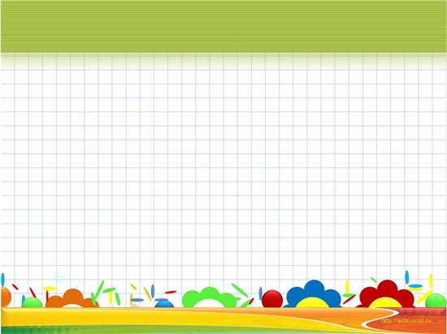
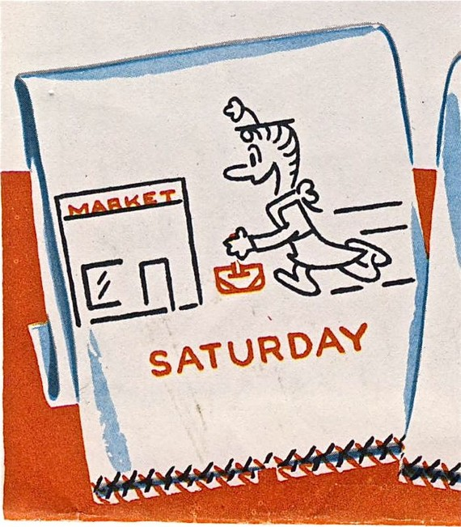
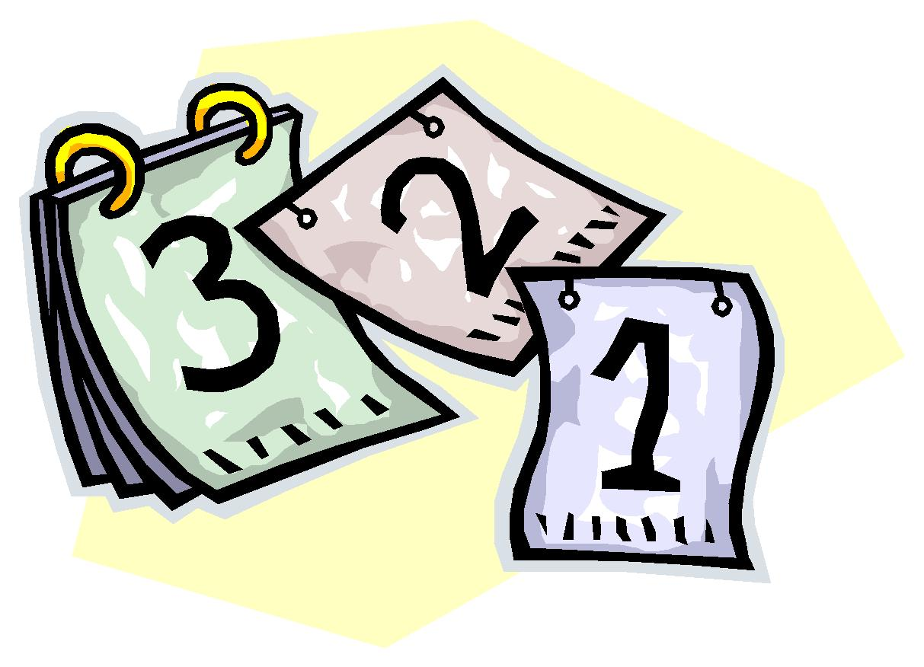
Days of the week

Slide 2
How are you today?
Fine, thanks!
Not bad, thanks!
Great, thanks!
So, so, thank you!

Slide 3
[ɒ]
[Λ]
[i]
[e]
[æ]
[ei]
[ju:]
[i:]
[ǝʊ]
[ai]

Slide 4
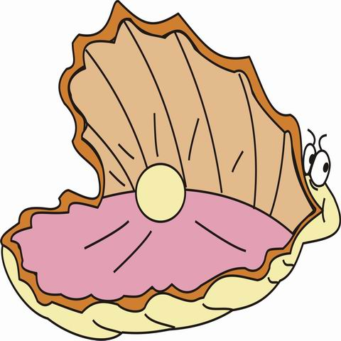
[ʃ]
She sells sea shells by the seashore

Slide 5
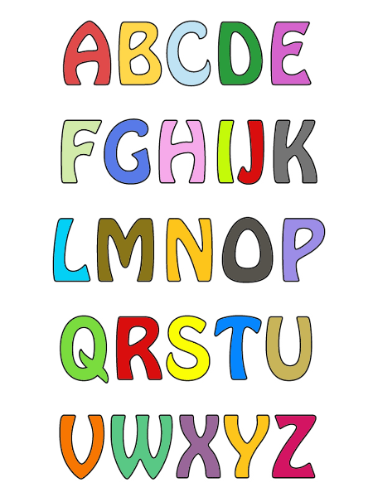

Slide 6
открытый слог закрытый слог
a [ei] - late [æ] - bat
e [i:] - Pete [e] - ten
i [ai] - like [i] - slip
o [ǝʊ] - nose [ɒ] - hot
u [ju:] - tube [Λ] - cup
y [ai] - fly [i] - gym

Slide 7
[s] или [k]
city
teacher
centre
chicken
black
nice
bicycle
clock
ice
socks
cube
crunch

Slide 8
to be
am
is
are
‘m
‘s
‘re
he
she
it
they
you
we
I

Slide 9
am? is? are?
She _____a teacher.
I ____ten.
They _______friends.
You______funny.
He ______a doctor.
We _______pupils.
7. I ____a good friend.
8. It _____a frog.

Slide 10
Sunday [sΛndei]
Monday [mΛndei]
Tuesday [tju:zdei]
Wednesday [wenzdei]
Thursday [θɜ:zdei]
Friday [fraidei]
Saturday [sætǝdei]

Slide 11
Monday

Slide 12
Tuesday

Slide 13
Wednesday

Slide 14
Thursday

Slide 15
Friday

Slide 16
Saturday

Slide 17
Sunday

