Slide 1
Школьные принадлежности

Slide 2
bag

Slide 3
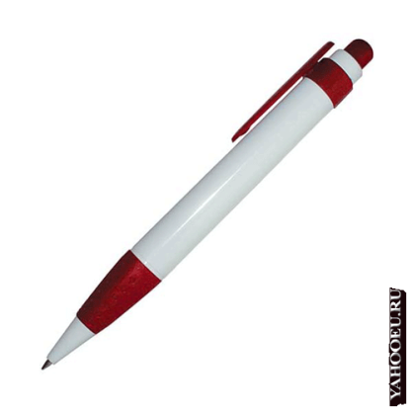
pen

Slide 4
pencil

Slide 5
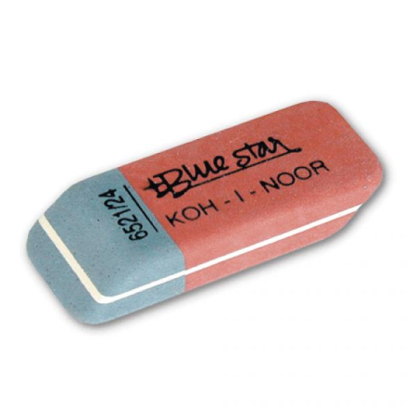
rubber

Slide 6
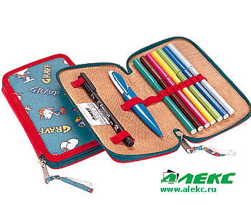
Pencil box

Slide 7
Text book

Slide 8
Work book

Slide 9
I have got …

