Slide 1
CAN YOU RUN?
LESSON 6

Slide 2
What is your name?
How are you?
What are you?
How old are you?

Slide 3
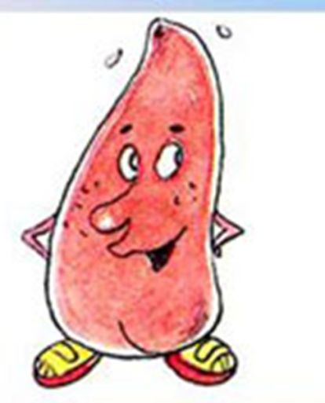
Let’s do phonetics drill!
Mr. Tongue идет гулять, он зовет друзей: [eı], [eı], [eı].
– Во дворе рычит собака: [r], [r], [r].
– Летят комарики: [z], [z], [z].
– Mr Tongue заводит машину, но мотор заглох: [p], [p], [p].
– Mr Tongue радуется, мотор завелся: [b], [b], [b].
– Машина поехала: [ʤ], [ʤ], [ʤ].
– Mr Tongue поет песенку: [l], [l], [l].

Slide 4
Let’s review the sounds
[n]
[n] – nice, Nick, name, nickname.
[l]
[l] – lemon, like, little, lake.
[w]
[w] – when, what, why.

Slide 5
Mr. Tongue хочет рассказать вам о новых звуках
[r] – run, rain.
[p] – pen, pan.
[b] – but, bike.
[m] – map, Mike.

Slide 6
Let’s sing the song.

Slide 7
Найдите значение следующих слов
1) one
2) two
3) three
4) four
5) five
6) six
7) seven
8) eight
9) nine
10) ten
а) десять
б) один
в) восемь
г) три
д) два
е) шесть
ж) пять
з) четыре
и) семь
к) девять

Slide 8
Проверим ответы!
1 | 2 | 3 | 4 | 5 | 6 | 7 | 8 | 9 | 10
б | д | г | з | ж | е | и | в | к | а

Slide 9
It’s time to have a rest
Clap, clap, clap your hands,
Clap your hands together.
Stamp, stamp, stamp your feet,
Stamp your feet together.
Wink, wink, wink your eyes,
Wink your eyes together.
Dance, dance, dance a dance,
Dance a dance together.

Slide 10
Pupil 1. Can you run?
Pupil 2. Yes, I can run.
Pupil 1. Can you jump?
Pupil 2. Yes, I can jump.
Pupil 1. Can you fly?
Pupil 2. No, I cannot fly.

Slide 11
I am Neznaika.
I can run.
I can jump
(climb, dance, sing).

Slide 12
Pupil 1.
He is a clown. His name is Tom. He can run. He can jump. He can climb. He can dance.

Slide 13
Ее

Slide 14
[e] [i:]
bed bee
ten he
hen we
men see

Slide 15
Our lesson is over. Goodbye!

Slide 16
Домашнее задание: выполнить упр. 1, 3 на с. 6 рабочей тетради

