Slide 1

HOME, SWEET HOME
Урок английского языка в IV классе
по учебнику М.З. Биболетовой «Enjoy English – 2»
Разработчик слайдов
Учитель английского языка
Шевелева Ю.А.

Slide 2


Slide 3

сегодня на уроке мы:
узнаем английские пословицы о доме
повторим слова по теме «Мой дом»
с помощью структуры there is/there are попробуем описать дом
разгадаем кроссворды
напишем мини-тест

Slide 4
Let’s practice the sounds
[ u:] room, bathroom, living room, bedroom
[ o:] wall, hall, floor, door
[ t∫] kitchen, chair
[ æ] pantry, flat, has
[ ә ] there, where, chair, share

Slide 5


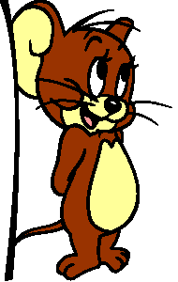
Let’s read the rhyme
Little mouse, little mouse,
Where is your house?
Little cat, little cat,
I have no flat.
I’m a poor mouse,
I have no house
Little mouse, little mouse
Come to my house
Little cat, little cat,
I can not do that,
You want to eat me

Slide 6

Do you know English proverbs?
Find Russian equivalents
East or West – home is best.
There is no place like home.
Нет лучше места, чем дома.
В гостях хорошо, а дома лучше.

Slide 7
Let’s review the words
English
Russian
Room
Bedroom
Bathroom
Living room
Kitchen
Pantry
Hall
Комната
Спальня
Ванная комната
Гостиная
Кухня
Кладовая
Прихожая

Slide 8
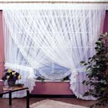
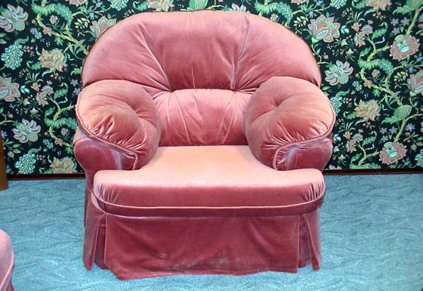
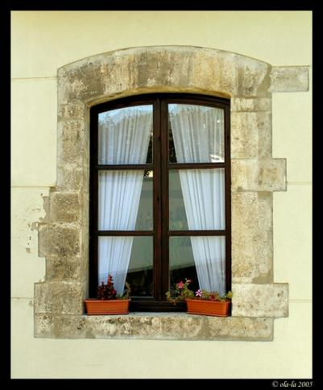
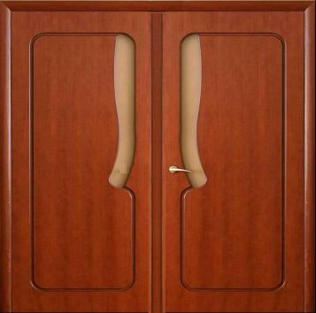
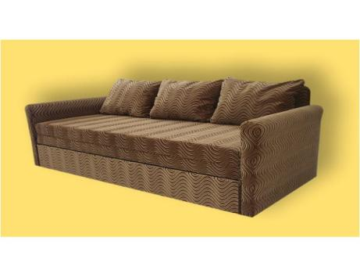
curtains
door
armchair
sofa
window

Slide 9
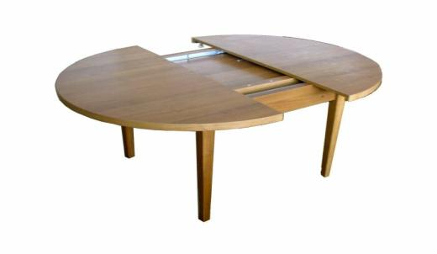
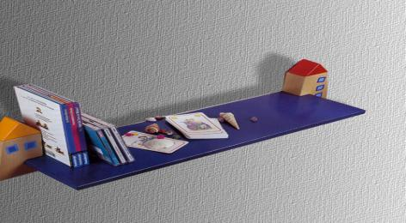
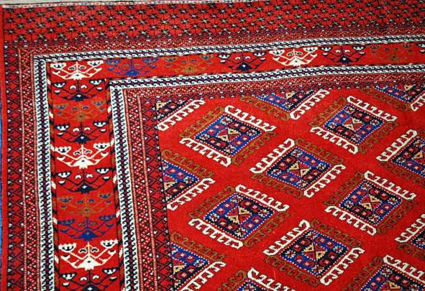
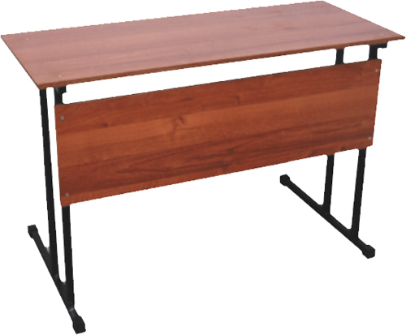
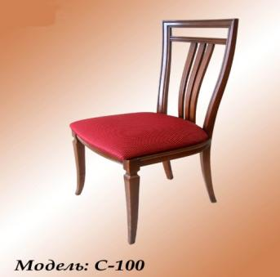
shelf
table
desk
chair
carpet

Slide 10
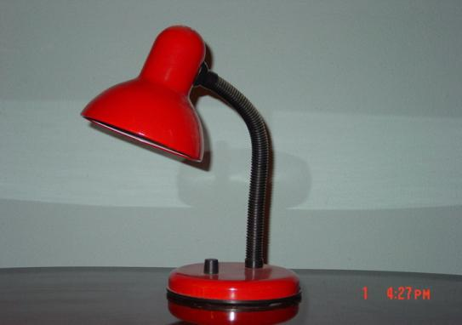
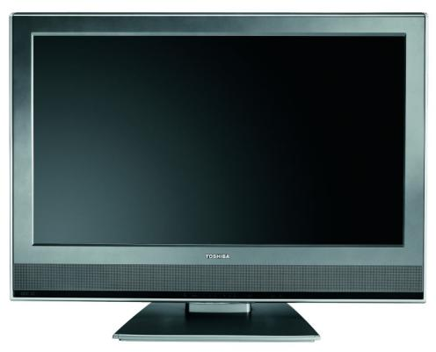

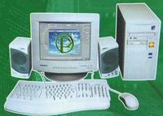
lamp
TV
bed
computer

Slide 11
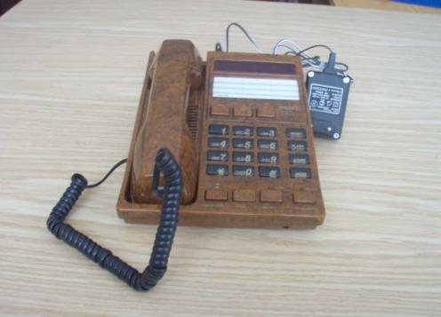
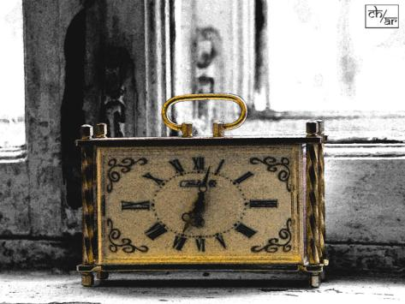
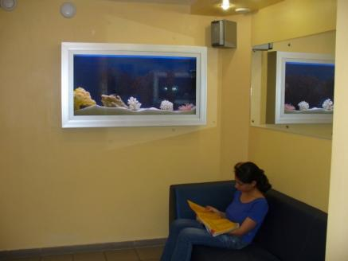
telephone
clock
picture

Slide 12
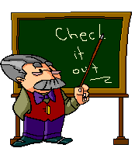
Where are these objects?
There is a bed in the
There is a sofa and a TV in the
There are two pictures on the
There are armchairs near the
wall.
fireplace.
bedroom.
living room.

Slide 13
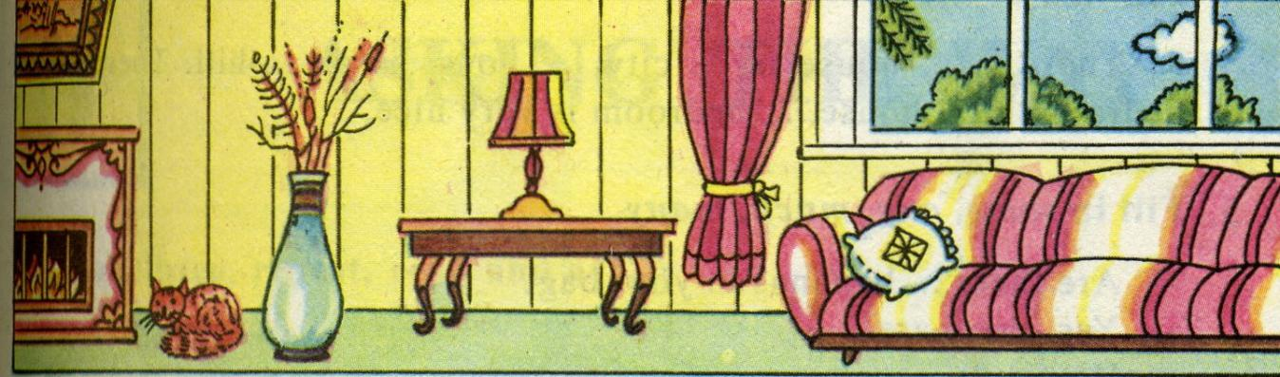
Read the text and find the object in the picture
This is a room. There is a sofa under the window.
To the left of the sofa there is a table.
There is a lamp on it. There is a picture above
the fireplace. There is a cat on the floor.
Near the cat there is …
(a vase)

Slide 14

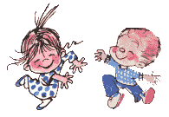
Head and shoulders, knees and toes, knees and toes,
Head and shoulders, knees and toes, knees and toes,
And eyes, and ears, and mouth, and nose,
Head and shoulders, knees and toes, knees and toes.

Slide 15
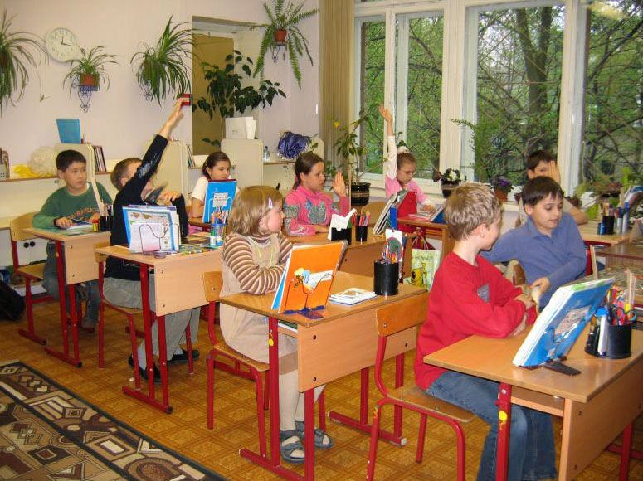
Let’s work in group

Slide 16


Choose between is / are
There ____ a cupboard in the hall.
There ____ pictures, a light switch and a shelf with books on the wall.
____ there a mirror in the bedroom?
There ____ a fireplace, an armchair and a carpet in the living room.
____ there pillows on the bed?
There ____ four chairs near the table.

Slide 17


Home task
To review the words at p.59
To prepare for home reading “Baby Elephant and his new things” p.68 – 71

Slide 18


