Slide 1
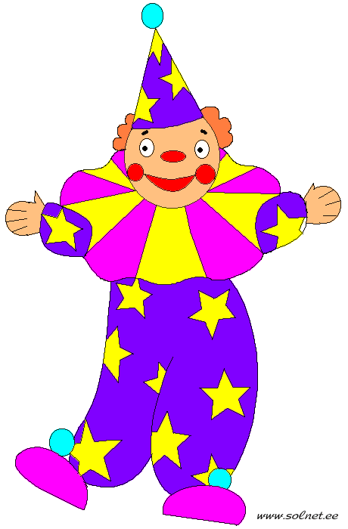
ou, ow
house down
count flower
town
mouth
clown

Slide 2
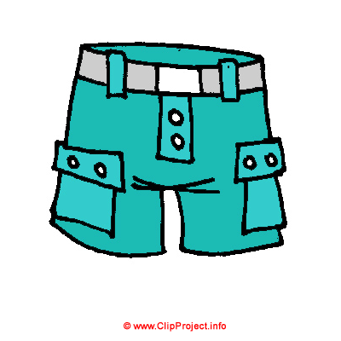
or
horse
fork
forty
for
popcorn
shorts
morning

Slide 3
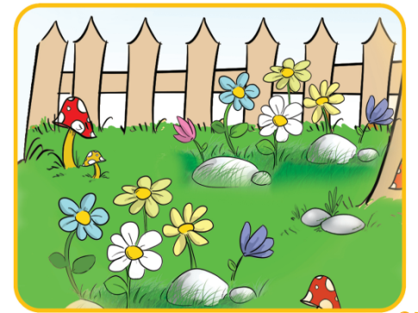
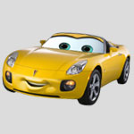
ar
garden
star
car
farm
park
party

Slide 4
ir
bird

Slide 5
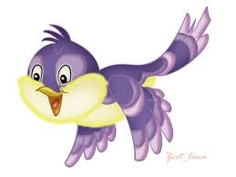
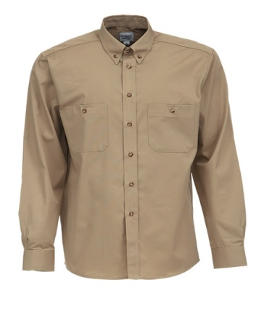
er, ir
her
bird
girl
shirt
thirteen
birthday
circle

Slide 6
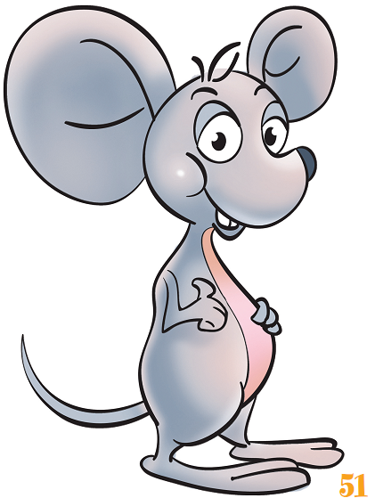
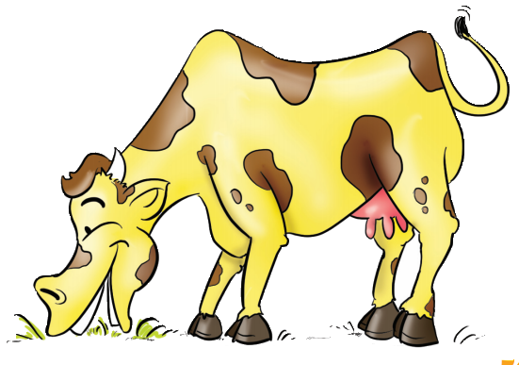
ou, ow
mouse cow

Slide 7
ou, ow
“Wow!” says the mouse.
“A cow that can count!” “I’m from a special town, dear Mouse. Come and see.”

Slide 8
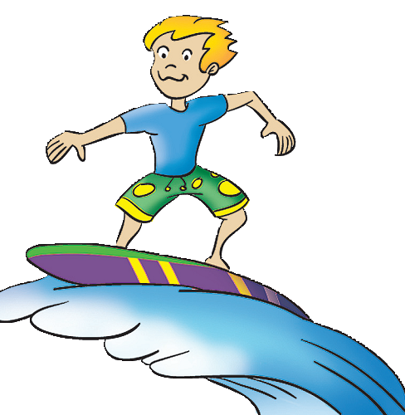
ur
surf

Slide 9
wor
worm

Slide 10
aw
paw

Slide 11
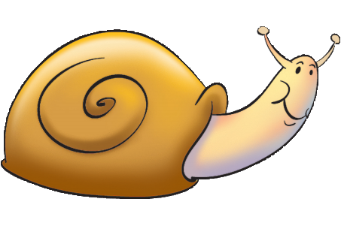
ai
snail

Slide 12
oa
boat

