Slide 1
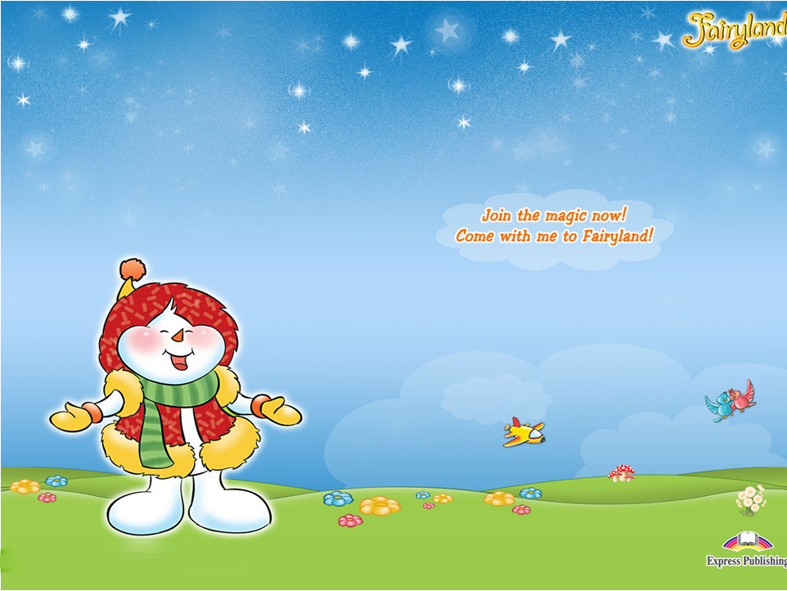
Yy
  [ai] [i]

Slide 2
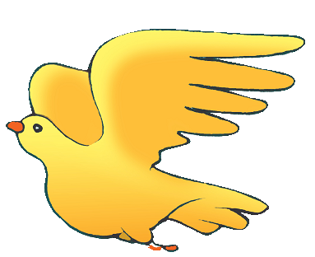

Yy
fly baby

Slide 3
Yy
  [ai] [i]
  fly baby
  sky teddy
  bye pretty
  my family

Slide 4
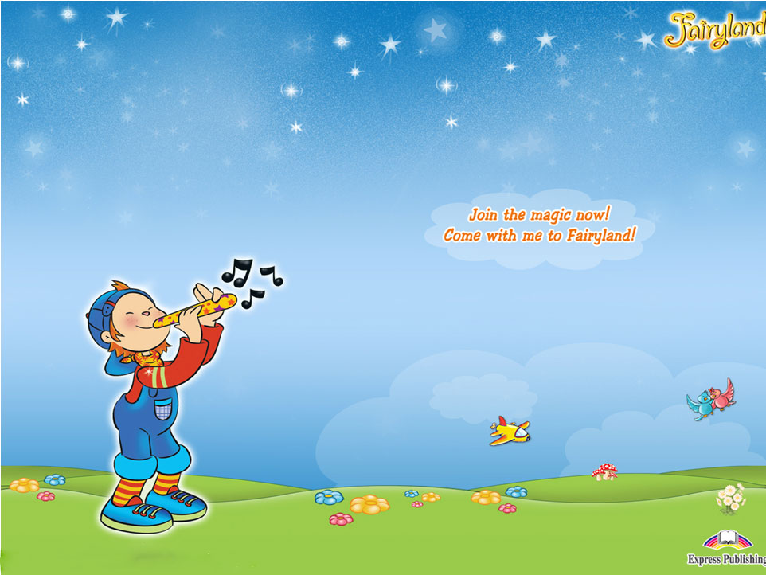
Oo
[əu ] [ɒ ]

Slide 5

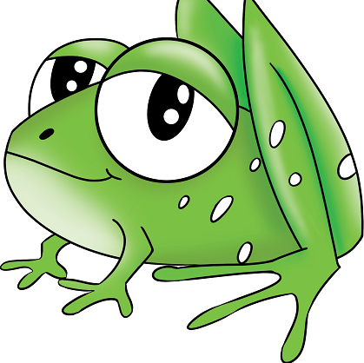
Oo
home frog

Slide 6
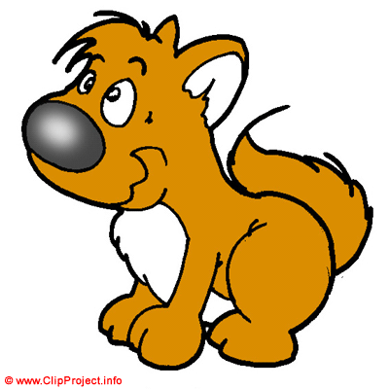

Oo
  [əu ] [ɒ ]
  home dog
  rose stop
  go hot
  Tony got
  nose Donna

Slide 7
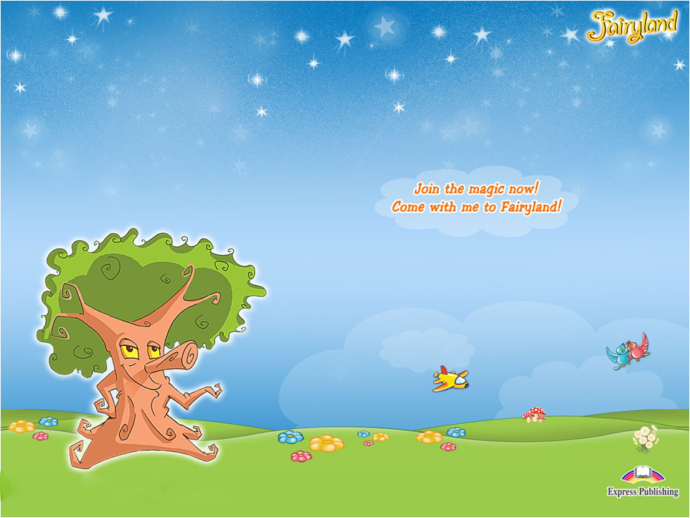
Uu
[ju:] [^ ]

Slide 8

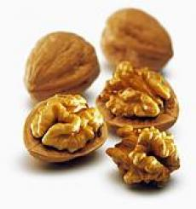
Uu
pupil nuts

Slide 9

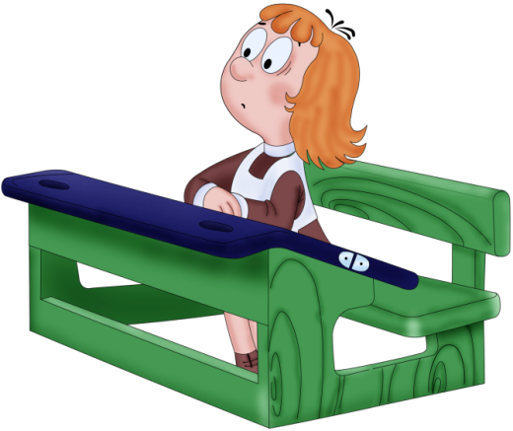
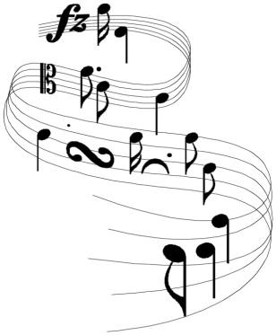
Uu [ju:]
  computer
  pupil music
  student use

Slide 10


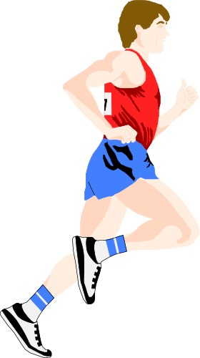
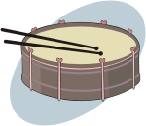

Uu [^]
  sun puppy
  fun Russia
  drum run
  cup

Slide 11
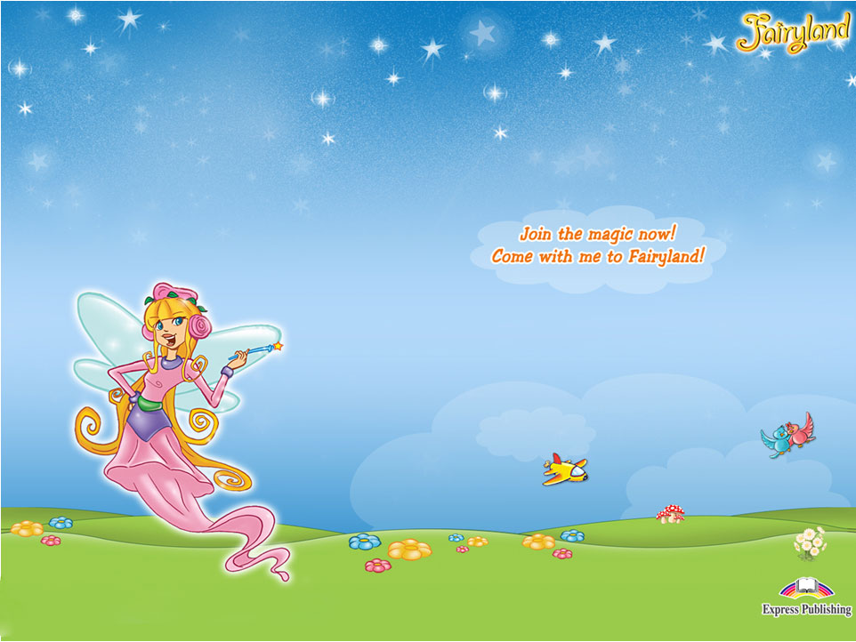
Ii
ee ea
[i:]

Slide 12
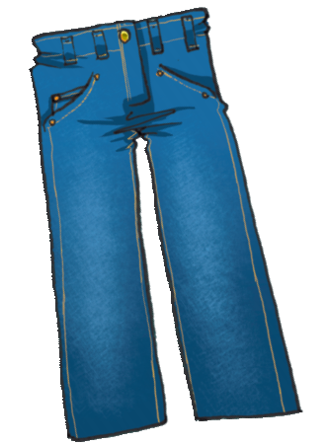

ee ea
bee jeans

Slide 13



[i:]
bee tree
green sweets
meat
eat read
please team

Slide 14
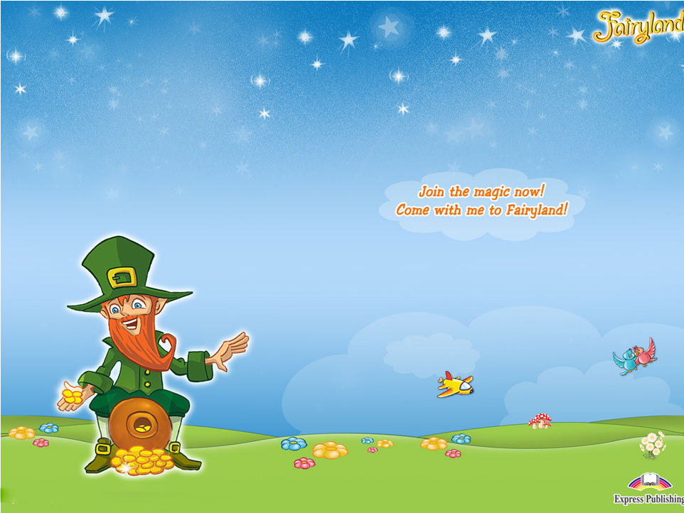
th
[ð] [Ɵ]

Slide 15
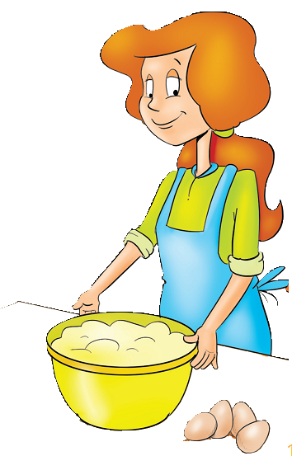
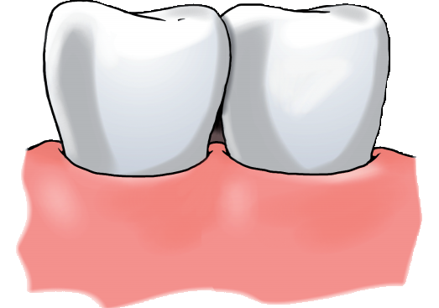
th
mother teeth

Slide 16
th
[ð] [Ɵ]
brother teeth
with thanks
this three
they think
then
that
the

Slide 17

wh
[w] [h]

Slide 18


wh
whale who

Slide 19
wh
[w] [h]
whale who
why
when
white
what

Slide 20
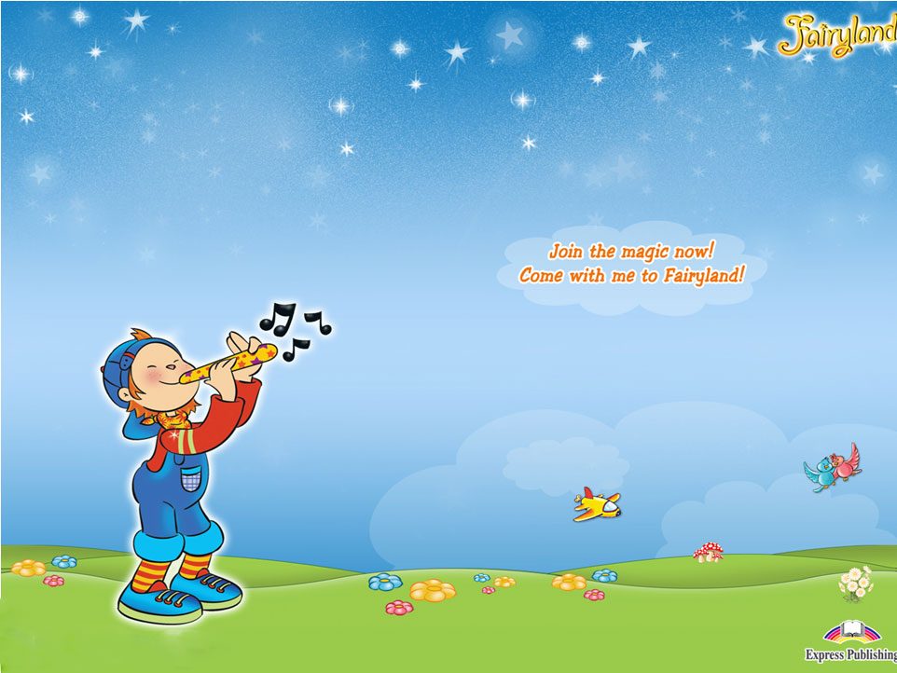
sh ph ch
[ʃ] [f] [tʃ]

Slide 21

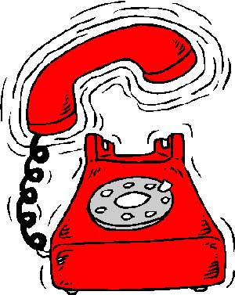
sh ph
ship phone

Slide 22
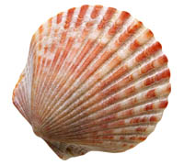


sh [ʃ]
she shell
shine shop
fish
wish
меню

Slide 23


ph [ f ]
phone
dolphin
elephant
меню

Slide 24
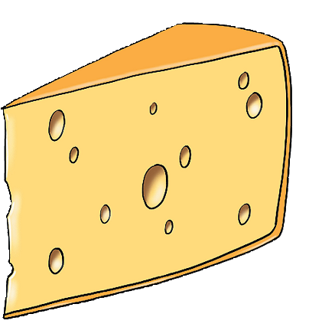
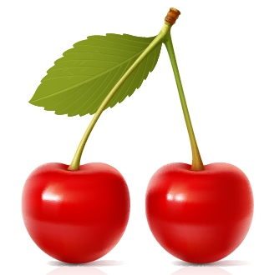

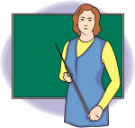
ch [tʃ]
cheese chips
chin
cherry
beach
chocolate
teacher

