Slide 1
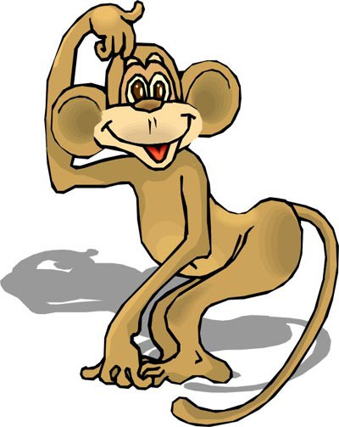

Slide 2
Crocodile
Swim
Big teeth, Strong tail
Meat

Slide 3
Kangaroo
Jump
Funny face, Brown eyes
Carrot and cabbage

Slide 4
Giraffe
Big and kind
Funny ears and long neck
Oranges and apples

Slide 5
Вставьте пропущенные слова face, neck, ears, tail, eyes, teeth
A giraffe has got a long……
A crocodile has got big……
A kangaroo has got a funny ….
An elephant has got very big …..
A monkey has got a long …..
A kangaroo has got brown …..

