Slide 1
Цветик-семицветик

Slide 2
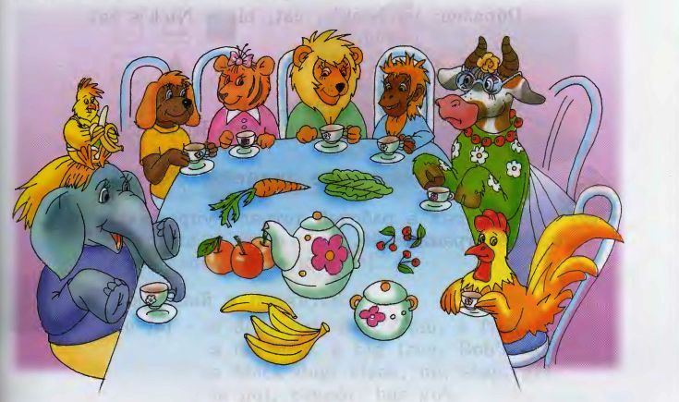
Опиши животное!

Slide 3
Назови рифму к словам
Fat
Frog
Doll
Trip
House
Toy
Cry
Bad

Slide 4
Выбери нужное слово
Ann, black, clock, big, rabbit, frog, pen, fat, bad, seven, pig, is, can, it, not, and, pencil, Nick, red, stick, hat, cannot, hen, bag, ten, pen, red, dog, seven, tennis, stop, Tim, has, got, black, clock, fox, pink, box, swim,

Slide 5
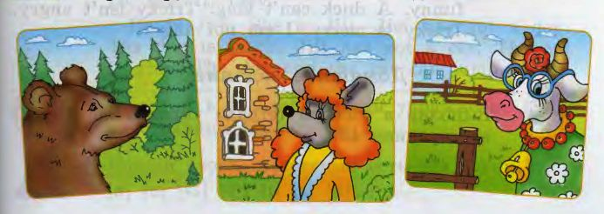
Угадай, кто он и где живет?

Slide 6
Лучший чтец
Ann's dog can swim. Jim's frog can skip. Nick's cat is not grey. It is black. Tom and Bob can sing. Ben has got a big black dog. Jill is sad. Jill's cat is fat.
Jim has got a pen. Jim's pen is red. Ann has got ten rabbits. Tim has got a grey cat. Tim's cat is fat. Sam has got a red hen. His red hen can sing.

Slide 7
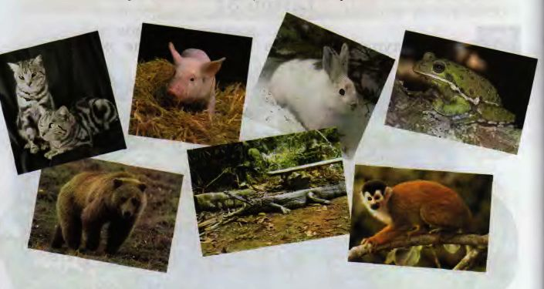
Скажи, кто где живет?

Slide 8
Домашнее задание: Учебник: упр. 7 стр. 84 РТ упр. 4 стр. 43

