Slide 1
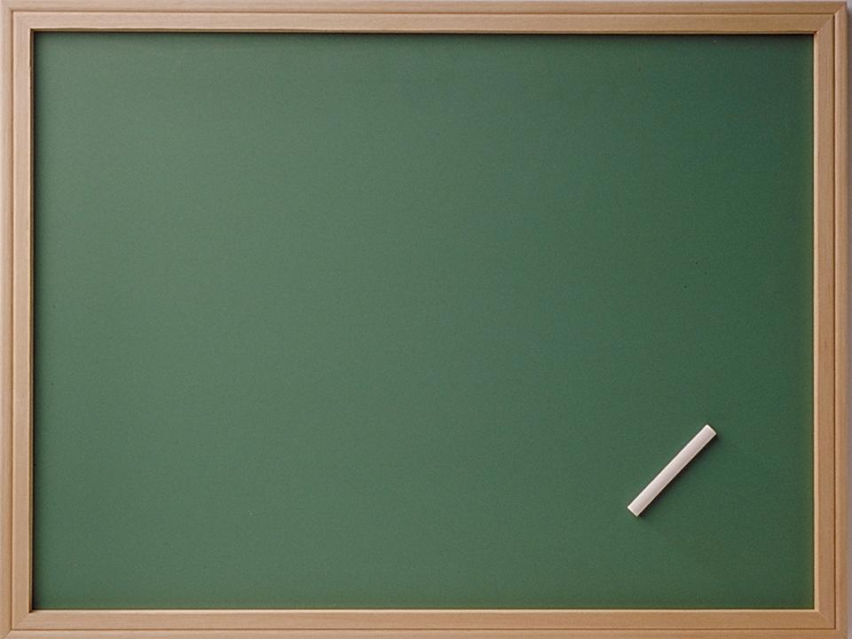
Глагол TO BE

Slide 2
Прочитай предложения:
I am a boy.
She is a teacher.
He is a dad.
It is a puppy.
You are a girl.
They are crocodiles.
We are doctors.

Slide 3
Создай предложение, используя слово и картинку.

Slide 4
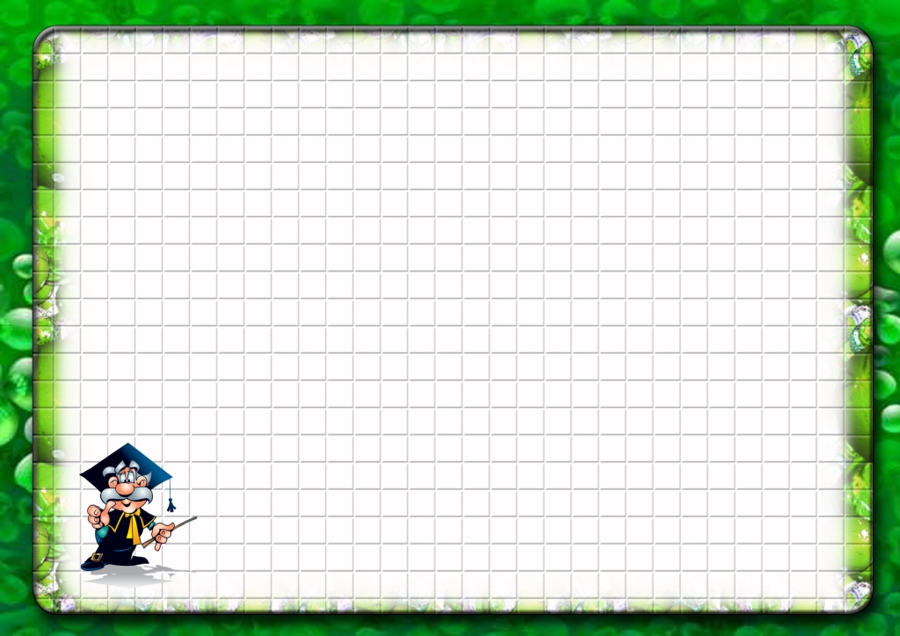
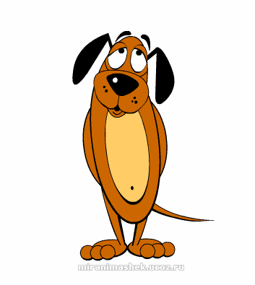
is
It … a

Slide 5
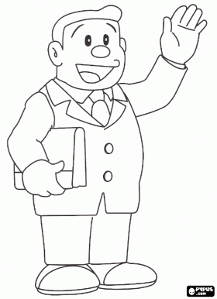
is
He … my

Slide 6
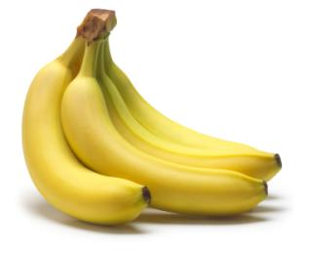
are
They …

Slide 7
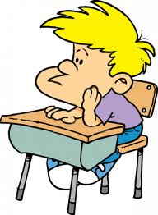
am
I … a

Slide 8
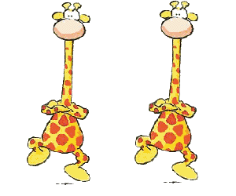
are
We …

Slide 9
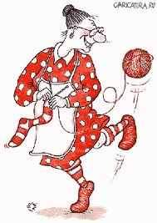
is
She … my

Slide 10
are
You … a

Slide 11
Составь предложения, используя картинки

Slide 12
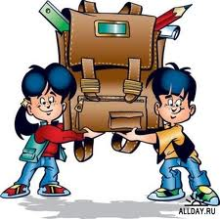
are
We
pupils.

Slide 13
a man.
He
is

Slide 14
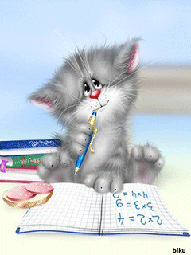
a cat.
It
is

Slide 15
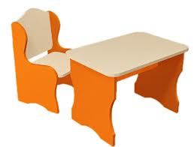
is
It
a desk.

Slide 16
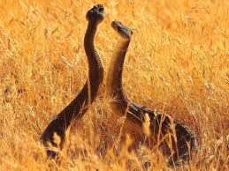
snakes.
are
They

Slide 17
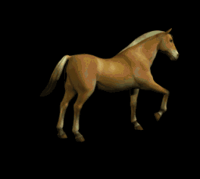
is
It
a horse.

Slide 18
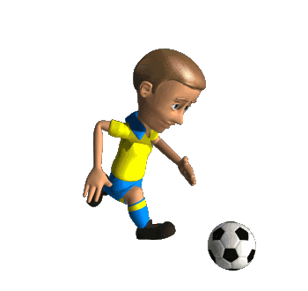
is
a footballer.
He

Slide 19
is
a tree.
It

Slide 20
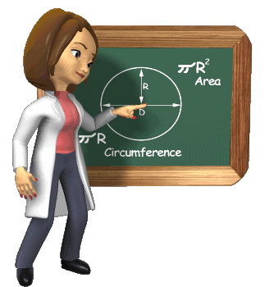
is
She
a teacher.

Slide 21
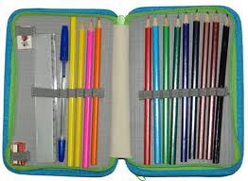
It
is
a pencil-box.

Slide 22
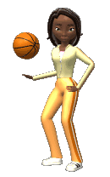
a sportsman.
She
is

Slide 23
Дай краткие ответы на вопросы

Slide 24
Is it merry?
Yes,
it is.

Slide 25
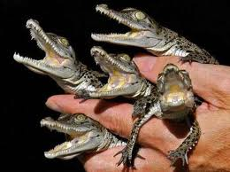
Are they crocodiles?
Yes,
they are.

Slide 26
Is it small?
No,
it is not.

Slide 27
Is she clever?
she is.
Yes,

Slide 28
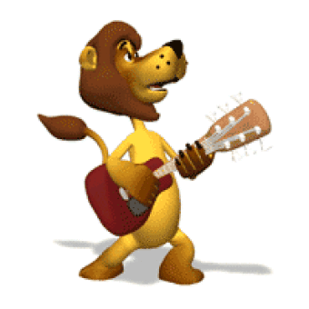
Is it brave?
Yes,
it is.

Slide 29
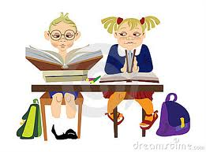
Are we lazy?
No,
we are not.

Slide 30
Is it black and red?
No,
it is not.

Slide 31
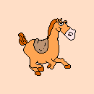
Is it fast?
Yes,
it is.

Slide 32
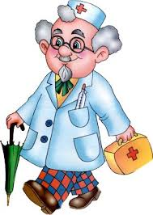
Are they teachers?
No,
they are not.

Slide 33
Is it ugly?
No,
it is not.

Slide 34
Is it long?
Yes,
it is.

Slide 35
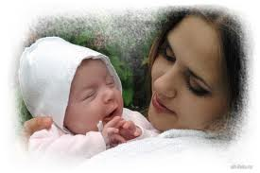
Is she kind?
she is.
Yes,

