Slide 1
Energy saving technologies of my house.

Slide 2
My name is Vasiliy.
I am pupil of the third form. I am fond of English.
Today I would like to tell about
Energy saving technologies of my house.

Slide 3
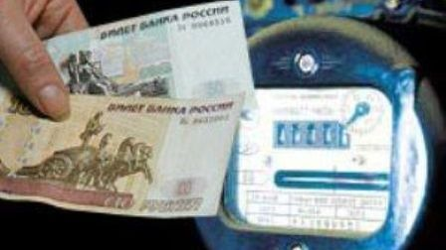
Мy mother paid a lot of money for the electricity.

Slide 4
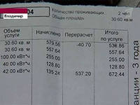
I saw the payment by the last month.

Slide 5
We have never left the TV and the computer on!

Slide 6
I asked my parents to buy energy saving lamps.

Slide 7
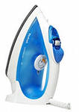
I seldom used the iron!

Slide 8
We were surprised very much…….

Slide 9
I was so happy!

Slide 10
I made questions in class

