Slide 1
Не согласитесь!
The bear is yellow.
The frog can fly.
The dog has got a clock.
The pig can skip.
The cat has got a pen.

Slide 2
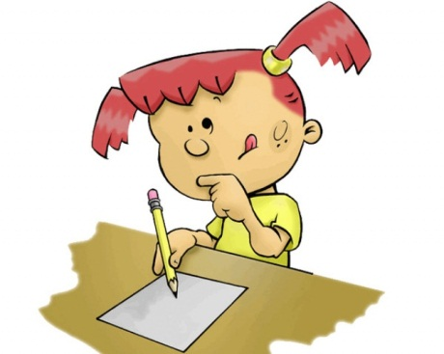
Составьте предложения!
Nick`s, Can, skip, pig?
______________________________
can not, The cockerel, swim.
_____________________________

Slide 3
has got, ten, Jim, black, pencils.
_____________________________
is, red, It.____________________
The fox, seven, has got, boxes, red.
_______________________________

Slide 4

WELL DONE!

