Slide 1
A Letter to Santa
Учитель МБОУ СОШ №7
им. Героя России Крупинова А.А
Цапулина Л.А.

Slide 2
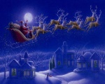
12 December
Dear Santa,
My name is ___. I am nine. I like to go to school. I am a good boy/girl. I help my mum/ I like New Year and I love you, dear Santa.
I would like new skates/mobile…
Come and see us.
Merry Christmas and Happy New Year!
With love,
Mary

Slide 3
A Song
We wish you a Marry Christmas!
We wish you a Marry Christmas!
We wish you a Marry Christmas!
And a Happy New year!

Slide 4
12 December
Dear Santa,
My name is ___. I am nine. I like to go to school. I am a good boy/girl. I help my mum/ I like New Year and I love you, dear Santa.
I would like new skates/mobile…
Come and see us.
Merry Christmas and Happy New Year!
With love,
Mary

Slide 5
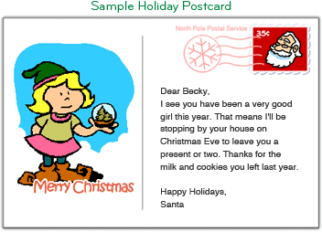
http://emailsanta.com/email_santa.asp

Slide 8
Dear Kate,
Merry Christmas! Ho Ho Ho! I am really excited to meet you on this Christmas!
You have been the sweetest kid in this world and at having a helping nature at such a young age makes me feel overwhelmed, and I am very excited to meet this lovely girl.
I have received a list of all your wishes and will be bringing all the gifts for you soon. I have already loaded my sleigh with the beautiful gifts, and will come very soon to give your gifts. You may hear a clatter on your roof top, which will be me with my reindeer!
Go to bed early on Christmas Eve, so that I could come and leave the beautiful presents for you on your bedside. Please do leave some cookies for me, because I would reach hungry and tired wandering around the world on my sleigh!
Love,
Santa

Slide 9
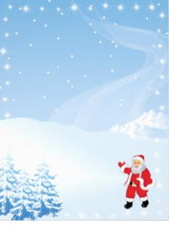
Dear Kate ,
Merry Christmas! The elves and I are very busy getting ready for Christmas, and I’m really exited that we’ll be visiting your home in Gorodets.
Have you been a good boy this year? I’ve been making a list and checking it twice, and it says that you’ve been nice! I’m proud of you! I’m going to do my best to bring you that the elves made especially for you.
Best wishes,
Your Santa

