Slide 1
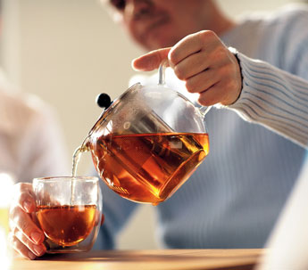
New Irregular verbs
To make tea
make -> made

Slide 2
New Irregular verbs
say -> said

Slide 3
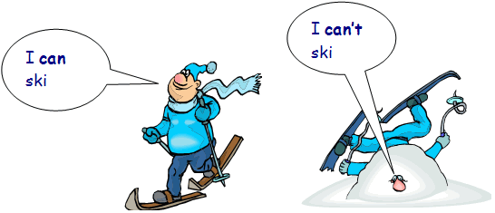
New Irregular verbs
can -> could

Slide 4
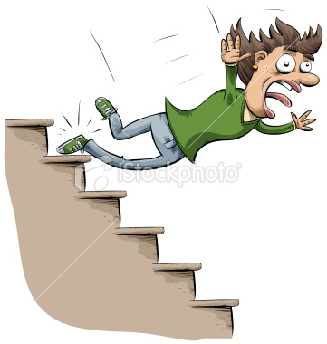
New Irregular verbs
fall -> fell

Slide 5
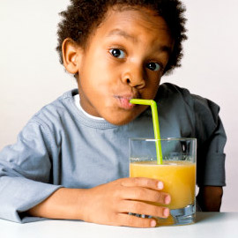
New Irregular verbs
drink -> drank

Slide 6
Динамическая пауза

Slide 7
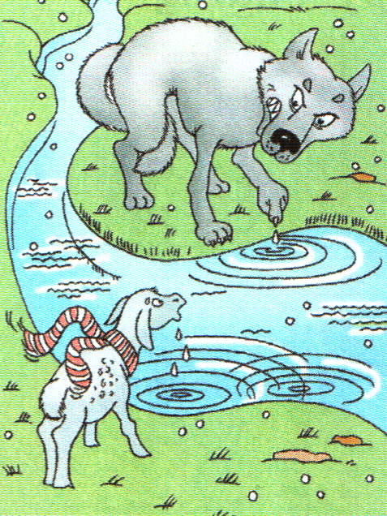
Do you like fairytales?

Slide 8
The Wolf and the Sheep
A Wolf saw a Sheep by a small river and wanted to eat him. He shouted, “I can’t drink this dirty water! It is very dirty! You have made (сделал) the water dirty. You put your dirty feet into the water!”
“No, I didn’t make it dirty,” the Sheep answered. “I didn’t put my feet into the water. I drink with my mouth and not with my feet. Look! My feet are not in the water.”
“OK. Then it was last year. You put your feet into the water last year!” the Wolf shouted. “And you made the water dirty.”
“But I am only four months old,” the Sheep said. “How could I put my feet into the river a year ago?” “If it was not you, then it was your brother or your father,” the Wolf shouted and jumped on the poor (бедный) Sheep. But the Sheep ran away. And the Wolf fell into the water.

Slide 9
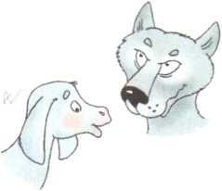
Answer the questions
Did the Wolf want to drink water?
Was the Wolf angry?
Did the Sheep make the water dirty?
Did the Sheep shout at the Wolf?
Was the Sheep brave?
- No, he didn’t
- Yes, he was
- No, she didn’t
- No, she didn’t
- Yes, she was

Slide 10
The Wolf and the Sheep
A Wolf saw a Sheep by a small river and wanted to eat him. He shouted, “I can’t drink this dirty water! It is very dirty! You have made (сделал) the water dirty. You put your dirty feet into the water!”
“No, I didn’t make it dirty,” the Sheep answered. “I didn’t put my feet into the water. I drink with my mouth and not with my feet. Look! My feet are not in the water.”
“OK. Then it was last year. You put your feet into the water last year!” the Wolf shouted. “And you made the water dirty.”
“But I am only four months old,” the Sheep said. “How could I put my feet into the river a year ago?” “If it was not you, then it was your brother or your father,” the Wolf shouted and jumped on the poor (бедный) Sheep. But the Sheep ran away. And the Wolf fell into the water.

Slide 11
Correct the sentences
The Wolf drank the dirty water.
The Sheep made the water dirty.
The Wolf met the Sheep before.
The Sheep came to the river a year ago.
- The Wolf didn’t drink the dirty water.
- The Sheep didn’t make the water dirty.
- The Wolf didn’t meet the Sheep before.
The Sheep didn’t come to the river
a year ago.

Slide 12
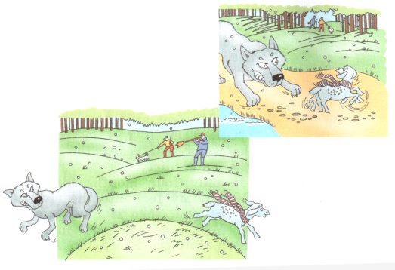
Look at the pictures and tell a new happy ending to the fairy tale
Use these words
1) ran away
2) ran after him
3) saw the hunters
4) shouted
5) help me, please
6) came and helped

Slide 13
Оцени свою работу
1)
3)
2)

Slide 14
Homework
SB: Exercise 30, page 59 (learn by heart)
Принести новогодние открытки (будем писать послания Деду Морозу)

