Slide 1
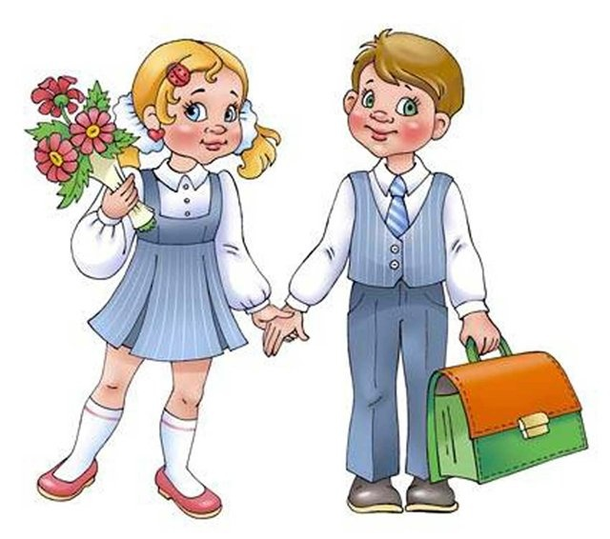
Good Morning!
Good morning, good morning
Good morning to you,
Good morning dear teachers,
We are glad to see you!

Slide 2
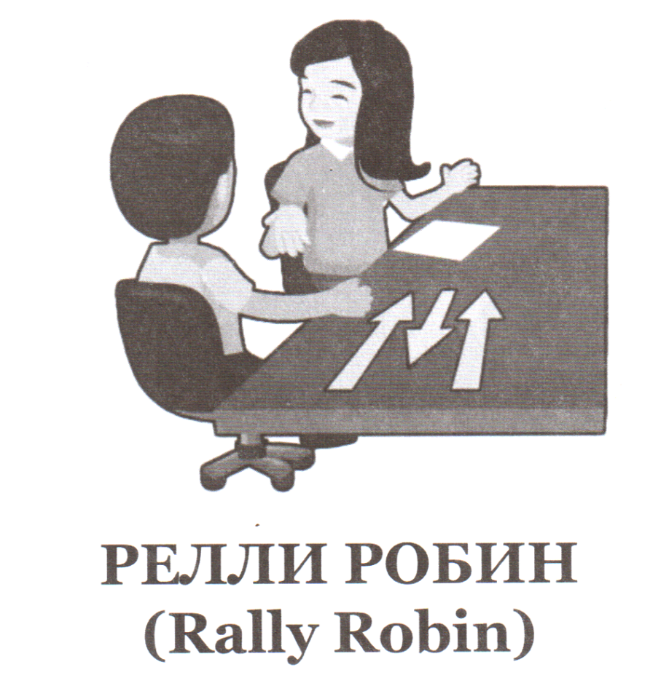
Let’s speak about today’s weather

Slide 3
Repeat after me!
[t] | [d] | [id]
watched walked talked finished liked helped | played laid tried cried smiled studied lived | skated wanted collected painted needed

Slide 4
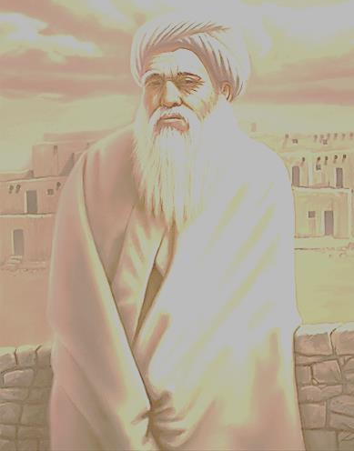
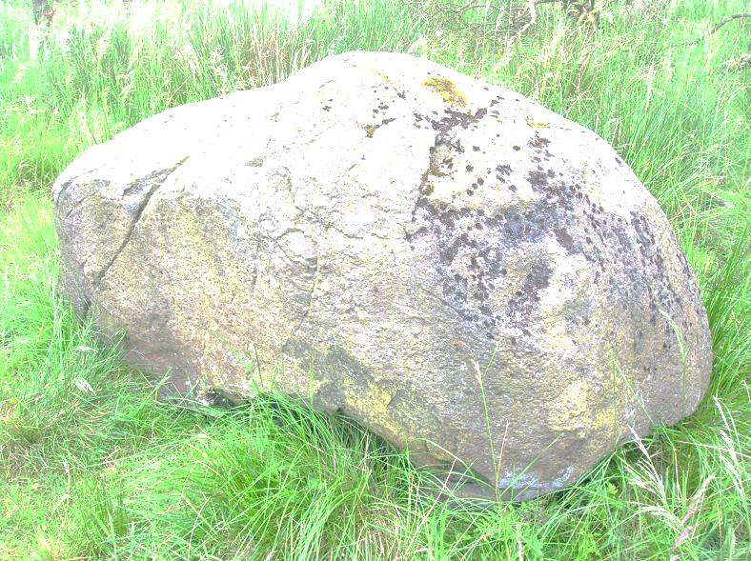
Parable of the Stone
Once upon a time there lived a very old wanderer. Once he saw a big-big stone. There was a very strange sign on it: “Turn and read!”. He hardly turned it and read it on the other side: “Why are you looking for new knowledge if you do not pay attention to what to things you have already known?”

Slide 5
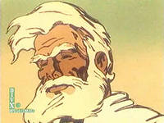
Притча о Камне
Один странствующий искатель
истины увидел большой камень,
на котором было написано:
«Переверни и читай!». Он с трудом перевернул его и прочёл на другой стороне: «Зачем ты ищешь нового знания, если не обращаешь внимания на то, что уже знаешь?»

Slide 6
We know it! ☺
1) пошли в лес -
2) было жарко -
3) сели под деревом -
4) увидели птичку -
5) пошли домой -
went to the forest
was hot
sat under the tree
saw the bird
went home

Slide 7
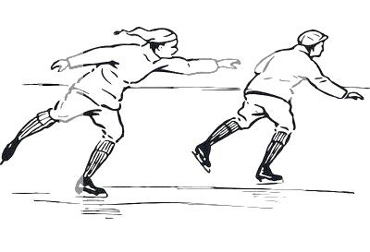
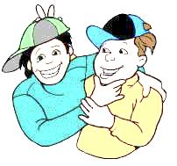
Find out mistakes
Yesterday I and my friend John go in the park. The weather is wonderful. We walked near the river, skated and skied. We meet our classmates in the park and played with them. It is a great day!

Slide 8
Check out
Yesterday I and my friend John went in the park. The weather was wonderful. We walked near the river, skated and skied. We met our classmates in the park and played with them. It was a great day!

Slide 9
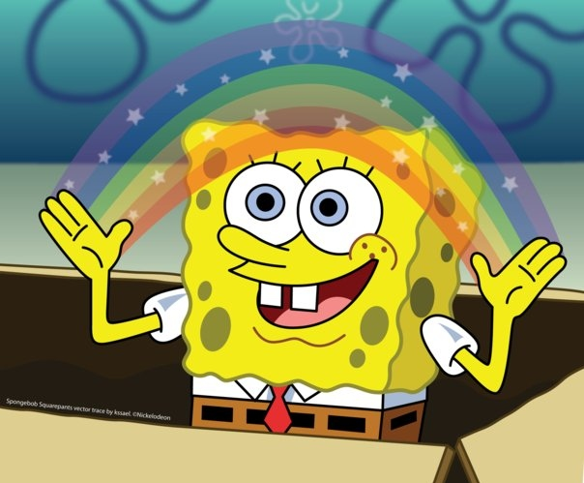
Тема урока
«Мир моих фантазий»
Неправильные глаголы в прошедшем времени (Past Simple)

Slide 10
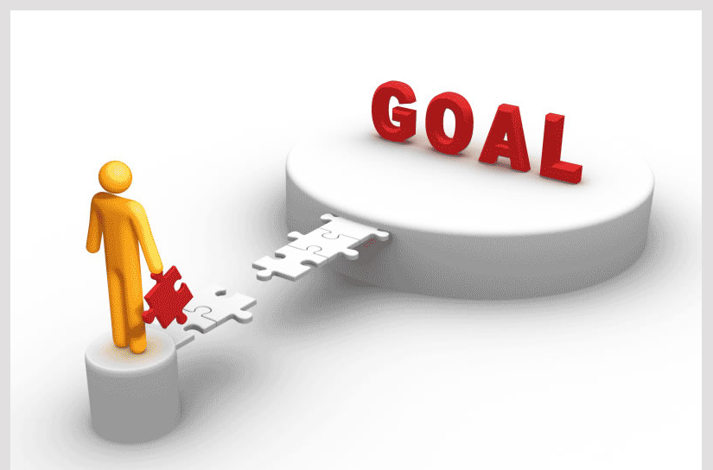
Цели урока
Продолжить знакомство с неправильными глаголами.
Научиться распознавать их.
Уметь применять их в речи, при чтении и при составлении рассказов

Slide 11
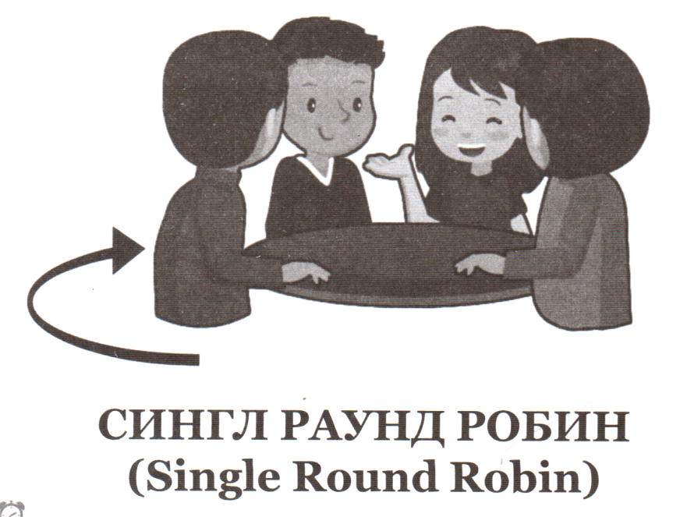
Do we know it?
take
live
give
want
see
fall
help
say
fly
paint
talk
like
open
have
collect
do

Slide 12
Check out
took
lived
gave
wanted
saw
fell
helped
said
flew
painted
talked
liked
opened
had
collected
did

Slide 13
New Irregular verbs
cut let make say can fall drink |  | cut let made said could fell drank

Slide 14
New Irregular verbs
cut -> cut

Slide 15
New Irregular verbs
let -> let

