Slide 1
St. Petersburg [sәnt‘pi:tәz,bɜ:g]
Rome [rәʋm]
Berlin [bɜ:‘lın]
London [‘lʌndәn]
Omsk [‘ ɒmsk]
Krasnodar [krʌsnә‘dɑ:]
Paris [‘pærıs]
Moscow [‘mɒskәʋ]

Slide 2
– Hello!
– Hello! Can I help you?
– What is the weather like in ….?
– It’s ……. ….. …….
– …. ……… . Bye-bye!
– Bye-bye.
It’s cloudy.
It’s sunny.
It’s windy.
It’s cold.
It’s warm.
It’s hot.
It’s rainy.
It’s snowy.
Great!
Fantastic!
Fine!
Wonderful!
St. Petersburg , Rome, Berlin, London, Omsk, Krasnodar, Paris, Moscow

Slide 3
Adjectives/прилагательные
warm – warmer – the warmest
тёплый – теплее – самый тёплый
strong – stronger – the strongest
сильный – сильнее – самый сильный
сold – colder – the coldest
холодный – холоднее – самый холодный

Slide 4
small — smaller — the smallest
big — bigger — the biggest
hot — hotter — the hottest
nice — nicer — the nicest
dirty — dirtier — the dirtiest
happy — happier — the happiest

Slide 5
Let’s compare
large
– larger
– the largest
wide
– wider
– the widest
big
– bigger
– biggest
fat
– fatter
– the fattest
easy
– easier
– the easiest

Slide 6
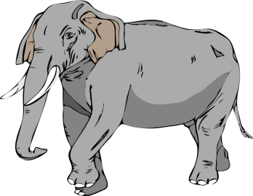
При сравнении двух лиц или предметов
употребляется союз than (чем).
A cat is smaller than an elephant.
An elephant is bigger than a cat.

Slide 7
A city is larger than a town.
A town is smaller than a city.
than .

Slide 8
Check yourself
strong | stronger | the strongest
clean | cleaner | the cleanest
hot | hotter | the hottest
funny | funnier | the funniest
big | bigger | the biggest
small | smaller | the smallest
happy | happier | the happiest
high | higher | the highest
long | longer | the longest

Slide 9
Home task:
EX. 3, p.48 SB.
Learn the ruler./
p. 124 (1,2)SB.
Good luck!

