Slide 1
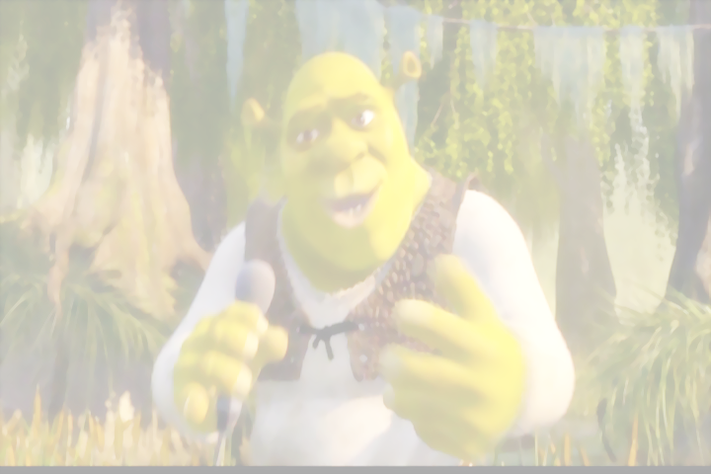
2 ЧАСТЬ
3"б" в магазине у Шрека

Slide 2
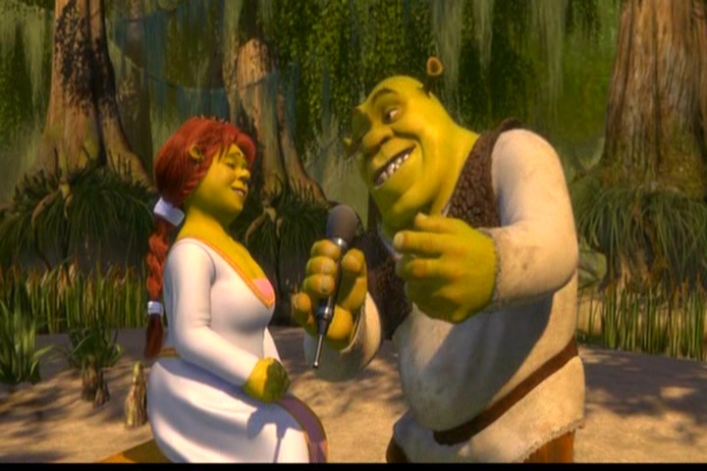
What would you like?

Slide 3
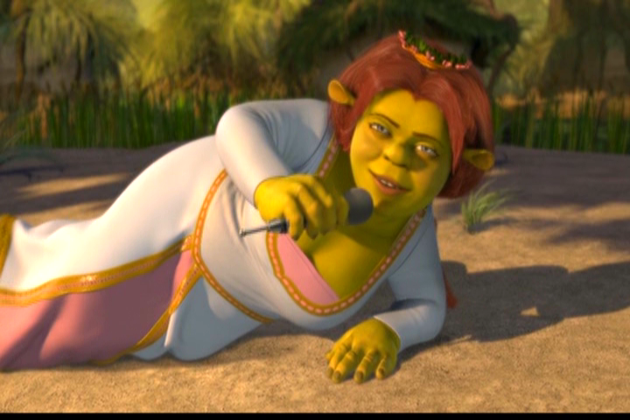
I would like… birds.

Slide 4
Listen and read:
A girl
A shirt
A bird
Dirty
Her

Slide 5
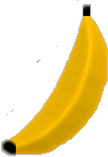
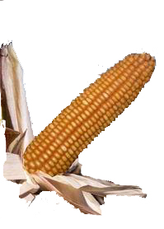
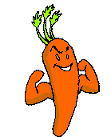
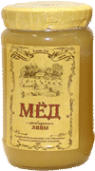
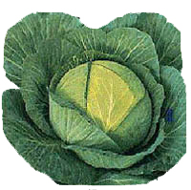
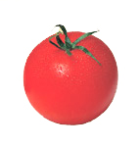
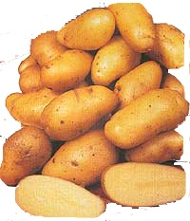
We can buy….

Slide 7
Would you like some….?
You are welcome!
Неге you are.
I'd like..

Slide 8
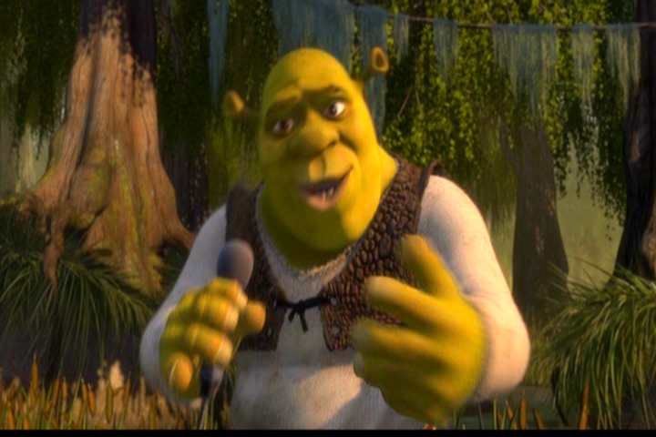
Нe must …

Slide 9
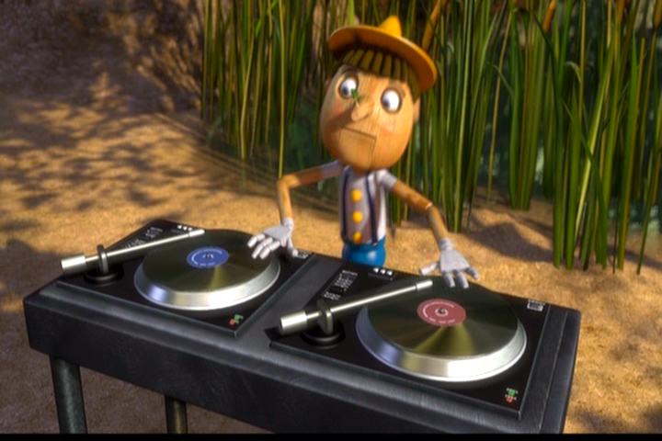
He is big.
He is green.
He likes sweets and meat.
He dislikes carrots and cabbage. He likes FIONA!

Slide 10
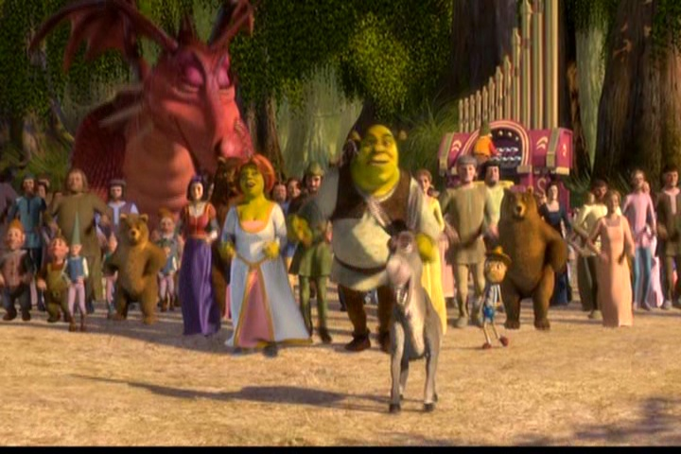
Нарисуйте мой магазин и подпишите названия продуктов на английском языке! ))))
Good bye!

