Slide 1
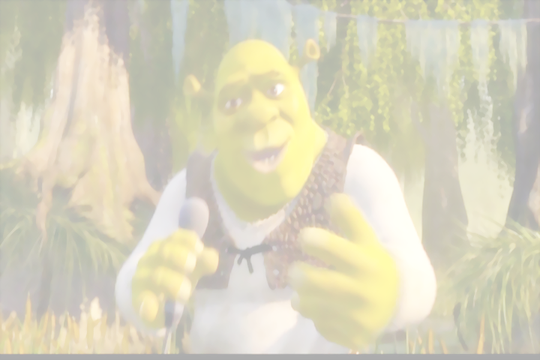
1 ЧАСТЬ
3"б" в магазине у Шрека

Slide 3
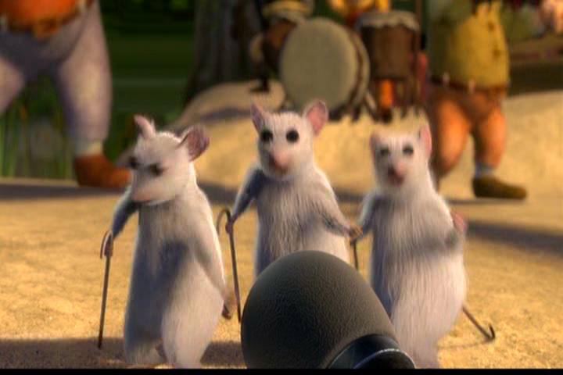
[ i: ]
I like ice-cream
She likes sweets
I like cookies
He likes cheese
I like coffee
She likes tea
I love you
Do you love me?

Slide 4
[i: ] [ i]
Swim
Eat
Ice-cream
Sweet
Skip
Cheese
Park
black
Tea

Slide 5
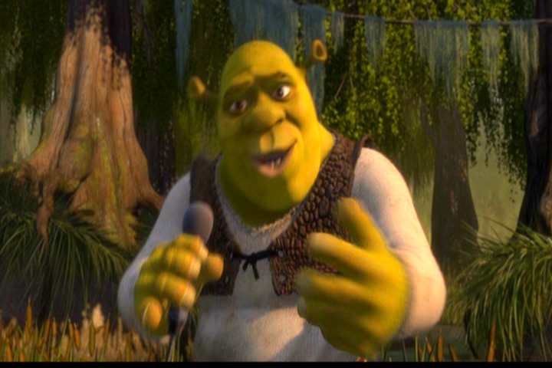
Посещение магазина
Hello children! Glad to see you! I want to know if you are good at English.

Slide 6
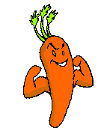
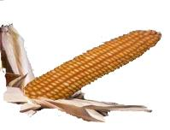
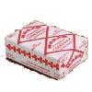
You are welcome!
I like sweets and cheese.
I don't like carrots and cabbage.

Slide 7
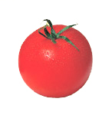
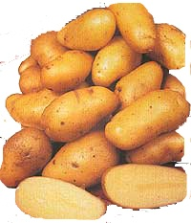
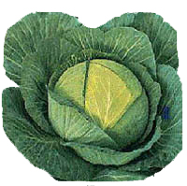
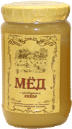
I like…
What do you like?

Slide 8
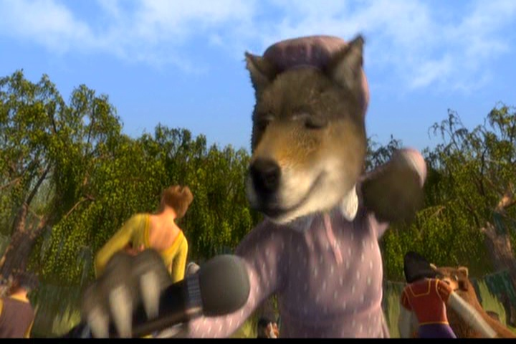
I'd like…

Slide 9
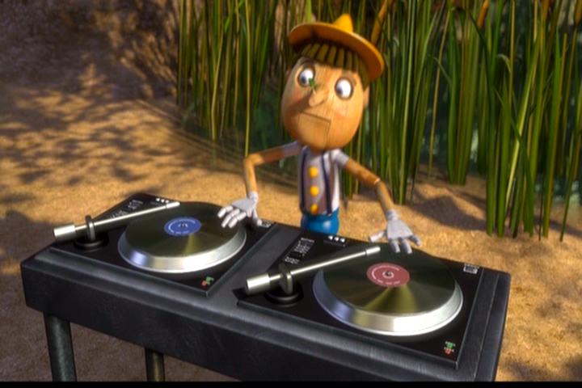
I'd like…

Slide 10
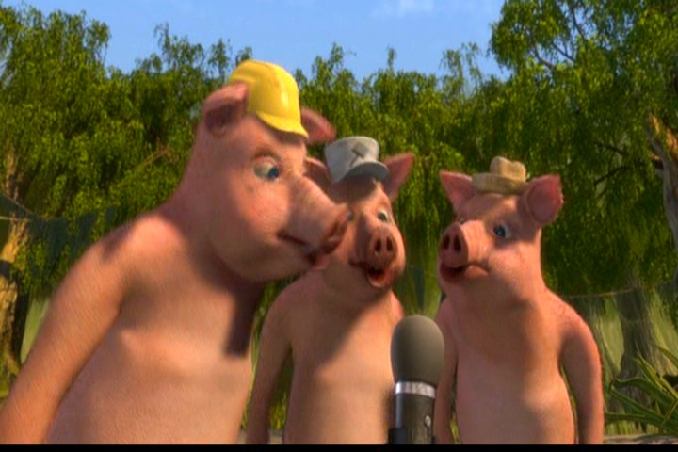
I'd like..
I'd like..
I'd like..

