Slide 1
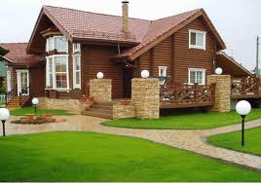
Презентация к УМК «Планета Знаний» 3 класс
Тема: «My house»
Автор: Глызова О.Н МБОУ СОШ №41 г. Н-Новгород

Slide 2
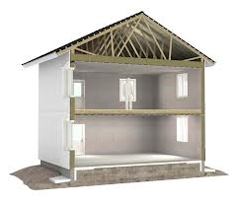
Look at my house!
a roof
a window
a ceiling
a door
a wall
a floor

Slide 3
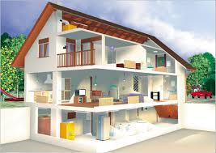
I have got a big and nice house.
There are three floors in my house.
There are many rooms in it.
What are they?

Slide 4
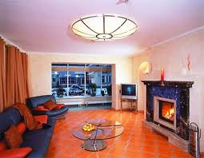
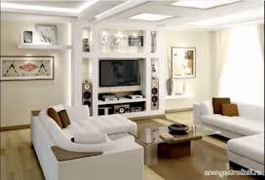
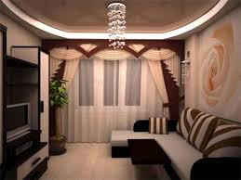
Sitting room
This is my sitting room.
It is big and light.
There are a lot of things in the room.

Slide 5
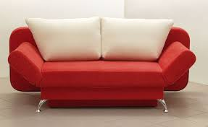
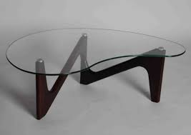
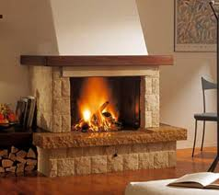
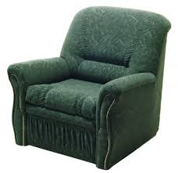
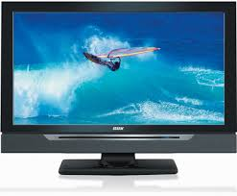
Remember!
a fire-place
a sofa
a coffee table
a TV-set
a carpet
an arm-chair

Slide 6
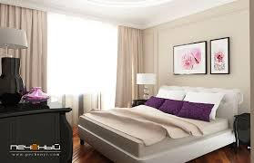
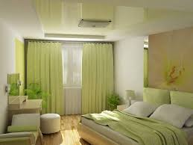
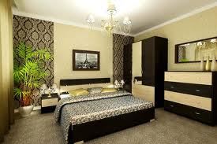
Bedroom
This is my bedroom.
It is very nice and comfortable.
There are a lot of things in the room.

Slide 7
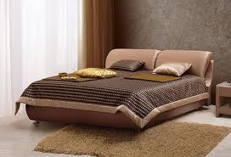
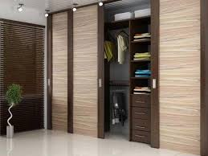
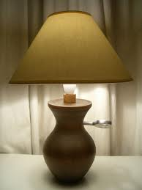
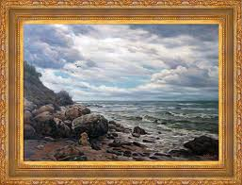
Remember!
a bed
a wardrobe
a lamp
a mirror
a picture

Slide 8
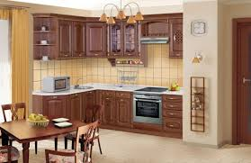
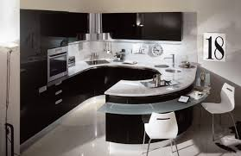
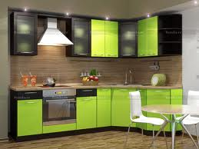
Kitchen
This is a kitchen.
It is big and modern.

Slide 9
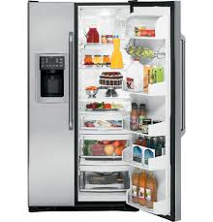
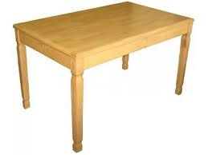
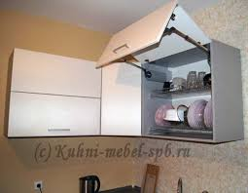
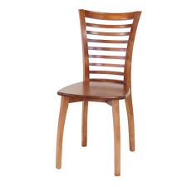
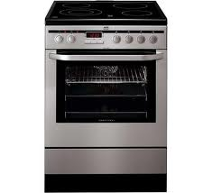
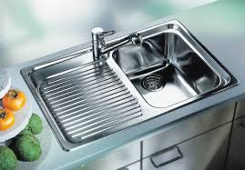
Remember!
a fridge
a table
a cupboard
a sink
a chair
a cooker

Slide 10
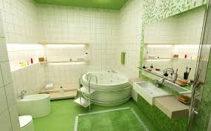
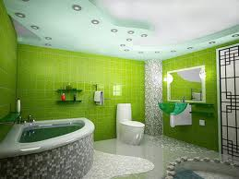
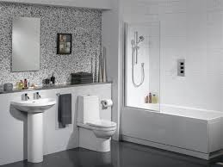
Bathroom
This is a bathroom.
It is very nice and comfortable.

Slide 11
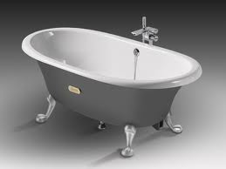
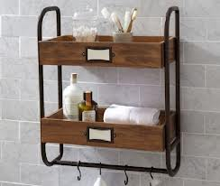
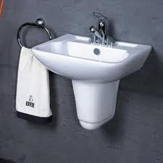
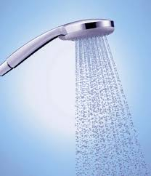
Remember!
a bath a shelf
a basin
a shower

Slide 12
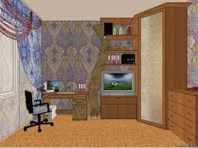
True/False
1. There are two windows in the room.
2. There is a table near the wall.
3. There is a TV to the right of the table.
4. There is a carpet on the floor.
5. There is a chair in front of the table.
false
true
true
false
true

Slide 13
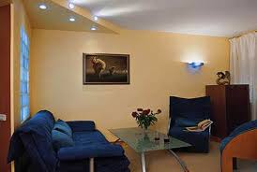
Answer these questions.
Is there a coffee table in front of the sofa?
Are there pictures on the wall?
Is there an armchair near the wall?
Are there lamps on the ceiling?
Is there a TV on the table?
1. Yes, there is.
2. No, there aren’t.
3. Yes, there is.
4. Yes, there are.
5. No, there isn’t.

Slide 14
What is it?
It is a sofa.
It is a bed.
It is a table.
It is a lamp.
It is a bath.

Slide 15
Let’s learn English together!

