Slide 1
Урок – презентация по теме «Sport».
Выполнила:
учитель английского языка
Тихановская Елена Алексеевна
МАОУ СОШ № 27
г. Таганрог
2014г.

Slide 2
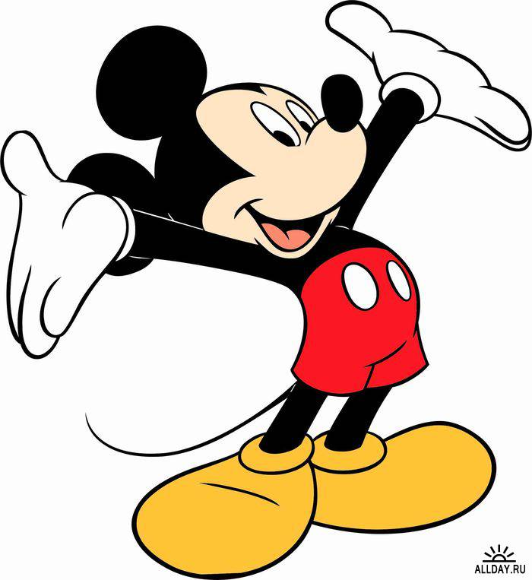
Super Simple ABCs Phonics Song!!!

Slide 3
the sound [ɔ ]
the sound [ r]
the sound [s]
the sound [k]
a dog, a fox, an orange, a crocodile, a ball
a kangaroo, an orange, run
six, seven, swim
a kangaroo, a cat, a crocodile

Slide 4
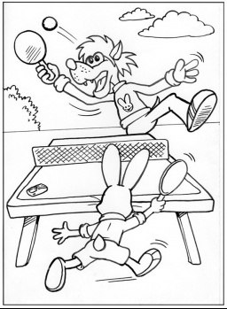
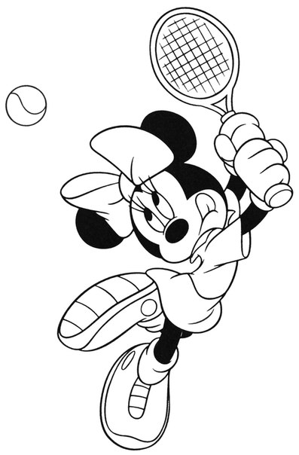
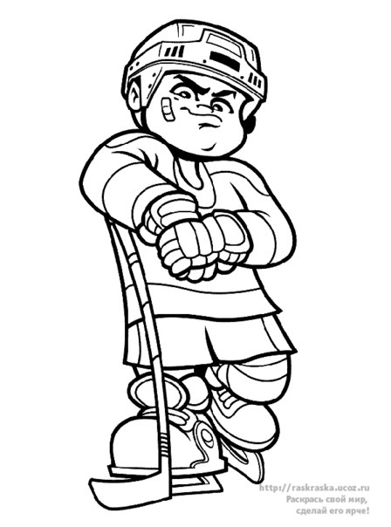
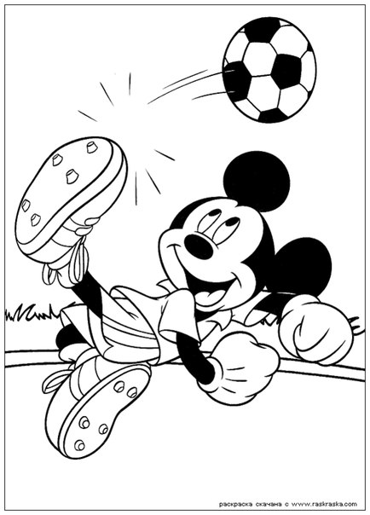
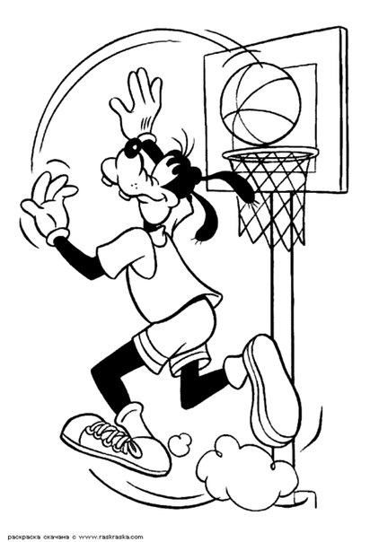
to play table tennis
to play tennis
to play hockey
to play football
to play basketball
to play chess

Slide 5
Now, let's repeat our models of the sentences.
I can play football.
?
Can you play football?
Yes, I can. No, I cannot.

Slide 6
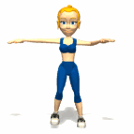
Up and Down
Up and down, up and down
Clap your hands and turn around.

Slide 7
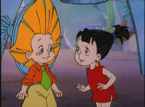
Our friend Neznayka is sad. Why is he sad?
What do you think. Can you help him?
He lost some letters.
Let's help him to find missing letters.
B ___ | P ___
D ___ | S ___
L ___ | W ___
N ___ | Z ___

Slide 8
HOMEWORK
Д.З. р.т. стр.24 № 1, 2.

