Slide 1
at the clothing store
Составила:
Мелешко О.Г.
Учитель английского языка
МБОУ «Лицей Сигма»
г.Барнаул

Slide 2
Hello! Welcome to our clothing store. My name is Alice. I’m a shop assistant. I will show you the best clothes we have got.

Slide 3
Name the clothes we have got in the shop
dress
blouse

Slide 4
shirt
skirt

Slide 5
jeans
trousers

Slide 6
T-shirt
sweater

Slide 7
raincoat
coat

Slide 8
fur coat
scarf

Slide 9
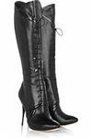
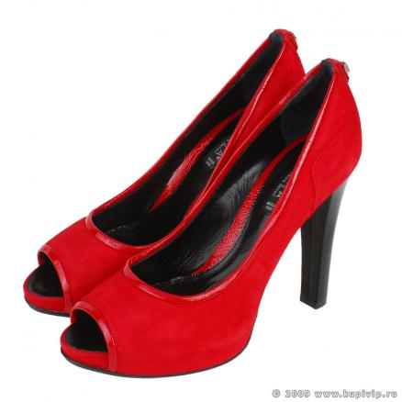
gloves
mittens
shoes
boots

Slide 10
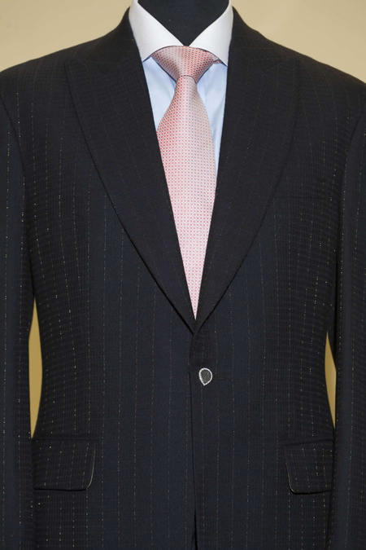
hat
suit
cap

