Slide 1
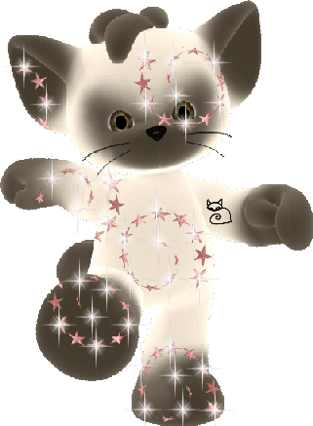
7
4
1
+2
2
8
6
5

Slide 2
6
-2
10
8
5
3

Slide 3
-2
3
3 +
5
6
-2
-2
10
-2

Slide 4
5
4
1
8
8
9
3

Slide 5
7
2
10
3
10
6

Slide 6
3 | 1 | 4
3 | 8 | 3
2 | 5 | 1
0 |  | 7
 | 9
6 |  | 1
5 |  | 3
 | 10
6 |  | 1

Slide 7
2 |  | 3
 | 9
1 |  | 4
0 |  | 5
 | 8
6 |  | 1
3 |  | 4
 | 9
2 |  | 5

Slide 8
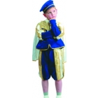
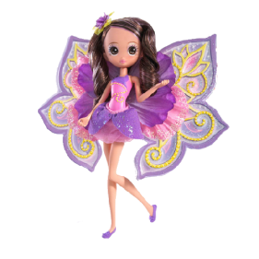
+9
+4
-5
+0
-2
3

Slide 9
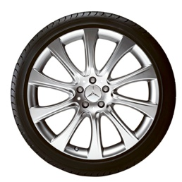
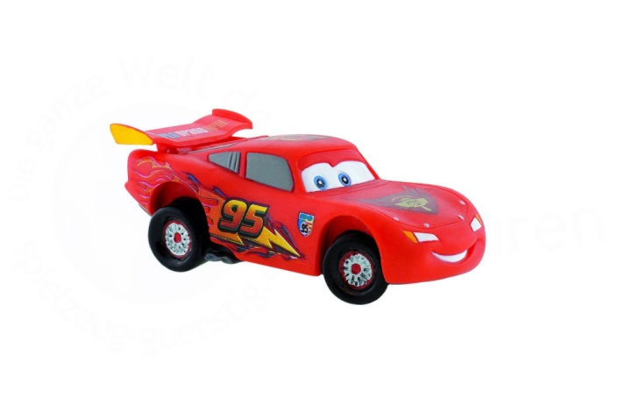
+6
-3
-8
+6
8
-1

Slide 10
10
8 | 3 | 5 | 9 | 7 | 1 | 4 | 2 | 6

Slide 11
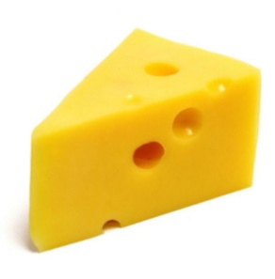
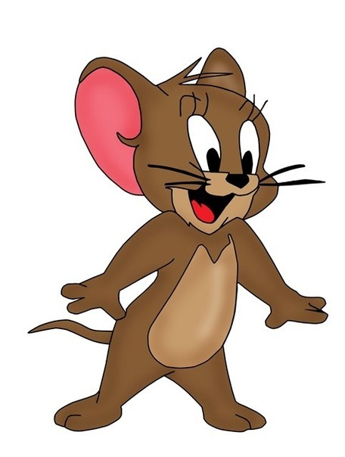
9 -
= 3
+ 4= 8
- 2 = 5
- 4 = 5
5 +
= 7
6 -
= 3

Slide 12
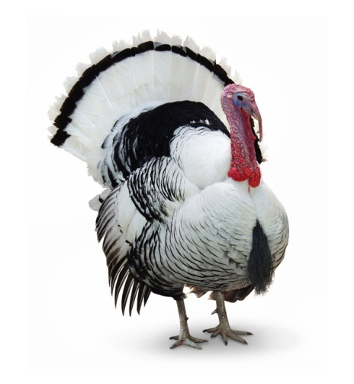
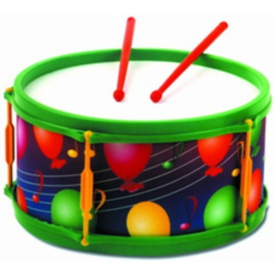
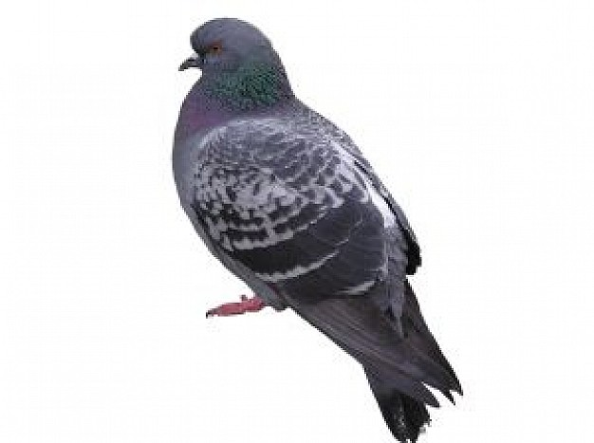
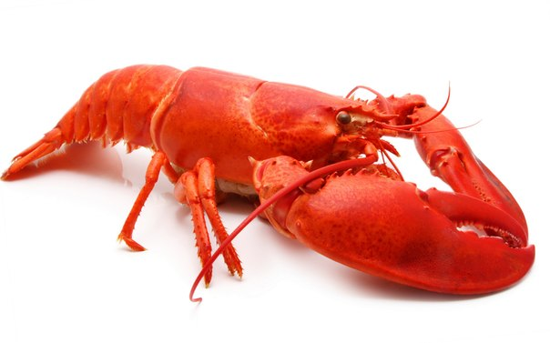
7- 5
10 - 6
9 - 6
9 - 8
1
2
3
4

