Slide 1
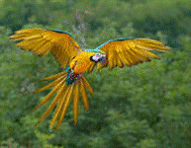
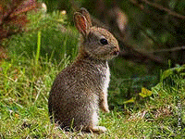
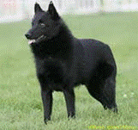
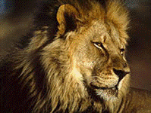
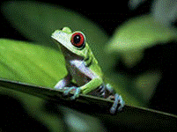
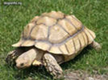
MY ANIMALS

Slide 2
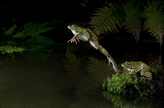
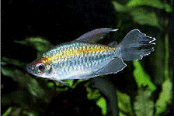
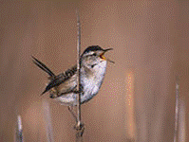
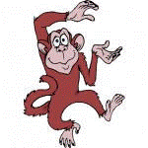
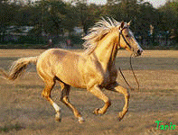
MY ANIMALS
frog
fish
jump
swim
bird
horse
sing
monkey
dance
run

Slide 3
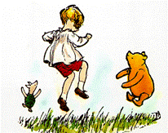
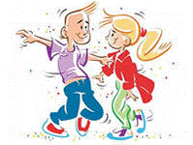
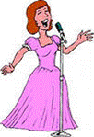
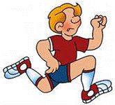
MY ANIMALS
I CAN JUMP LIKE A FROG
BOING, BOING.
I CAN SWIM LIKE A FISH
SPLISH, SPLASH.
I CAN JUMP AND I CAN SWIM,
I CAN DANCE AND I CAN SING,
AND I CAN RUN AND RUN AND RUN
JUST LIKE THIS!

Slide 4
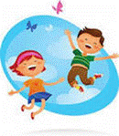
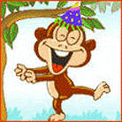
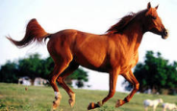
MY ANIMALS
I can jump too
I can jump like a frog
dance like a monkey
swim like a fish
run like a horse
sing like a bird

Slide 5
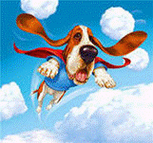
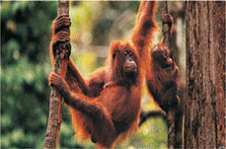
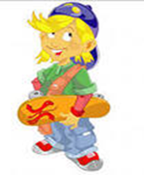
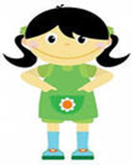
MY ANIMALS
fly
climb
CAN YOU YUMP?
YES, I CAN
CAN YOU FLY?
NO, I CANT

Slide 6
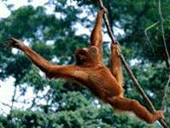
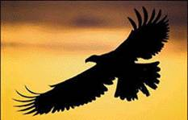
MY ANIMALS
CAN YOU FLY?
CAN YOU FLY?
CAN YOU FLY?
NO, I CANT.
CAN YOU CLIMB?
CAN YOU CLIMB?
CAN YOU CLIMB?
YES, I CAN!
CAN YOU CLIMB LIKE A CHIMP?
CAN YOU FLY LIKE A BIRD?
CAN YOU CLIMB?
YES, I CAN!
CAN YOU FLY?
NO, I CANT!

Slide 7
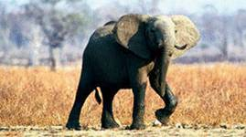
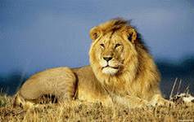
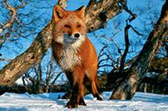
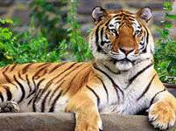
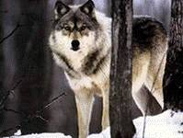
MY ANIMALS

Slide 8
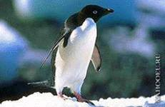
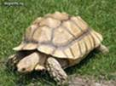
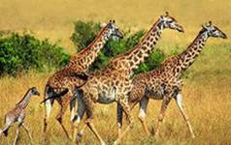
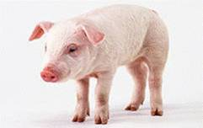
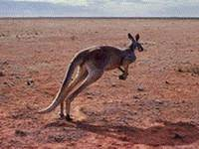
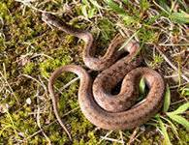
MY ANIMALS

Slide 9
ИНФОРМАЦИОННЫЕ РЕСУРСЫ:
1. ФОТОГРАФИИ ВЗЯТЫ С WWW.IMAGES.YANDEX.RU

Slide 10
THANK YOU FOR YOUR ATTENTION!!!
Презентация подготовлена Смирновой Екатериной Юрьевной, учителем английского языка МБОУГ № 20 г. Тулы

