Slide 1
Tongue-twister
Father, mother, sister, brother – Hand in hand with one another.

Slide 2
Let`s play a little!

Slide 3
Guess!
Grandfather stars
family grandmother grandson
sister
toy
daughter
puzzles granddaughter brother

Slide 4
Выбери лишнее слово
Father, mum, grandma, family,
daughter, star, dad

Slide 5
Grandfather, grandson, son, grandpa,
grandmother, granddaughter

Slide 6
Daughter, grandpa, mum, dad, grandma

Slide 7
Word search
m | p | z | l | e | s | t | h
o | u | z | z | b | r | o | e
t | h | e | r | s | o | n | r
f | a | m | i | l | y | m | b

Slide 8
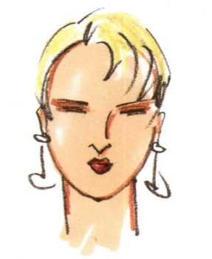
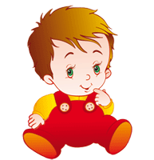
Family relations
Who is Bill for his mother?
Bill is a son for his mother.

Slide 9
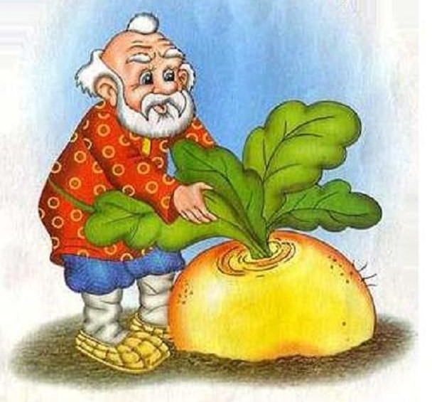
Bill is a ……. for his grandfather.

Slide 10
Bill is a ……. for his …

Slide 12
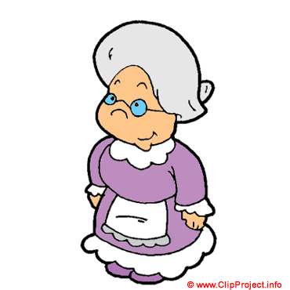

Slide 13
Who is Mag for her mother?
Mag is a daughter for her mother.

Slide 14
Mag is a … for her grandfather.

Slide 15
Mag is a … for her … .

Slide 18
Well done!

