Slide 1
Seasons and months
Урок английского языка в 3 классе
III четверть

Slide 2
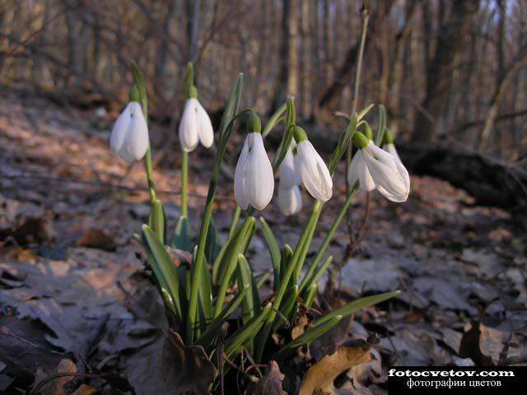
seasons

Slide 3
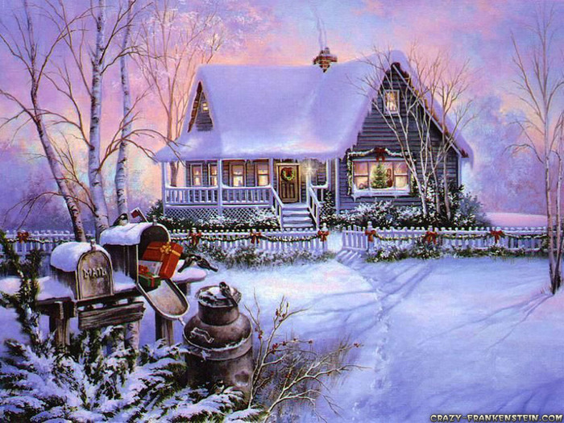
Winter months are …
December January February

Slide 4
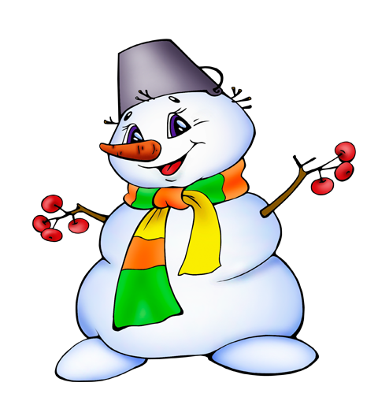
December

Slide 5
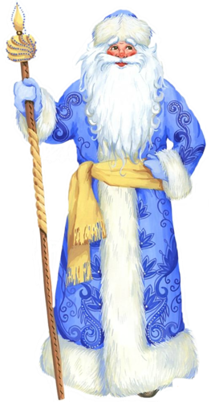
January

Slide 6
February

Slide 7
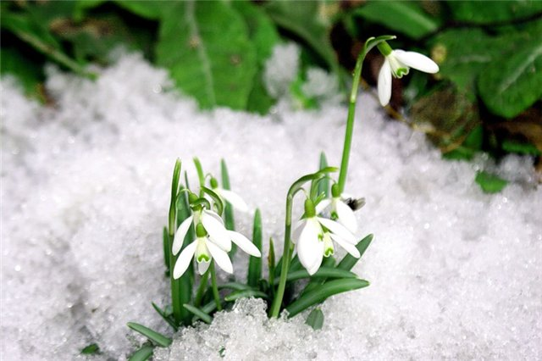
spring months are …
March April May

Slide 8
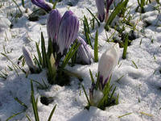
March

Slide 9
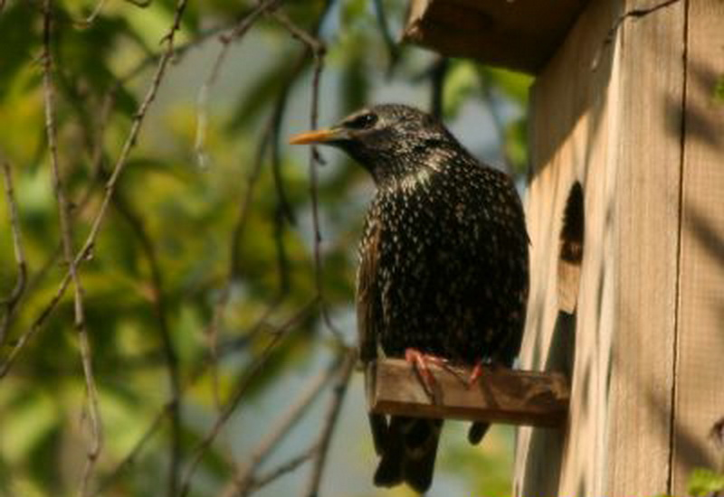
April

Slide 10
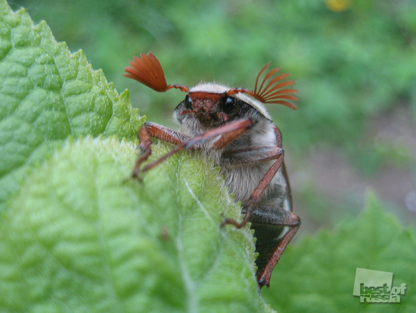
May

Slide 11
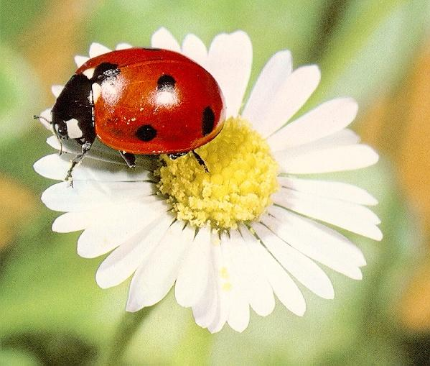
summer months are …
June July August

Slide 12
June

Slide 13
July

Slide 14
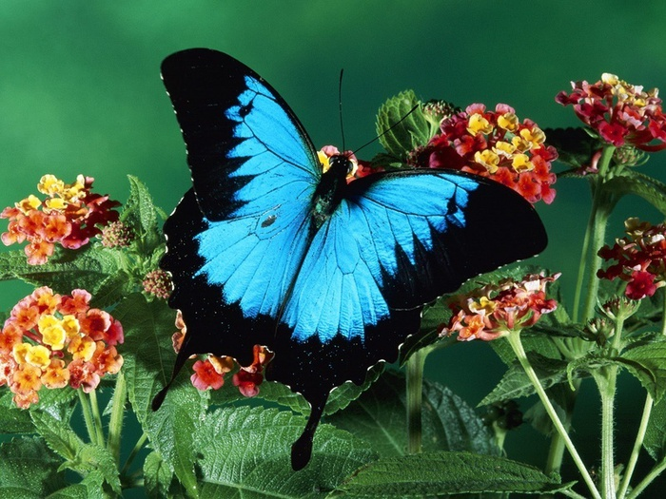
August

Slide 15
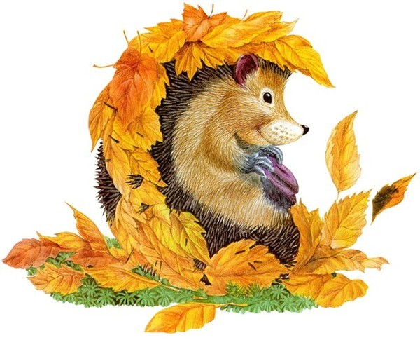
autumn months are …
September November October

Slide 16
September

Slide 17
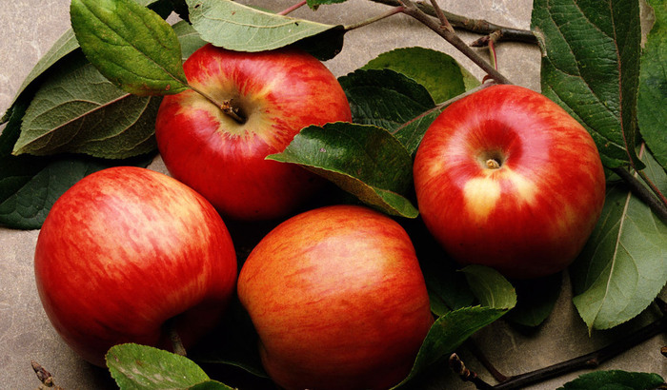
October

Slide 18
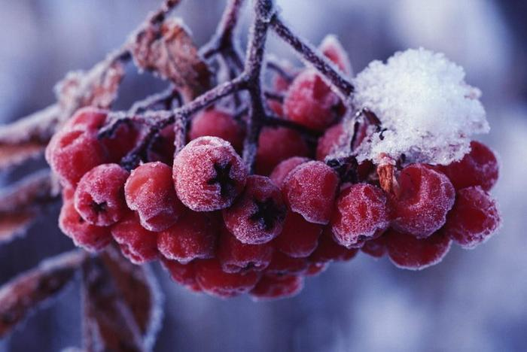
November

Slide 19
What Month Do You Like?
December March
January April
February May
September June
November July
October August

