Slide 1
OLYMPIC GAMES 2014
7.02-23.02

Slide 2

WINTER OLYMPIC GAMES

Slide 3
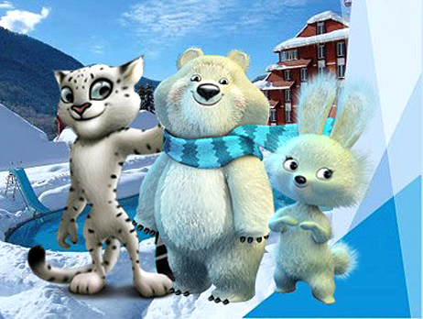
OLYMPIC SYMBOLS 2014

Slide 4
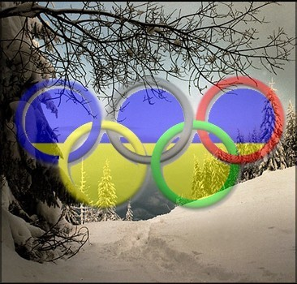
WINTER OLYMPIC SPORTS

Slide 5
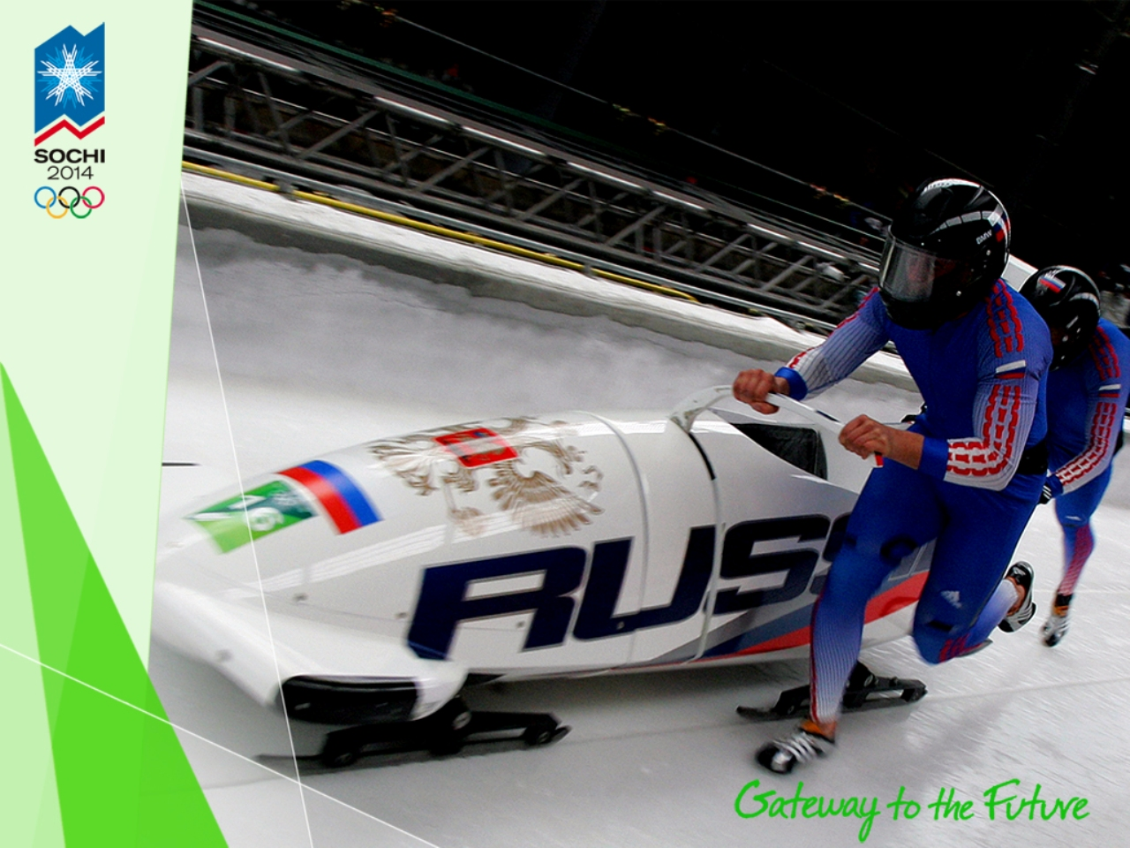
BOBSLEIGH

Slide 6
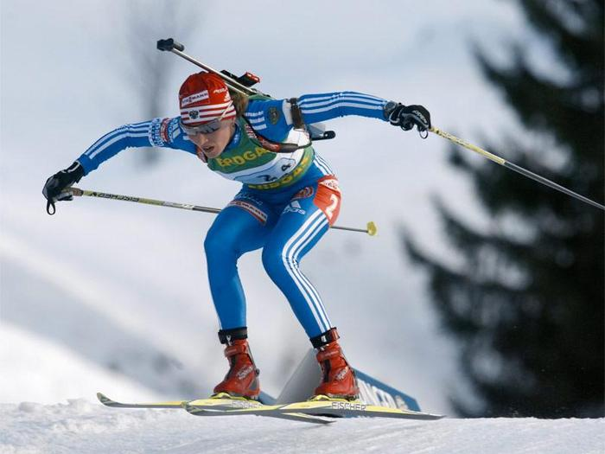
BIATHLON

Slide 7
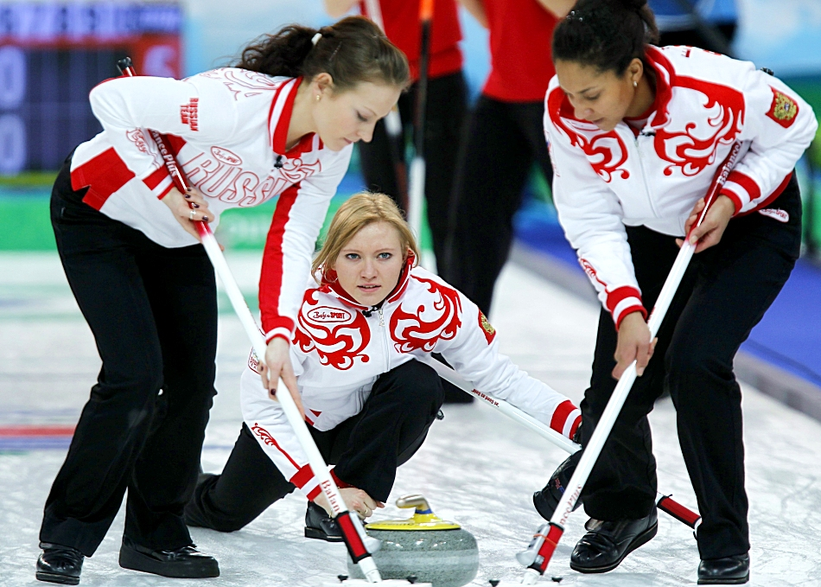
CURLING

Slide 8
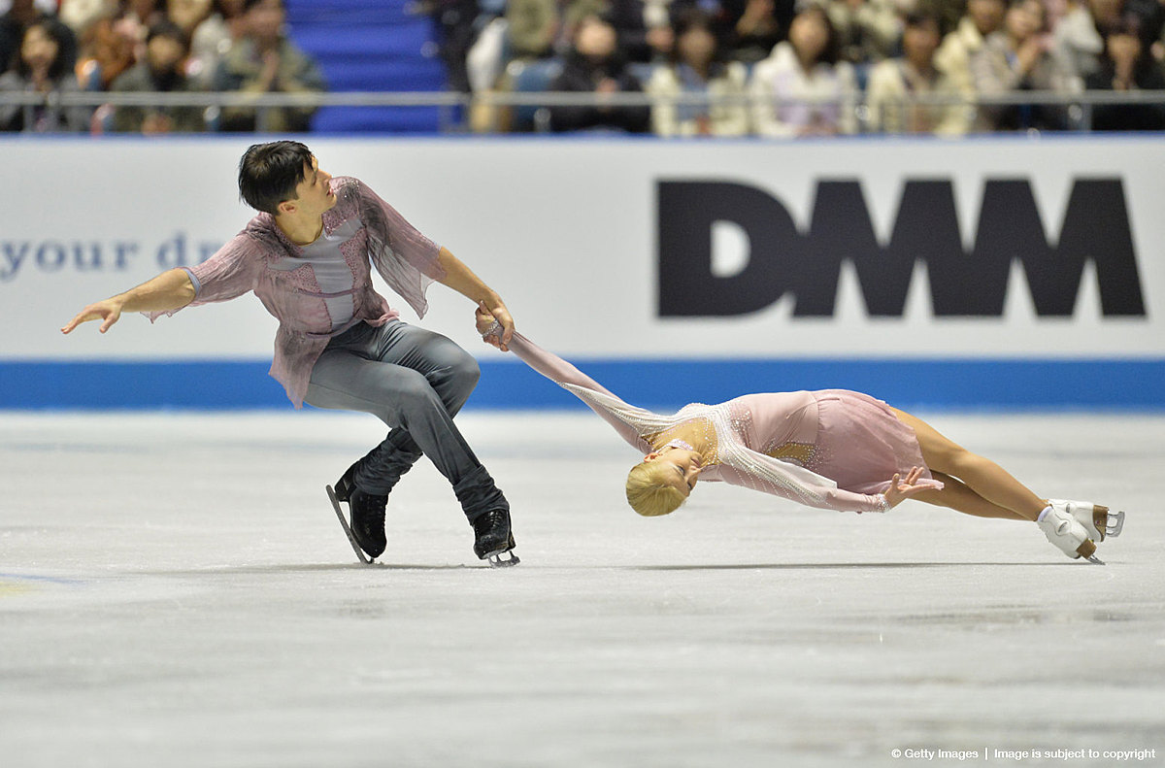
FIGURE SKATING

Slide 9
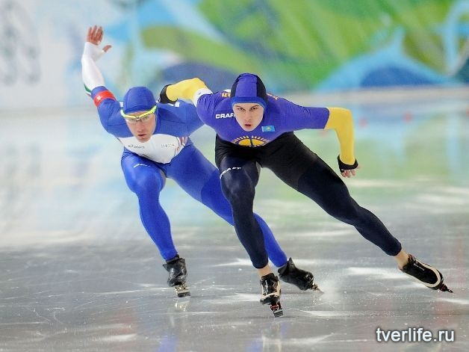
SPEED SKATING

Slide 10
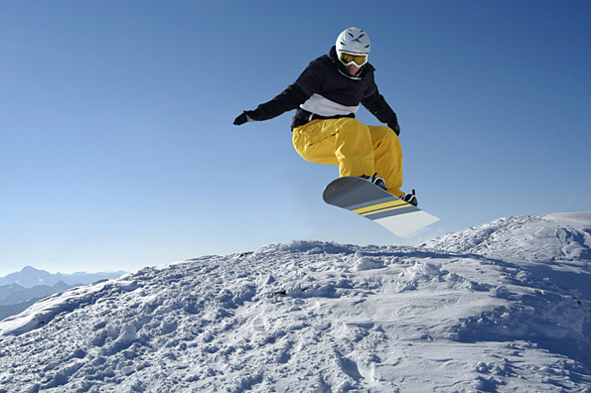
SNOWBOARDING

Slide 11
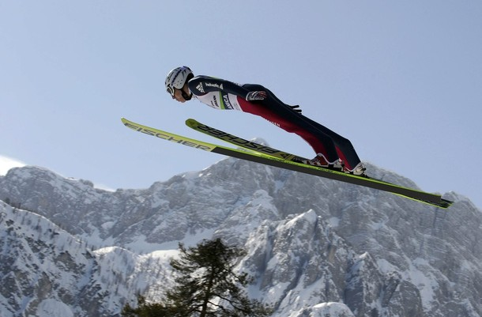
SKI JUMPING

Slide 12
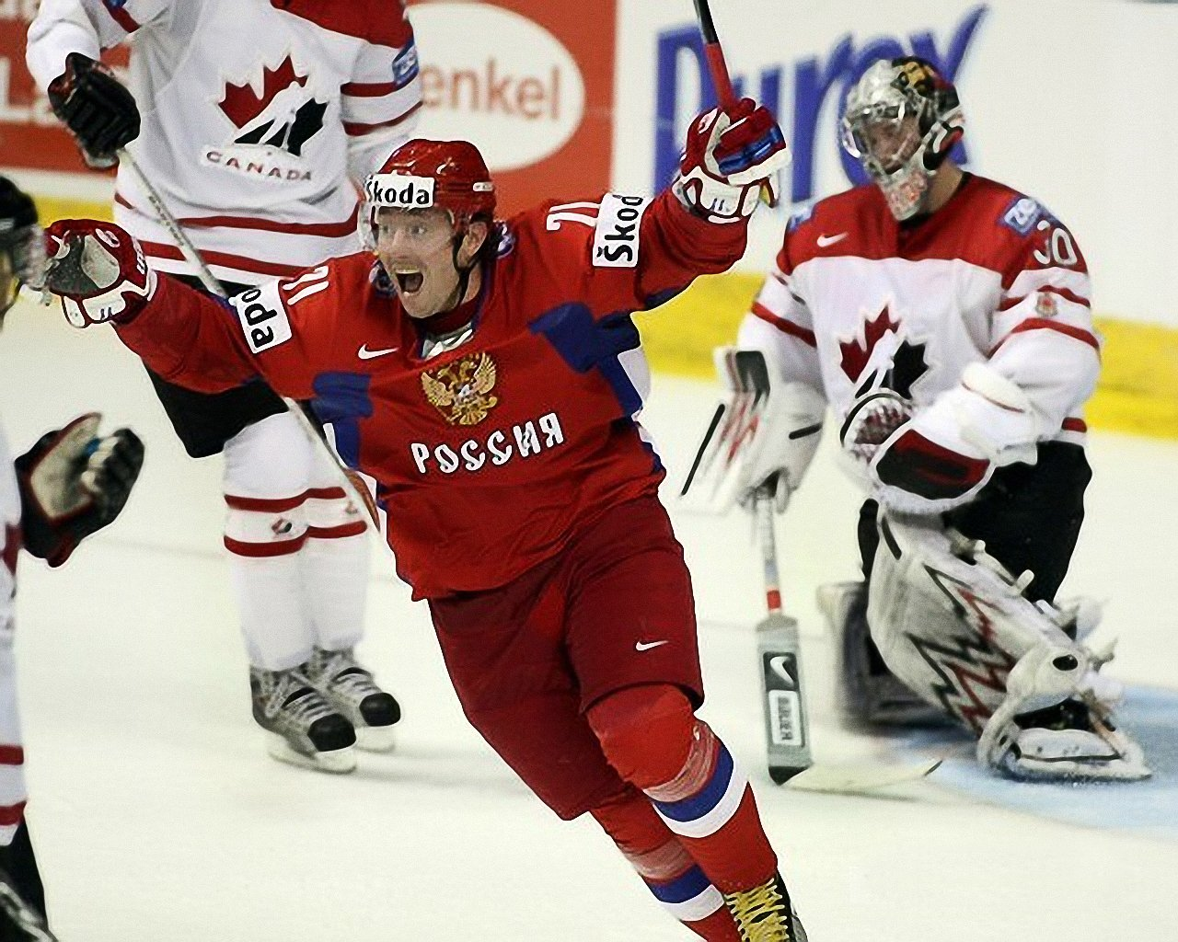
ICE HOCKEY

Slide 13
What kind of sport is it?
- Figure skating
- Curling
- Ice hockey

Slide 14
CURLING

Slide 15
What kind of sport is it?
- Biathlon
- Curling
- Snowboarding

Slide 16
SNOWBOARDING

Slide 17

What kind of sport is it?
– Ice hockey
- Figure skating
- Speed skating

Slide 18
ICE HOCKEY

Slide 19
What kind of sport is it?
- Bobsleigh
- Ski jumping
- Curling

Slide 20
BOBSLEIGH

Slide 21
What kind of sport is it?
- Bobsleigh
- Ski jumping
- Figure skating

Slide 22
SKI JUMPING

Slide 23
What kind of sport is it?
– Bobsleigh
- Figure skating
- Ski jumping

Slide 24
FIGURE SKATING

Slide 25
WINTER OLYMPIC SPORTS

