Slide 1
A postman

Slide 2
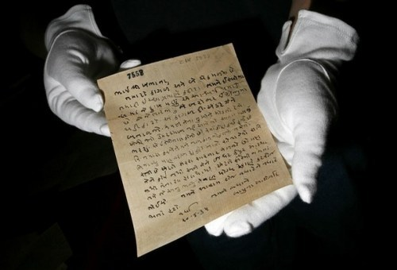
A letter

Slide 3
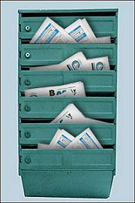
A letter box

Slide 4
An address

Slide 5
paper

Slide 6
A postcard

Slide 7
a stamp

Slide 8
A poster

Slide 9
A post office

Slide 10
An envelope

