Slide 1
What is there in our flat?

Slide 2
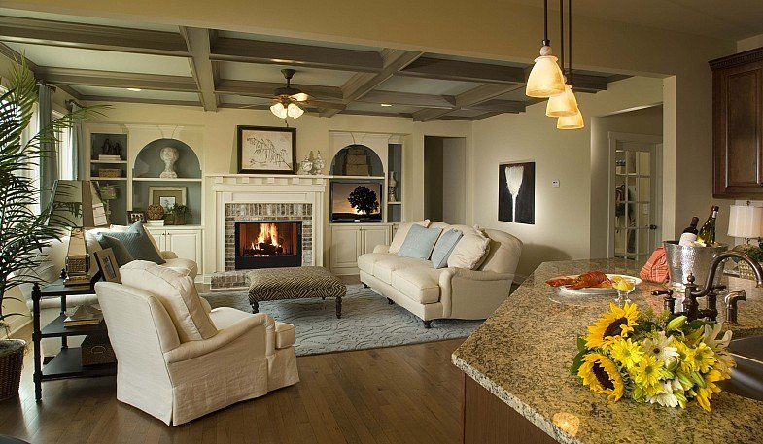

Slide 3
a living room

Slide 4
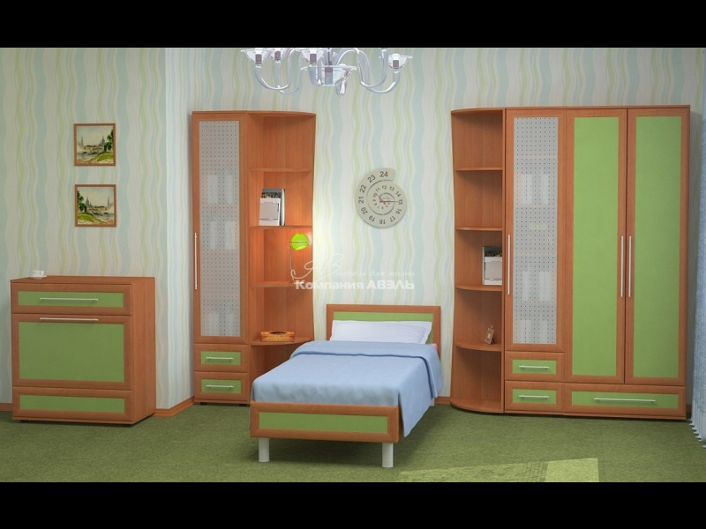

Slide 5
a bedroom

Slide 6
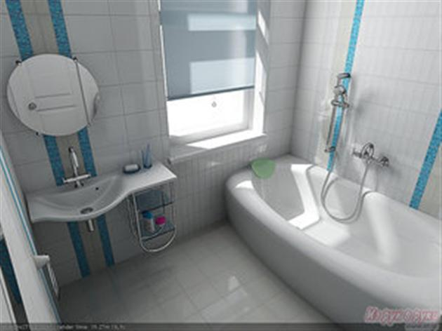

Slide 7
a bathroom

Slide 8
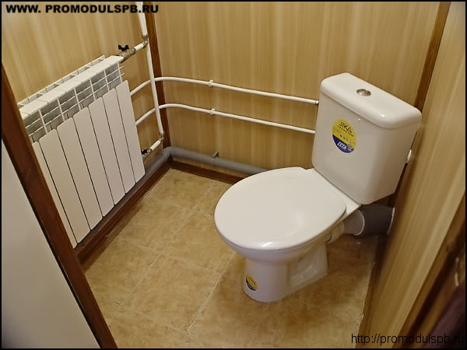

Slide 9
a toilet

Slide 10
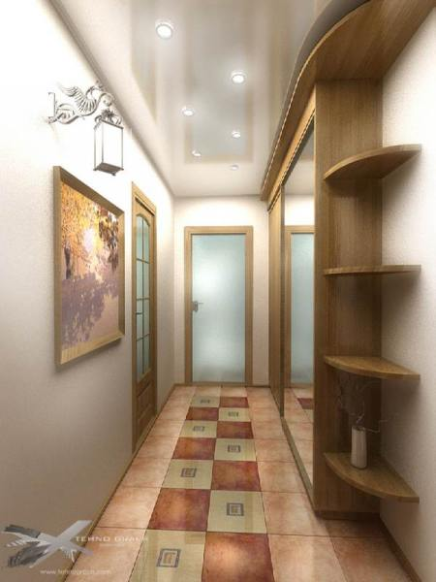

Slide 11
a hall

Slide 12
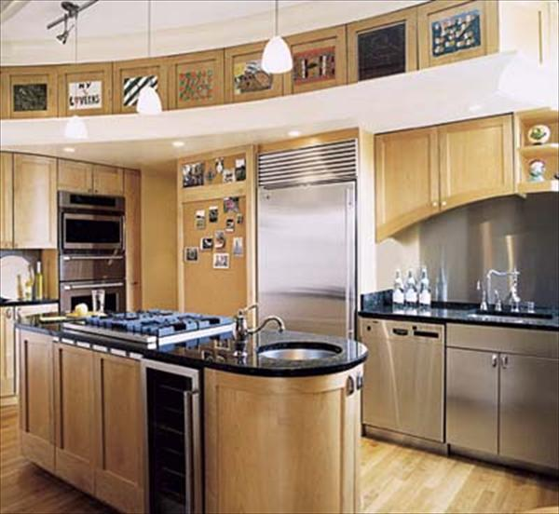

Slide 13
a kitchen

Slide 14
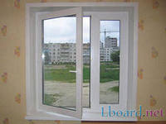
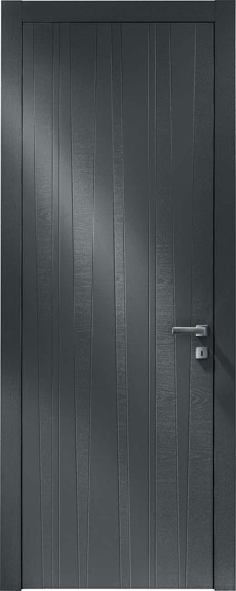

Slide 15
a window
a door

Slide 16
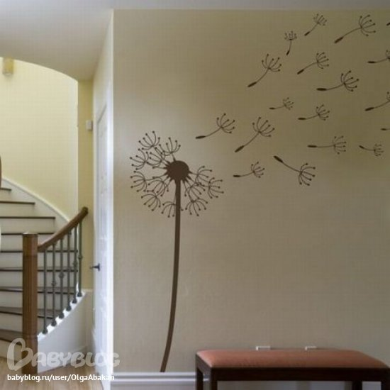

Slide 17
a wall

