Slide 1
Lesson 20. “Enjoy English”
Урок английского языка
в 3-ем классе
Учитель: Куликова Т.А.

Slide 3
Read the words
Meat, drink, eat, Tuesday, teacher, speak, clean, books, farm, shirt, game, girl, jeans, that, bring, dirty, short, where, why, who, Saturday.
ea
[ i:] [e]
bread
head
healthy
breakfast

Slide 4
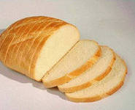
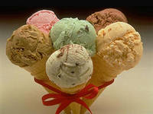
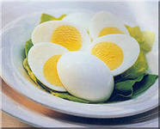
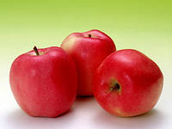
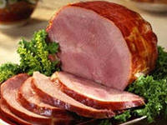
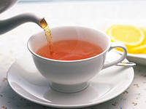
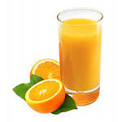
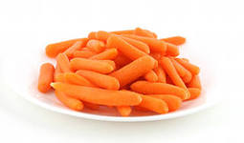
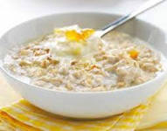
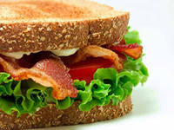
What do you like to eat for breakfast?

Slide 5
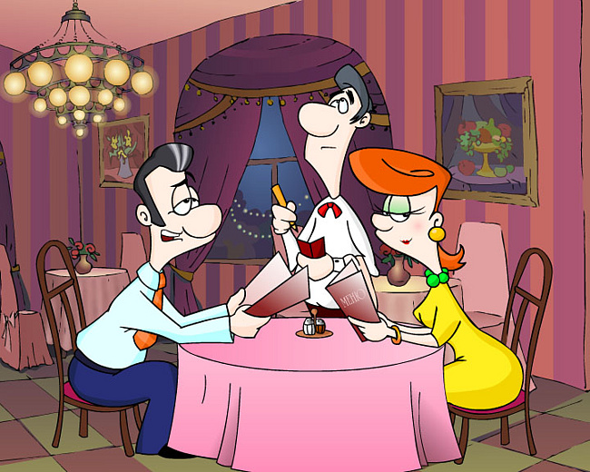
T.B.ex.1p.32
May I have (some)…….?
Можно мне немного……?
Here you are.
Вот, пожалуйста.
You are welcome.
На здоровье!
W.B.ex.2p.23

Slide 6
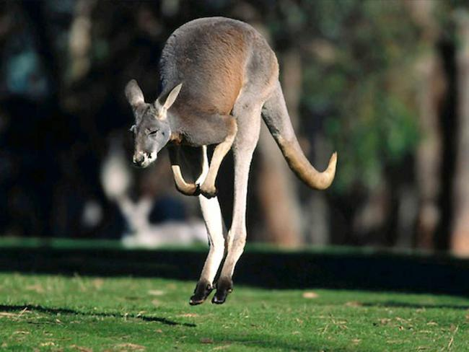
Name the parts of the body of the kangaroo

Slide 7
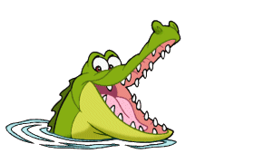
Fill the letters
T… …th
Ea…s
N…se
Fa…e
Ey…s
Ne… …
Ta…l

Slide 8
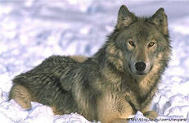
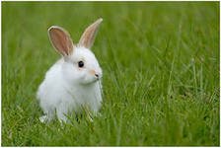
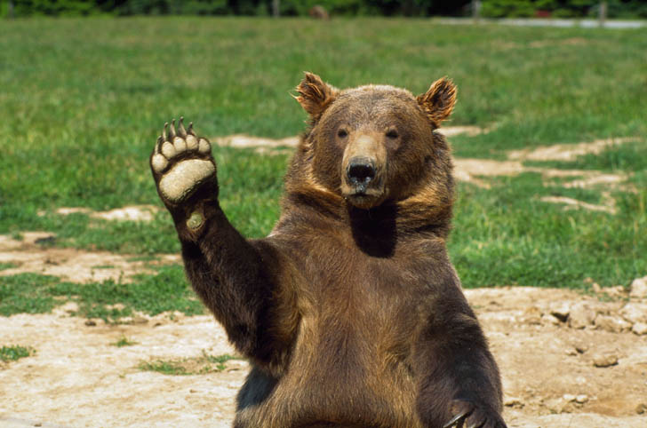
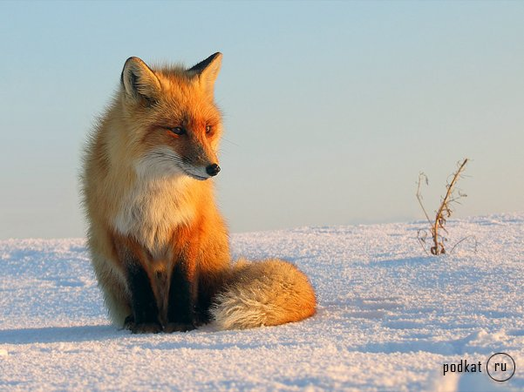
Who is it ???
Notes:
Учитель читает загадки. Дети отгадывают животного.

Slide 9
Correct mistakes.
a big teeth
a small nose
a funny ears
a long neck
a black eyes
short tail

