Slide 1
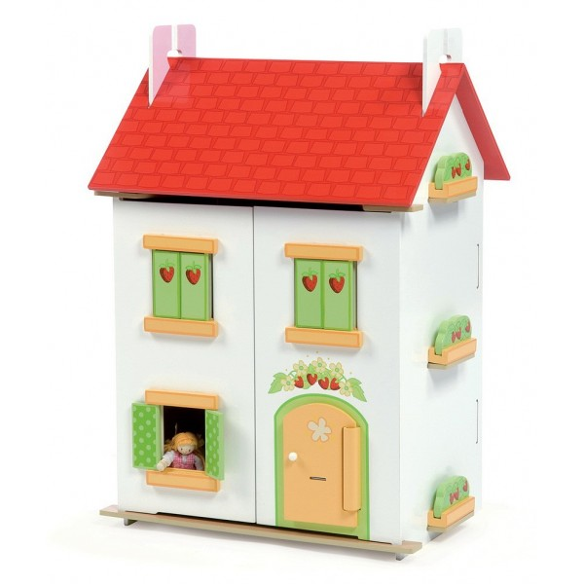
My house.
Автор: Малахова Светлана Анатольевна, учитель иностранных языков
МБОУ СОШ № 5 города-курорта Анапа, Краснодарского края.

Slide 2
Do you remember what’s that?
It’s a bed.

Slide 3
It’s a drawer.

Slide 4
It’s a table.

Slide 5
It’s a sofa.

Slide 6
It’s a chair.

Slide 7
It’s a wardrobe.

Slide 8
It’s a dressing table.

Slide 9
It’s Mary.

Slide 10
It’s Ben.

Slide 11
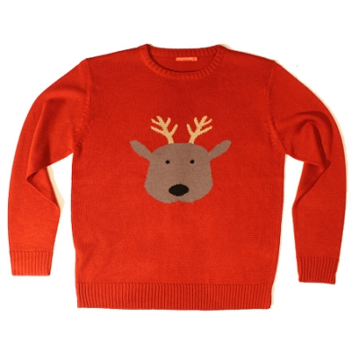
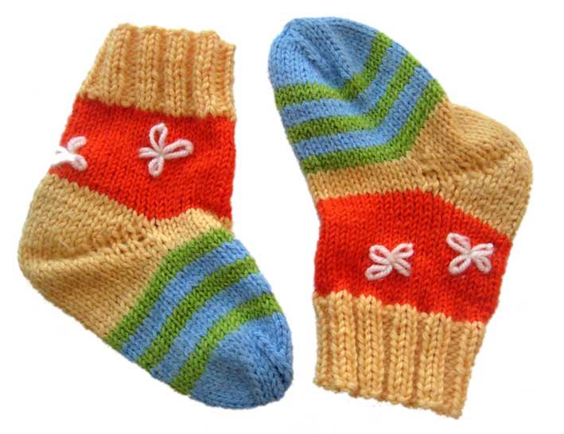
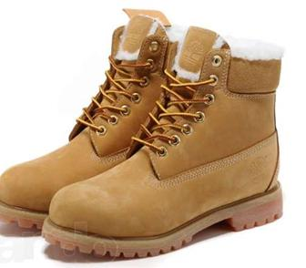
Ben’s clothes
JUMPER
SCARF
SOCKS
SHOES

Slide 12
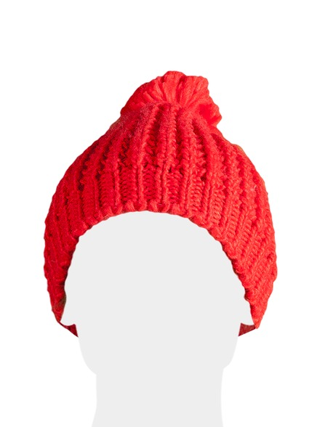
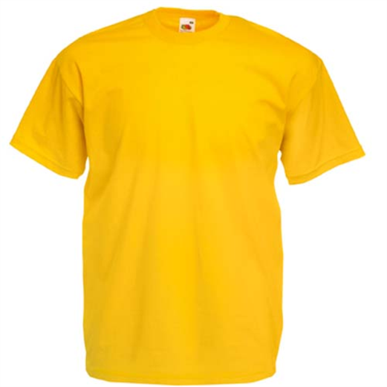
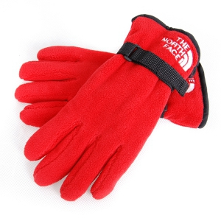
Mary’s clothes
JACKET
HAT
T-SHIRT
GLOVES

Slide 13
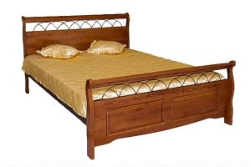
It’s on the bed.
Where is Ben’s jumper?
ON

Slide 14
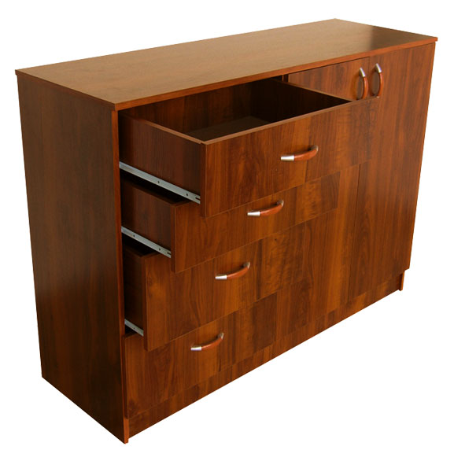
It’s in the drawer.
Where’s Ben’s scarf?
IN

Slide 15
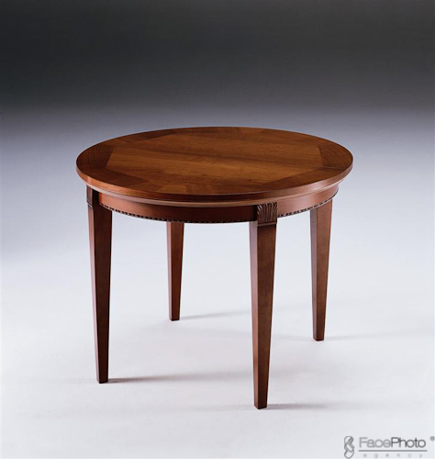
They are under the table.
Where are Ben’s socks?
UNDER

Slide 16
They are behind the sofa.
Where are Ben’s shoes?
BEHIND

Slide 17
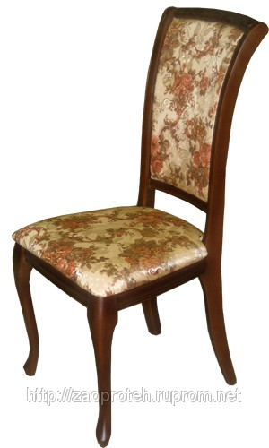
… is … the chair.
Where’s Mary’s hat?
ON

Slide 18
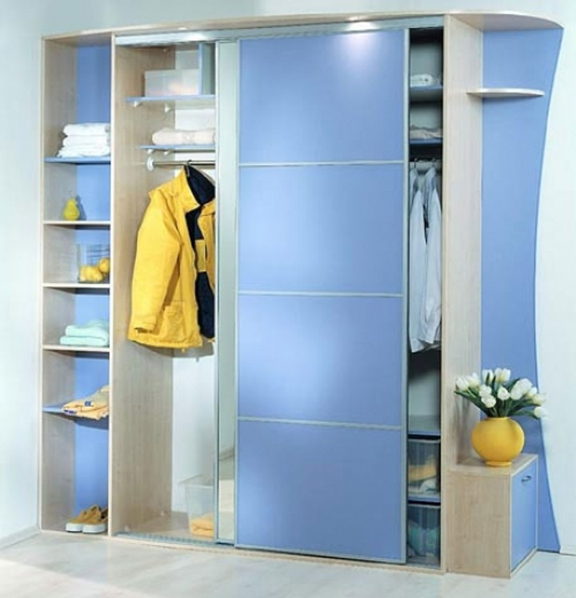
… is … the wardrobe.
Where’s Mary’s jacket?
IN

Slide 19
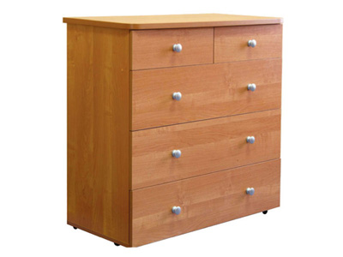
… is … the drawer.
Where’s Mary’s T-shirt?
BEHIND

Slide 20
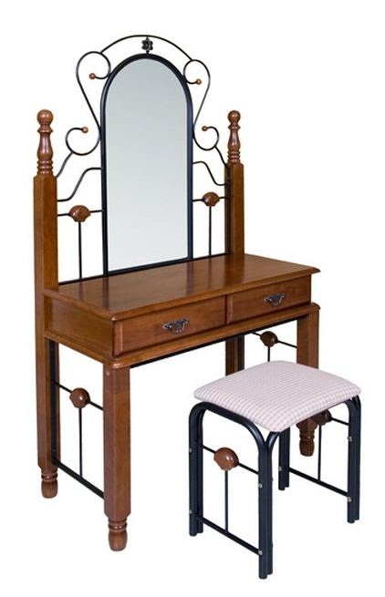
… are … the dressing table.
Where are Mary’s gloves?
UNDER

Slide 21
Where is the cat?

Slide 22
Where is the dog?

Slide 23
Where is the snail?

Slide 24
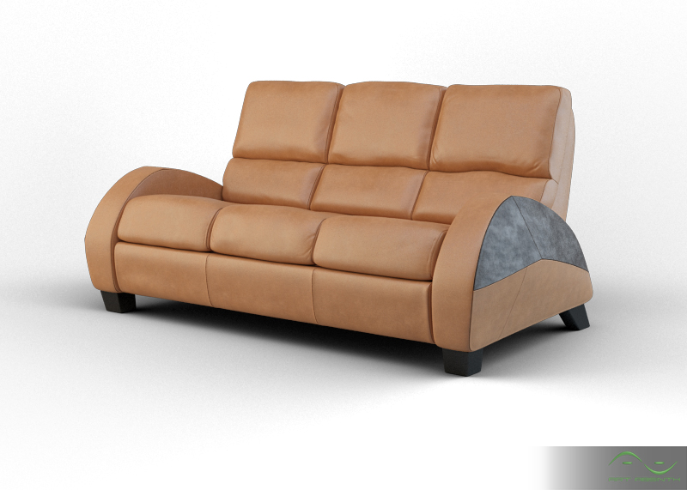
Where is the bee?

Slide 25
Использованные материалы:
1.УМК “Forward” учебник для 3 класса под ред. д.ф.н. Вербицкой М.В.
2.Картинки rambler.picture.ru

