Slide 1
A letter from my friend
Составила:
Мелешко О.Г.
Учитель «МБОУ Лицей Сигма»
г.Барнаул

Slide 2
I have got a letter from Tiny’s brother Ted. Let’s read it.

Slide 3
Who is this lady?
She is a witch.

Slide 4
Hello, children! My name is Mrs. Black. I take a letter from Ted. You must do my tasks and I will give it to you.
Solve my riddles.

Slide 5
Много боли, много бед, И страдает моя
head.
Друг мой, ты запоминай! Глаз мы называем
eye.
Уши у меня большие, по-английски
ear.
При любой погоде, закаляю тело
body.
За отметочки плохие мне надрали славно
ear.

Slide 6
От плеча до кисти сам, Руку называю
arm.
Руку протянул мне friend. Кисть руки назвали
hand
Я люблю отличный бег, ногу все назвали
leg.
Футбол. Все за мячом бегут. Ступню мы называем
foot.

Slide 7
Ну что без шеи человек? Шея по-английски
neck.
Взад-вперёд и сверху-вниз утром с пастой чищу
teeth
Отрастайте побыстрее для моих косичек
hair
Папа бреется: вжик-вжик. Стала гладкой, нежной
cheek

Slide 8
Well done! And now I want you to guess a crossword. Good luck!

Slide 9
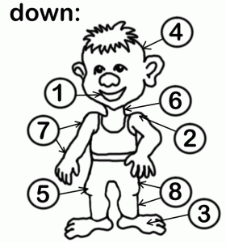
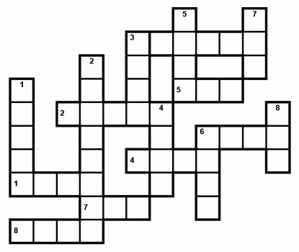

Slide 10
Let’s check the crossword

Slide 11
I know that your home task was to describe your friend. I want to listen to your stories!
Good. Your stories are funny and nice. Do you study grammar?
Make questions from these words.

Slide 12
your, is, What, name?
What is your name?
When, go to bed, you, do?
When do you go to bed?
a pet, Have, got, you?
Have you got a pet?
you, Where, live, do?
Where do you live?
to do, What, like, you, do?
What do you like to do?

Slide 13
Now all of you will get a card. And you must agree or disagree
You are good and clever children. So you can take a letter from your friend.

Slide 14
My dear friends!
My name is Ted. I live in the Yellow Forest. I am a student too. I like to write poems and to draw funny pictures. I have got a cat and a dog. I like my pets. Tell me about your school and pets.
Ted

Slide 15
Home task
Write letters to Ted and tell him about your school and pets.
You may also write him about
your family;
your hobbies;
your friends.

Slide 16
Список источников
Изображение конверта
http://static.diary.ru/userdir/6/7/4/8/674872/37973734.jpg
Изображение ведьмы
http://images.yandex.ru/yandsearch?source=wiz&text=%D0%B8%D0%B7%D0%BE%D0%B1%D1%80%D0%B0%D0%B6%D0%B5%D0%BD%D0%B8%D0%B5%20%D0%B2%D0%B5%D0%B4%D1%8C%D0%BC%D0%B0&noreask=1&pos=19&rpt=simage&lr=197&uinfo=sw-1349-sh-645-fw-1124-fh-448-pd-1&img_url=http%3A%2F%2Fmga.ucoz.ru%2FAnime%2Fanime_halloween.gif
Стихотворения с рифмами
http://peekaboo.wmsite.ru/glubina/1-j-shag/chasti-tela/

Slide 17
Кроссворд по теме части тела
http://like2teach.tmweb.ru/fun/crosswords_021.html
Изображение гномика
http://images.yandex.ru/yandsearch?text=%D0%B8%D0%B7%D0%BE%D0%B1%D1%80%D0%B0%D0%B6%D0%B5%D0%BD%D0%B8%D0%B5%20%D0%B3%D0%BD%D0%BE%D0%BC%D0%B8%D0%BA%D0%B0&pos=17&uinfo=sw-1349-sh-645-fw-1124-fh-448-pd-1&rpt=simage&img_url=http%3A%2F%2Fimg-fotki.yandex.ru%2Fget%2F5500%2Felena-komarov.1e0%2F0_57dc0_60db9ab1_XL

