Slide 1
Home sweet home
March, 17th 2014

Slide 2
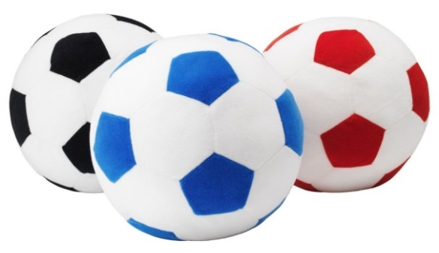
Rooms
What rooms
do you know?
Furniture
What furniture do you know?

Slide 3
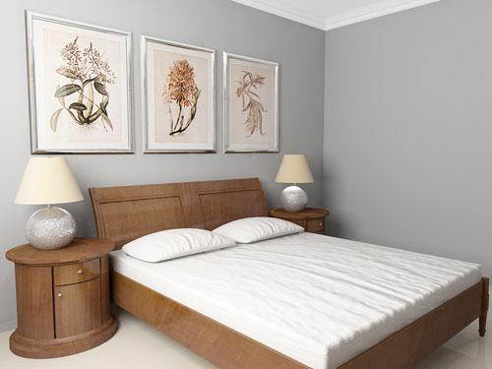
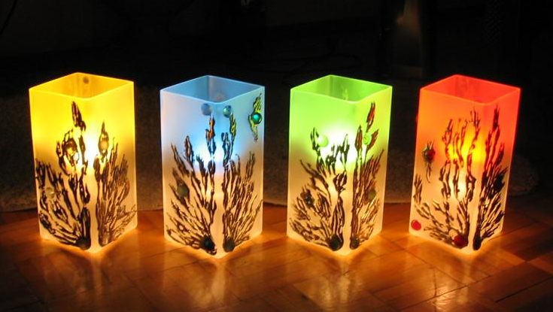
There is / There are
There is a mirror in the bedroom.
There are four lamps in the bedroom.

Slide 4
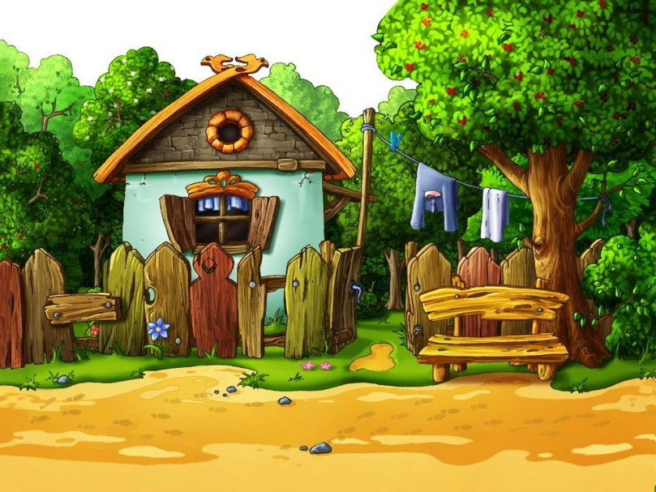
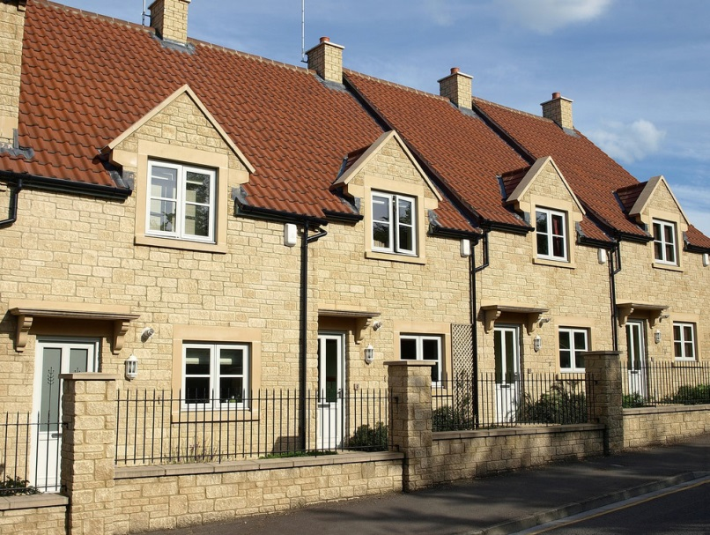
Country house
Town house
Country Mouse
Town Mouse

Slide 6
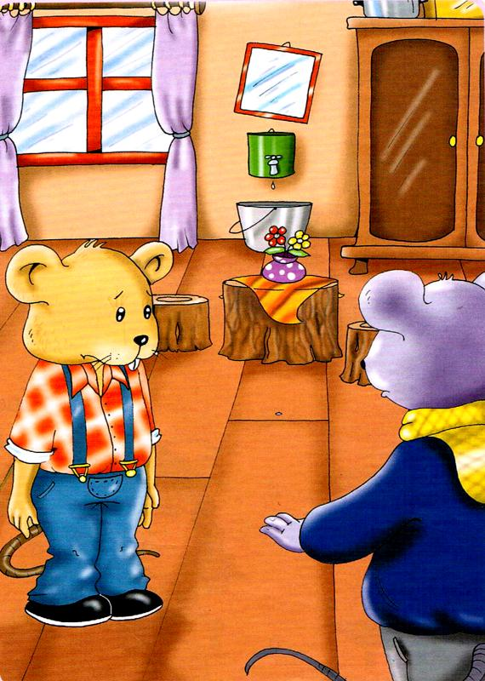
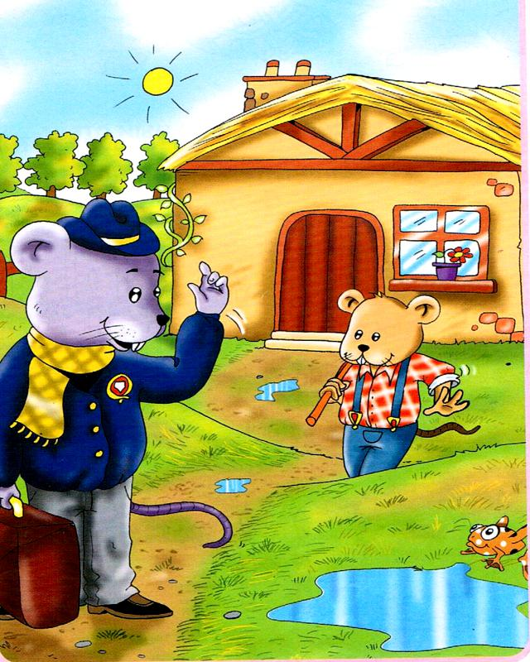
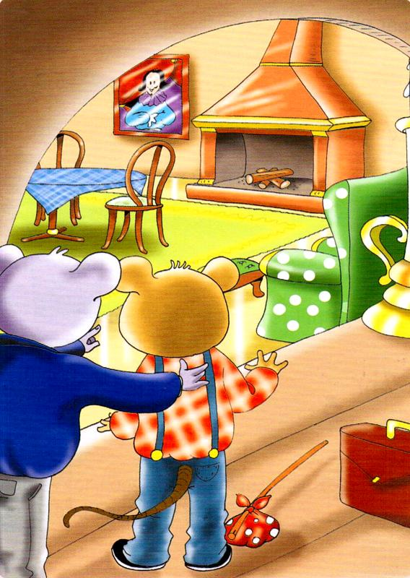
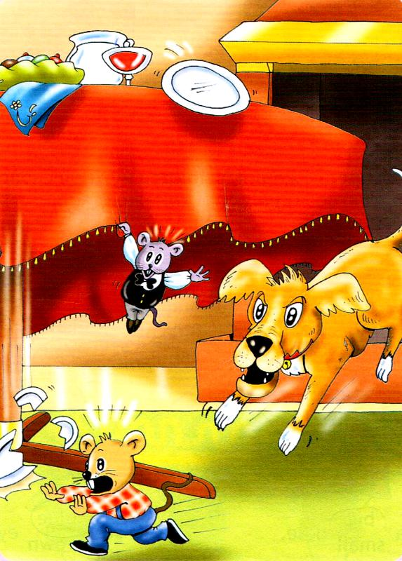
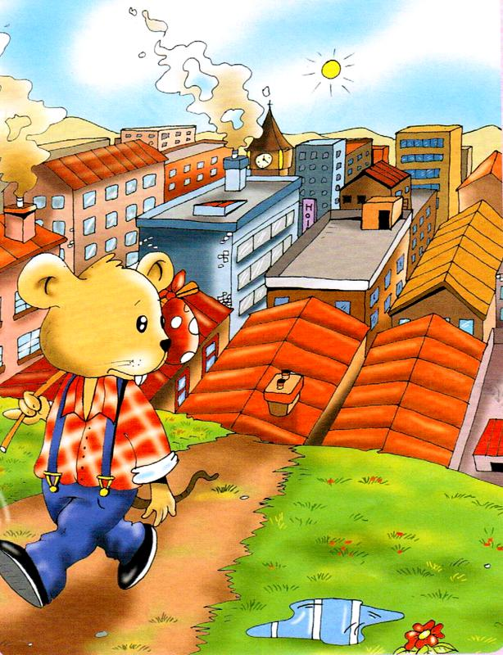
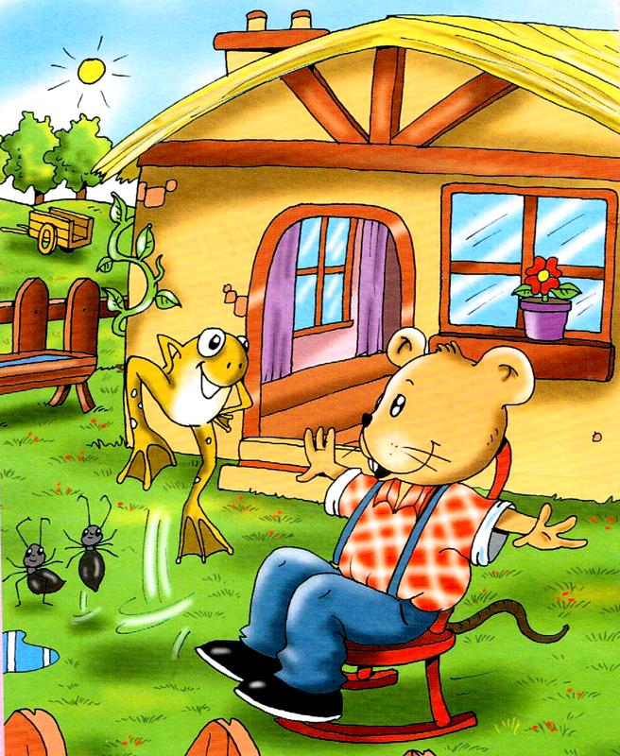
Please put these pictures in the correct order

Slide 7
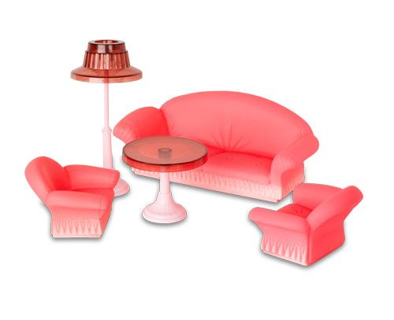
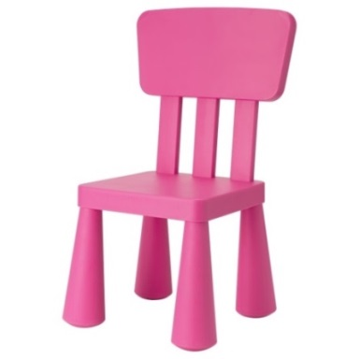
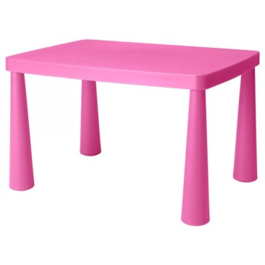
Living room
ants
chair
frogs
table
dog

Slide 8
Now lets make a project
Plan:
The name of the house
Pictures
The names of the pictures
The text

Slide 9
Thank you for the lesson my dear children!
Have a nice day!
Good bye!

