Slide 1
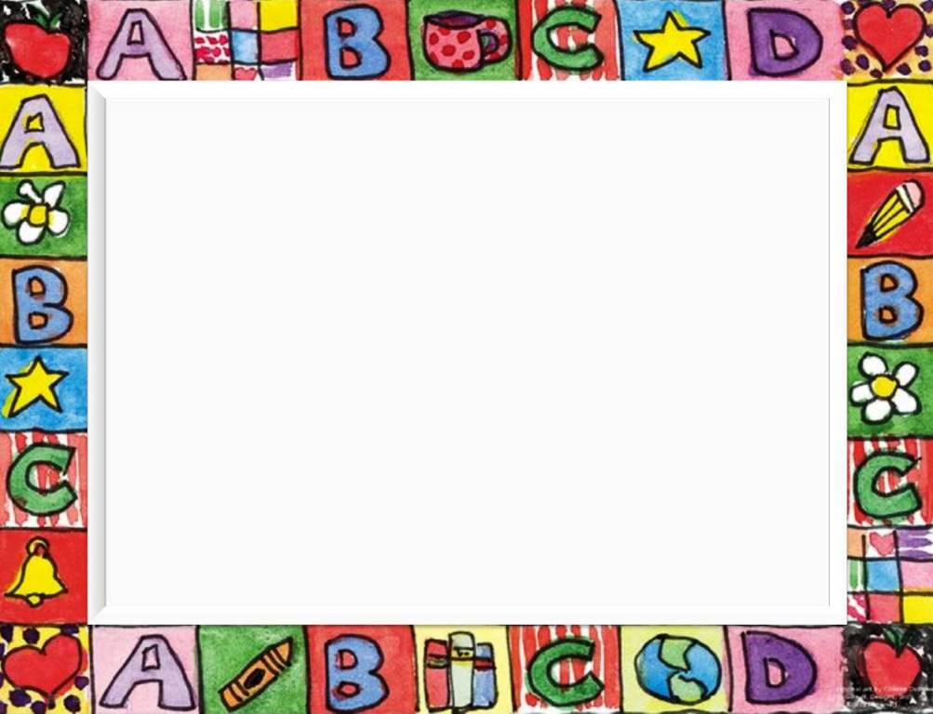
All the things I like!

Slide 2
Listen and repeat
Chicken Vegetables
Ice cream Chocolate
Water Lemonade
Pizza Cheese
Eggs Sandwiches
Burgers Chips

Slide 3
Listen and repeat
Meat Potatoes
Biscuits Milk
Cake Orange juice
Pasta Carrots
Sausages Rice
Popcorn Coke

Slide 4
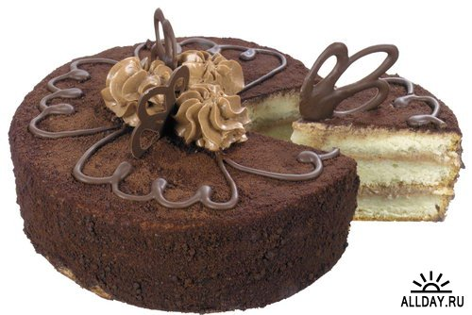
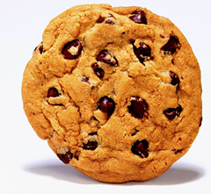
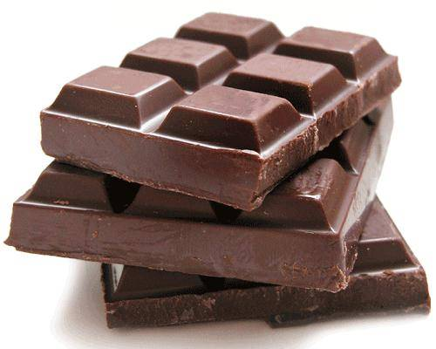

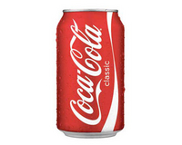
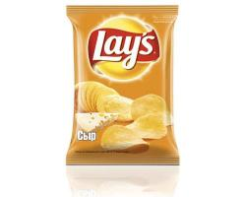

Slide 5
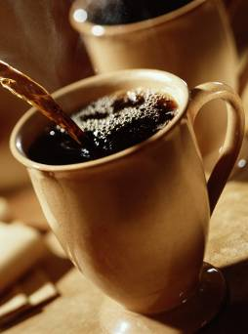
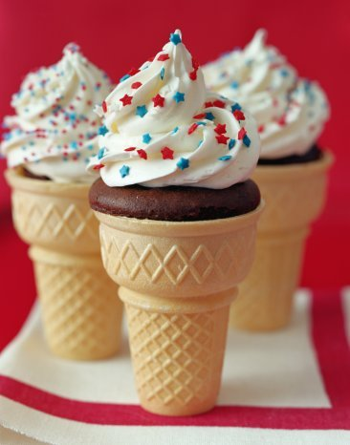
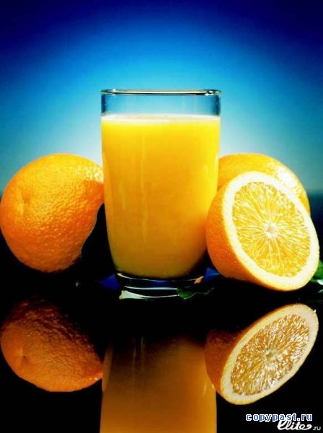
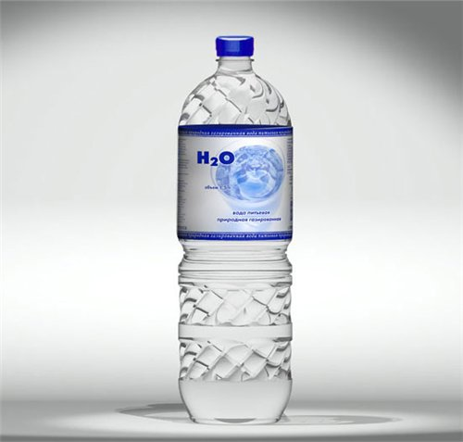
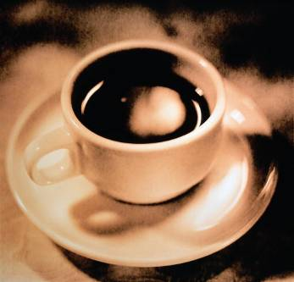

Slide 6
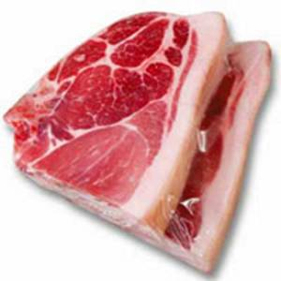
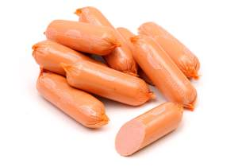
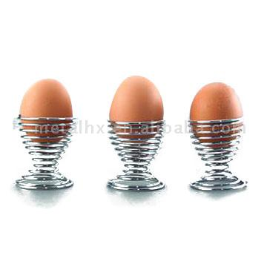
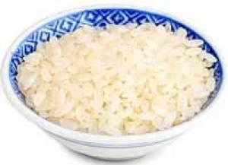

Slide 7
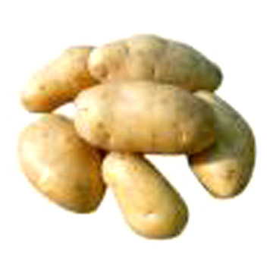
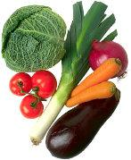
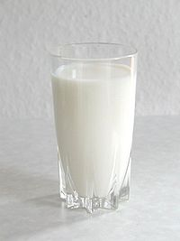
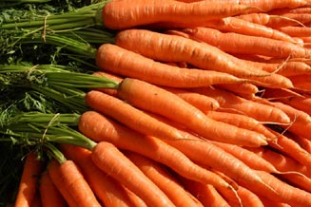
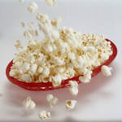

Slide 8
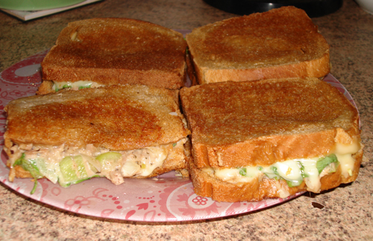
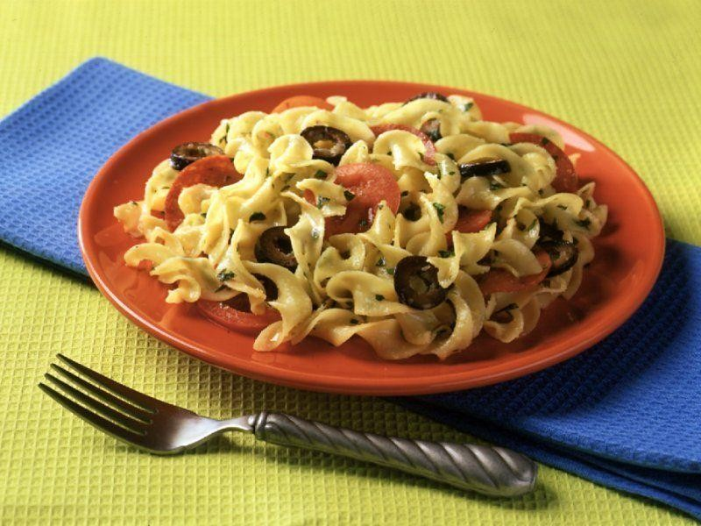
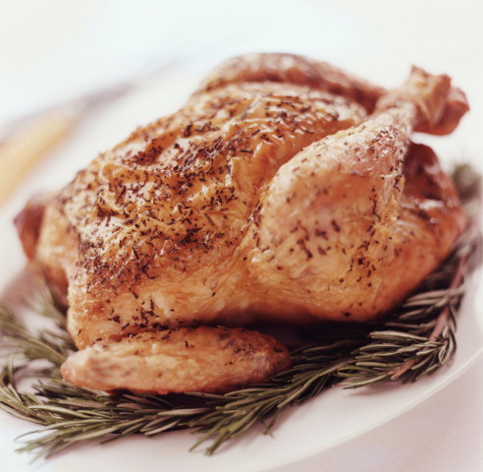
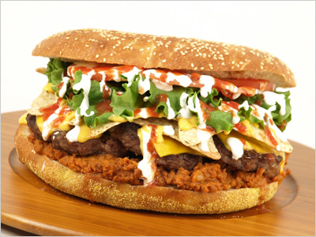
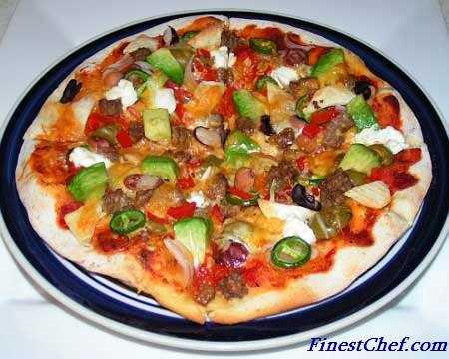

Slide 9
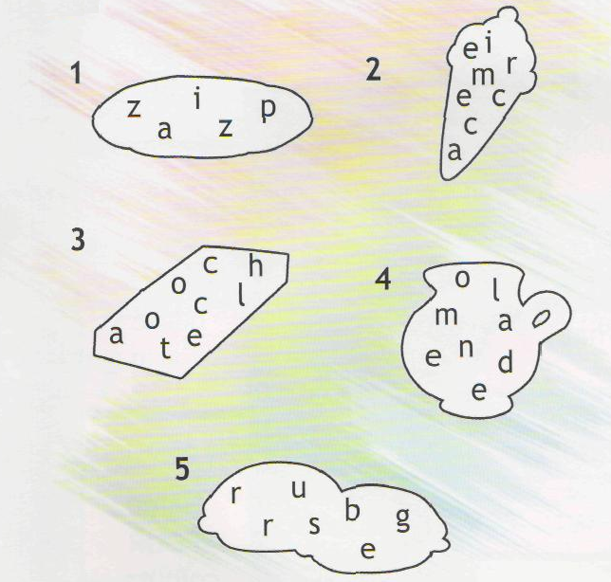
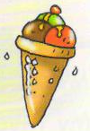

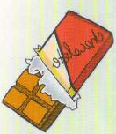

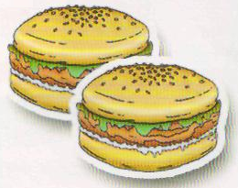
DO YOU KNOW THESE WORDS?

Slide 10
Puzzle
bananafhcc
uwueggklhh
rarllmsioi
gtfishkacc
eechipsjok
rrlraalzle
majncakean
pizzafjxto
hrwzgbvaeh

Slide 11
Puzzle
bananafhcc
uwueggklhh
rarllmsioi
gtfishkacc
eechipsjok
rrlraalzle
majncakean
pizzafjxto
hrwzgbvaeh

Slide 12

Make up sentences
- Can you pass me the lemon, please?
- Sure. Here you are!

Slide 13
Questions
- What is your favourite food?
- Pizza, yum! What about you?

Slide 14
Questions
-I like ice cream.
-Do you like ice cream?
- Yes, I do./No, I don’t.

Slide 15
Tell about yourself
I like… .
I don’t like… .
My favourite food is… .

Slide 16
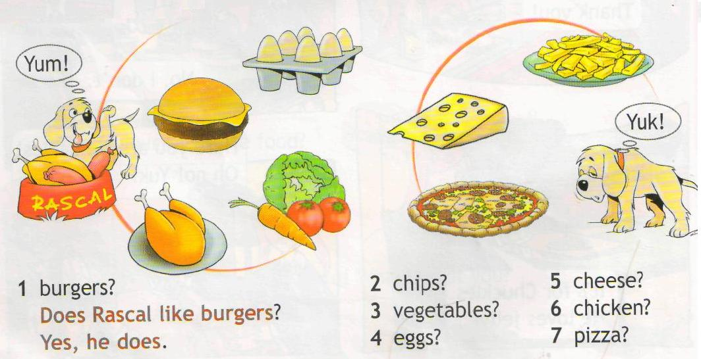
Look and answer

Slide 17
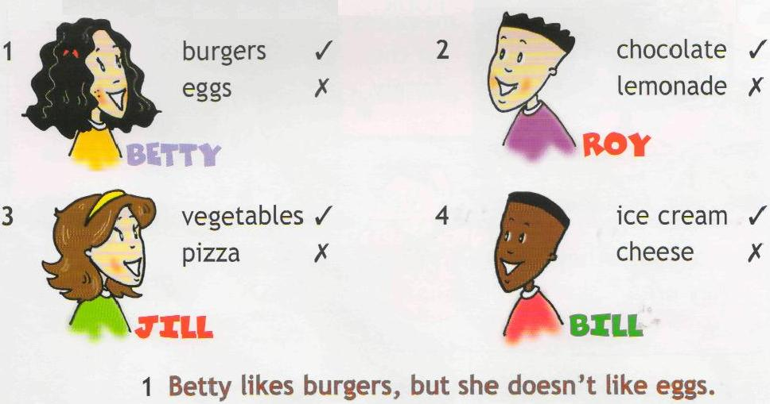
Look and make sentences

Slide 18
Read and choose
A We doesn’t like milk. B We don’t like milk.

Slide 19
Read and choose
B We don’t like milk.

Slide 20
Read and choose
B We don’t like milk.
A Does Sue likes potatoes? B Does Sue like potatoes?

Slide 21
Read and choose
B We don’t like milk.
B Does Sue like potatoes?

Slide 22
Read and choose
B We don’t like milk.
B Does Sue like potatoes?
A I like chips. B I likes chips.

Slide 23
Read and choose
B We don’t like milk.
B Does Sue like potatoes?
A I like chips.

Slide 24
Read and choose
B We don’t like milk.
B Does Sue like potatoes?
A I like chips.
A Peter, does you like rice? B Peter, do you like rice?

Slide 25
Read and choose
B We don’t like milk.
B Does Sue like potatoes?
A I like chips.
B Peter, do you like rice?

Slide 26
Some or Any?
We use some in the plural in the affirmative.
There are some flowers in the vase.
We use any in the plural in the negative and interrogative.
There are not any flowers in the vase
Are there any flowers in the vase?

Slide 27
Read and complete. Use: some or any
1 She's got ... biscuits.
2 They haven't got ... orange juice
3 Have they got ... pasta?
4 He's got ... popcorn.
5 We haven't got ... Coke.
6 Have you got ... milk?
7 They've got ... cake.
8 I haven't got ... rice.

Slide 28
Read and complete. Use: some or any
1 She's got some biscuits.
2 They haven't got ... orange juice
3 Have they got ... pasta?
4 He's got ... popcorn.
5 We haven't got ... Coke.
6 Have you got ... milk?
7 They've got ... cake.
8 I haven't got ... rice.

Slide 29
Read and complete. Use: some or any
1 She's got some biscuits.
2 They haven't got any orange juice
3 Have they got ... pasta?
4 He's got ... popcorn.
5 We haven't got ... Coke.
6 Have you got ... milk?
7 They've got ... cake.
8 I haven't got ... rice.

Slide 30
Read and complete. Use: some or any
1 She's got some biscuits.
2 They haven't got any orange juice
3 Have they got any pasta?
4 He's got ... popcorn.
5 We haven't got ... Coke.
6 Have you got ... milk?
7 They've got ... cake.
8 I haven't got ... rice.

Slide 31
Read and complete. Use: some or any
1 She's got some biscuits.
2 They haven't got any orange juice
3 Have they got any pasta?
4 He's got some popcorn.
5 We haven't got ... Coke.
6 Have you got ... milk?
7 They've got ... cake.
8 I haven't got ... rice.

Slide 32
Read and complete. Use: some or any
1 She's got some biscuits.
2 They haven't got any orange juice
3 Have they got any pasta?
4 He's got some popcorn.
5 We haven't got any Coke.
6 Have you got ... milk?
7 They've got ... cake.
8 I haven't got ... rice.

Slide 33
Read and complete. Use: some or any
1 She's got some biscuits.
2 They haven't got any orange juice
3 Have they got any pasta?
4 He's got some popcorn.
5 We haven't got any Coke.
6 Have you got any milk?
7 They've got ... cake.
8 I haven't got ... rice.

Slide 34
Read and complete. Use: some or any
1 She's got some biscuits.
2 They haven't got any orange juice
3 Have they got any pasta?
4 He's got some popcorn.
5 We haven't got any Coke.
6 Have you got any milk?
7 They've got some cake.
8 I haven't got … rice.

Slide 35
Read and complete. Use: some or any
1 She's got some biscuits.
2 They haven't got any orange juice
3 Have they got any pasta?
4 He's got some popcorn.
5 We haven't got any Coke.
6 Have you got any milk?
7 They've got some cake.
8 I haven't got any rice.

Slide 36

Read and put in the correct order.
-Chips, yum! What about you?
-What's your favourite food?
-My favourite food is pizza.

Slide 37
Read and put in the correct order.
-What’s your favourite food?
-Chips, yum! What about you?
-My favourite food is pizza.

Slide 38
Read and put in the correct order.
-Thank you!
-Here you are!
-Can I have some chicken, please?

Slide 39
Read and put in the correct order.
-Can I have some chicken, please?
-Here you are!
-Thank you!

Slide 40
Read and put in the correct order.
-Great! Let’s make a lemon pie.
-Have we got any lemons?
-Yes, there are some in the fruit basket.

Slide 41
Read and put in the correct order.
-Have we got any lemons?
-Yes, there are some in the fruit basket.
-Great! Let’s make a lemon pie.

Slide 42
Read and put in the correct order.
- Can I have some coffee, please?
- Sorry, there isn’t any coffee left. Would you like a cup of tea?
- Yes please.

Slide 43
Read and put in the correct order.
- Yes please.
- Sorry, there isn’t any coffee left. Would you like a cup of tea?
- Can I have some coffee, please?

Slide 44
Text
Russian people like tea. English people like tea, too. They drink a lot of tea. They have tea for breakfast, lunch, dinner and supper.
English people drink tea out of the cups, not out of glasses. English people like to have tea with milk, not with lemon. They call tea with lemon “Russian tea”.

Slide 45
Questions
Do you like tea?
Do you like it with milk or with lemon?
Do you like “English tea” or “Russian tea”?

Slide 46
Meals
Meal | Food | Drink | Fruits & Vegetables
Tomato
Tea
Milk
Potato
Meat
Cabbage
Fish
Eggs
Cheese
Carrot

Slide 47
Meals
Meal | Food | Drink | Fruits & Vegetables
Tomato |  |  | \/
Tea |  | \/
Milk |  | \/
Potato |  |  | \/
Meat | \/
Cabbage |  |  | \/
Fish | \/
Eggs | \/
Cheese | \/
Carrot |  |  | \/

Slide 48
Read and choose
1 We haven't got some/any eggs.

Slide 49
Read and choose
1 We haven't got any eggs.

Slide 50
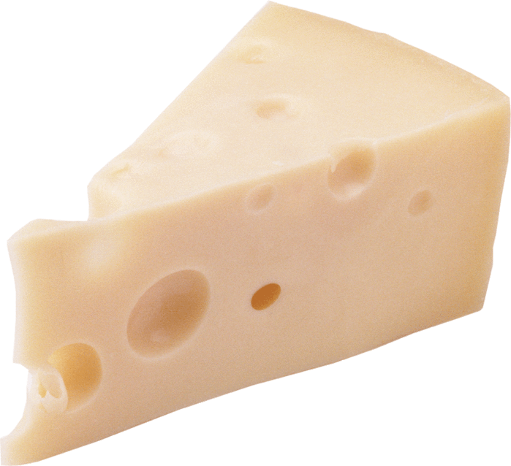
Read and choose
1 We haven't got any eggs.
2 Have you got some/any cheese?

Slide 51
Read and choose
1 We haven't got any eggs.
2 Have you got any cheese?

Slide 52
Read and choose
1 We haven't got any eggs.
2 Have you got any cheese?
3 Сan I have some/any meat?

Slide 53
Read and choose
1 We haven't got any eggs.
2 Have you got any cheese?
3 Сan I have some meat?

Slide 54
Read and choose
1 We haven't got any eggs.
2 Have you got any cheese?
3 Сan I have some meat?
4 I haven't got some/any cake.

Slide 55
Read and choose
1 We haven't got any eggs.
2 Have you got any cheese?
3 Сan I have some meat?
4 I haven't got any cake.

Slide 56
Read and choose
1 We haven't got any eggs.
2 Have you got any cheese?
3 Сan I have some meat?
4 I haven't got any cake.
5 We’ve got some/any burgers.

Slide 57
Read and choose
1 We haven't got any eggs.
2 Have you got any cheese?
3 Сan I have some meat?
4 I haven't got any cake.
5 We’ve got some burgers.

Slide 58
Song
Yummy, yummy, chocolate,
That’s what I like!
Chocolate on a biscuit,
Chocolate on a cake!
I don’t like eggs,
And I don’t like cheese!
But yummy, yummy, chocolate,
Ooh, yes, please!

Slide 59
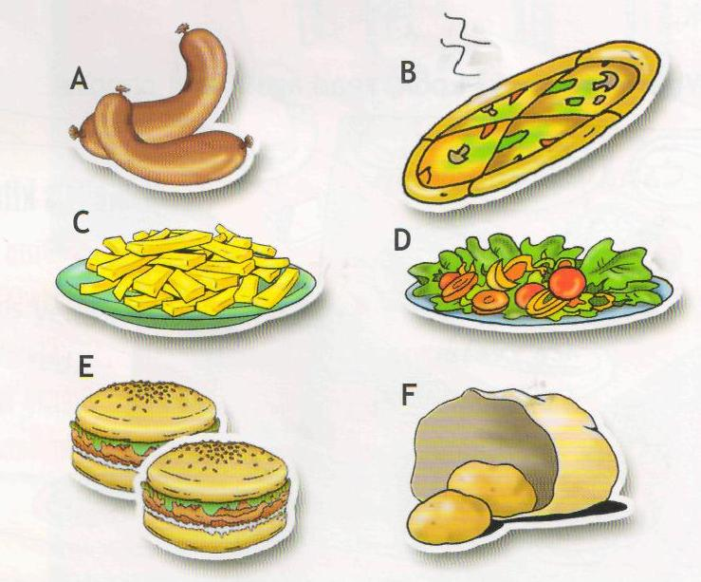
Listen and answer
What are Danielle’s friends having for lunch?
Kate
Winny
Jake
Grant
Judy

