Slide 1
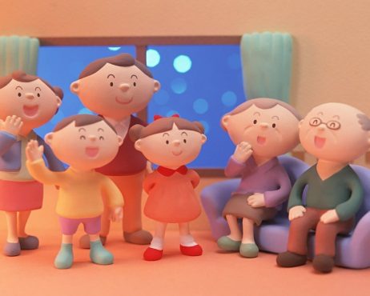
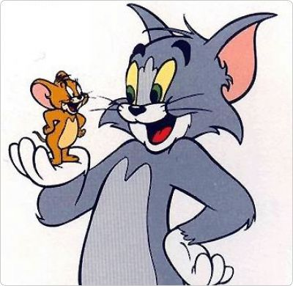
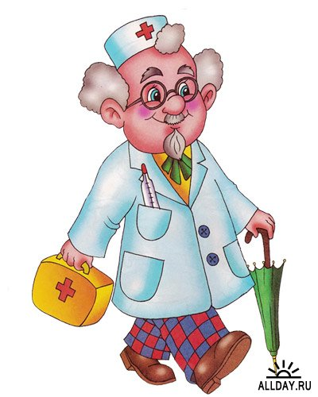
«The World Around Us »
«What is a family?»
«Amazing creatures»
«Yummy! Yuk!»
«Jobs»

Slide 2
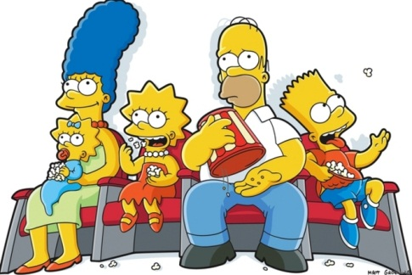
«What is a family?»
"The Simpsons" is a very popular TV show all over the world. It`s about a funny cartoon family from Springfield, USA.
There are five members in their family : Homer, Marge, Bart, Lisa and Maggie.
Homer Simpson is the father of the family. He is 39 and he likes eating and drinking very much.
Marge Simpson is the mother of the family. She is 38 and she is very kind. Her hair is blue. She can cook well.
Bart Simpson is 10 and he is naughty and noisy. He likes comics and skateboarding. He can speak French.
Lisa Simpson is 8 years old. She is very clever. She can sing, play the saxophone and speak Swedish.
Maggie Simpson is a baby. She can`t walk and talk, but she can play the saxophone as Lisa. She is friendly and clever.

Slide 3
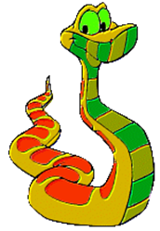
«Amazing Creatures»
Read the riddle and guess the animal.
1) I can catch a frog,
I can sleep like a log.
I can find your sock!
I am a .......!
2) I can lie on the mat,
I can catch a rat.
I am black, I am fat!
I am a .....!
3) This animal can live in a house. It likes cheese. It`s grey.
4)It lives in Africa. It has got a long neck. It likes to eat grass and leaves. It`s yellow and brown.
5)It lives in the rivers. It has got a long body and tail. It has got terrible teeth. It`s green.

Slide 4
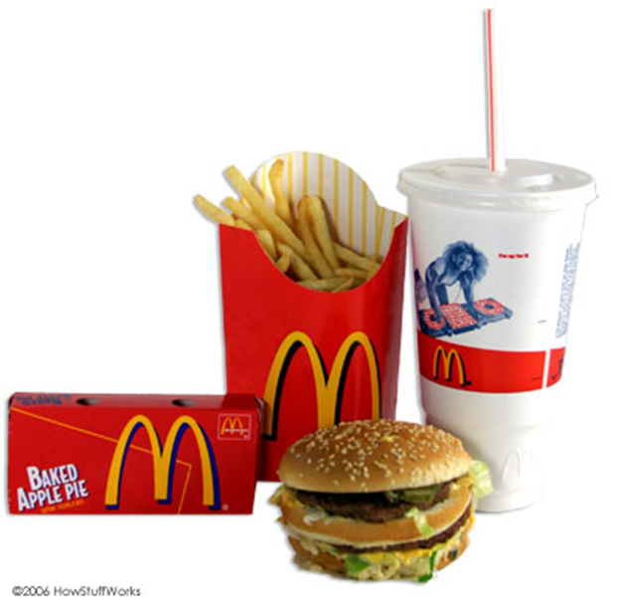
«Healthy or unhealthy?»
lemons, chips, carrots, burgers, mangoes, cabbage, sandwiches,
soup, biscuits, chocolate,

Slide 5
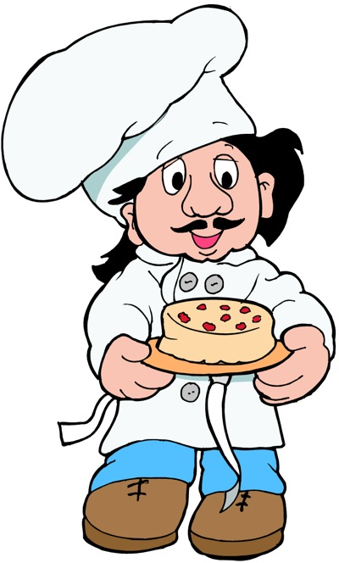
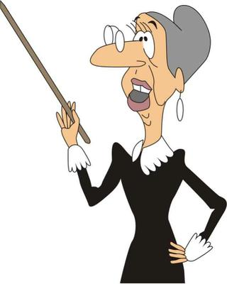
«Jobs»

Slide 6
Read and match. Then say.
1) Farmer garage serve people
2) Baker post office fix cars
3) Teacher farm bake bread
4) Mechanic cafe teach students
5) Postman baker`s take letters to people
6) Waiter school grow vegetables

Slide 7
Good luck!

