Slide 1
We see, hear, speak, do and all will be OK!

Slide 2
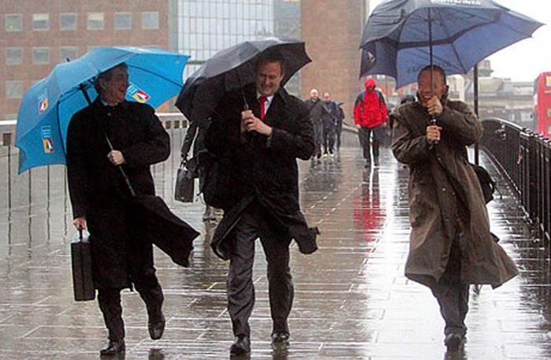
What is the weather like in Britain?

Slide 3
[k]
cold
cloudy
cool

Slide 4
[t]
frosty
hot
stormy

Slide 5
[f]
frosty
foggy

Slide 6
[w]
warm
windy

Slide 7
[ɒ]
frosty
foggy
hot

Slide 8
Hot
It’s hot.

Slide 9
Cold
It’s cold.

Slide 10
Snowy
It’s snowy.

Slide 11
Sunny
It’s sunny.

Slide 12
Windy
It’s windy.

Slide 13
Rainy
It’s rainy.

Slide 14
Stormy
It’s stormy.

Slide 15
Cloudy
It’s cloudy.

Slide 16
Foggy
It’s foggy.

Slide 17
I like summer because
it is sunny.
I like… because
it is…

Slide 18
Read the text and answer the question
1: What is the weather like in winter?
2: What is the weather like in spring?
3: What is the weather like in summer?
4: What is the weather like in autumn?

Slide 19
What is the weather like in your region?
In winter it’s…
In spring it’s…
In summer it’s…
In autumn it’s…

Slide 20
What is the winter like in Scotland? What is the winter like in England?

Slide 21
Match the weather symbols to the words

Slide 22
Check each other
1 | Sunny | 4 | Hot | 7 | Windy
2 | Rainy | 5 | Cold | 8 | Snowy
3 | Cloudy | 6 | Warm | 9 | Stormy

Slide 23
Home task
AB ex. 2, p.63

Slide 24
Choose the drawing that reflects your spirits

