Slide 1
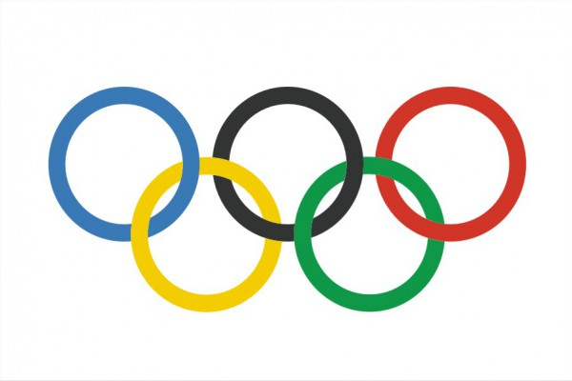
\
The Olympic Flag

Slide 7
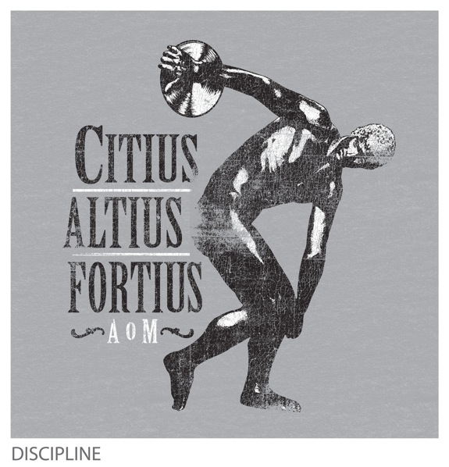
The Olympic MOTTO

Slide 8
Beginning in 776 BC, the Olympic Games were held in the Valley of Olympia in Greece

Slide 9
They were dedicated to the Olympian Gods and took place every four years. Sportsmen competed in running, wrestling, jumping, throwing the discus and throwing the javelin. In time boxing, a chariot race, and other events were included.

Slide 11
Baron Pierre de Coubertin is the organizer of the Modern Olympic Games.
The Modern Olympic Games took place in Greece in 1896. Almost 300 athletes from 13 countries participated in 9 different sports.

Slide 12
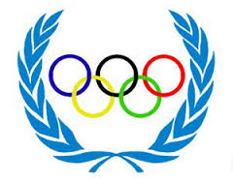
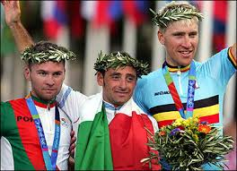
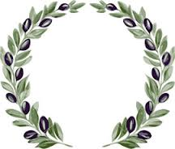
The victors of the early games were awarded with wreaths from the olive tree that was planted by Hercules
( Heracles), founder of the Games.

Slide 13
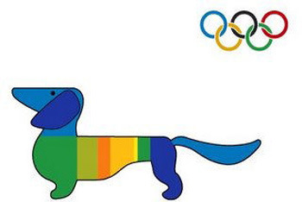
Olympic Mascots
First it appeared at the 1972 Munich Olympic Games. It was Waldi, the dachshund. Since that time it has been one of the symbols of the Olympics. It shows the geographical features, history and culture of the host city.

Slide 14
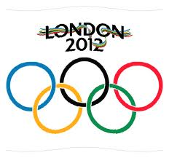
The latest 30-th Olympic Games took place in London in 2012. Athletes from 204 countries competed in 37 different sports.

Slide 15
