Slide 1
Primary Schools in Great Britain and in Russia

Slide 2
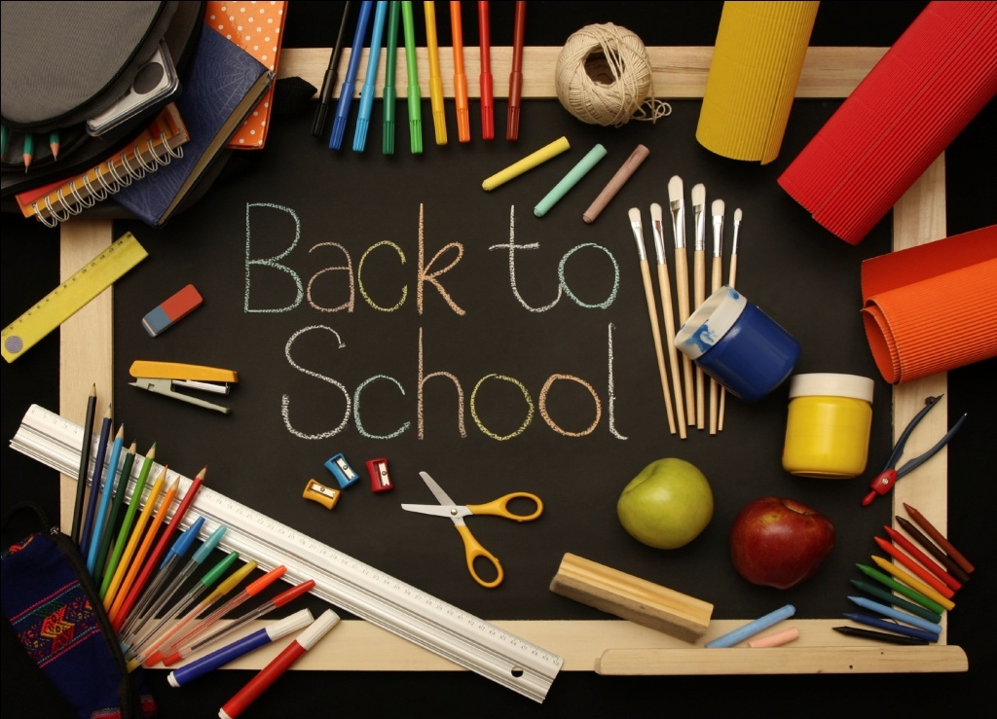
In Great Britain school begins at the age of four or five . In Russia school usually begins at the age of 7. Many boys and girls usually leave school at the age of sixteen.
In England and in Russia the school year begins in September, but in England it does not always begin on the first day of month, as school rarely begins on Monday.
The English think that Monday is not a good day to start school. So pupils usually begin their school year on the first Tuesday of September (not always on the 1st of September as we do).

Slide 3
The weather is usually fine. It’s warm. The sky is often blue and the sun is bright. Little children go to school with their parents on their first school day. They don’t have any bags or books with them, as there is no need for these things on their first day at school. Pupils will get them later. They will get exercise books, pencils, pens, rulers and rubbers too.

Slide 4
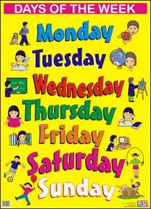
English children have classes five days a week, as well as children in Russia. They have classes on Monday, Tuesday, Wednesday, Thursday and Friday. Classes are usually over at about three o’clock and the pupils go home. They rarely have classes on Saturday and on Sunday. Saturdays and Sundays are their days off.

Slide 5
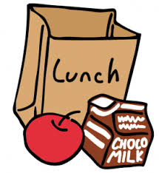
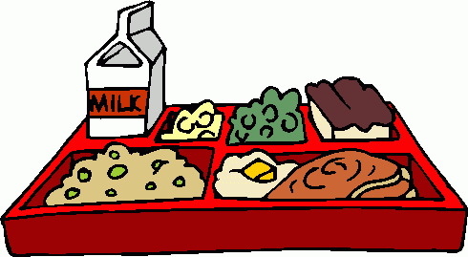
In both countries (in England
and in Russia) classes usually
begin at nine. Pupils have a break
at 10.30 and may have a drink of
milk or orange juice. At half past twelve or at one o’clock they usually have lunch – meat, pudding, juice, an apple or a cake.

Slide 6
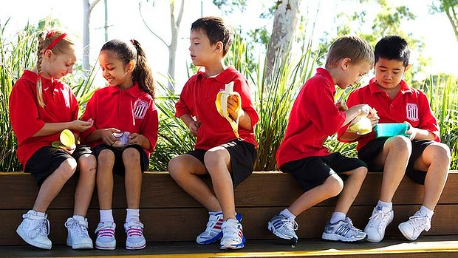
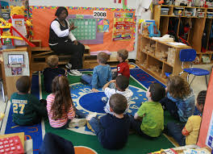
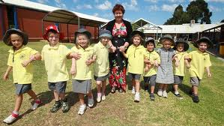
After lessons teachers usually read fairy tales and stories to them or sometimes they tell them something interesting.
English and Russian pupils often play outdoors.

Slide 7
SCHOOL ROOMS:
Classroom ['klɑːsrum]
Gym [ʤim]
Computer room [kəm'pjuːtə ruːm]
Library ['laɪbr(ə)rɪ]
Canteen [kæn'tiːn]

Slide 8
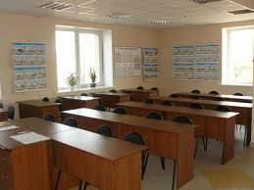
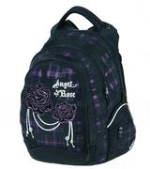
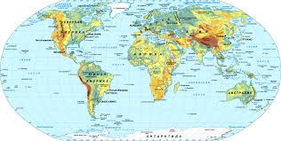
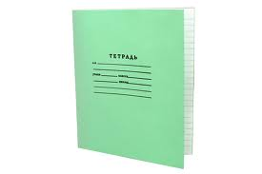
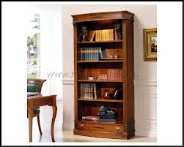
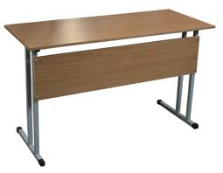
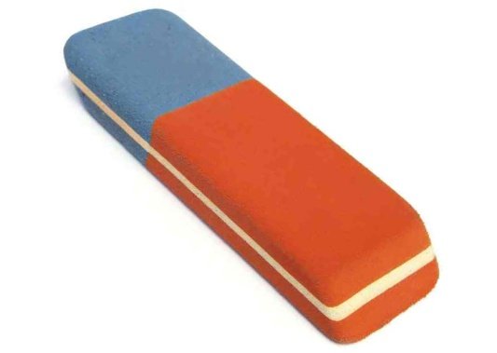
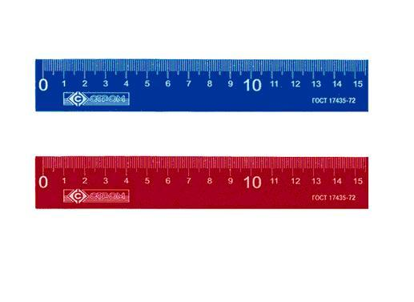
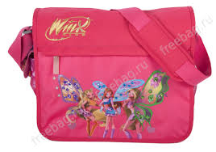
1.A RUBBER
2.AN EXERCISE BOOK
3.A CLASSROOM
4.A SCHOOLBAG
5.A RULER
6.A BLACKBOARD
7.A BOOKCASE
8.A MAP
9.A DESK
10.A PENCIL

Slide 9
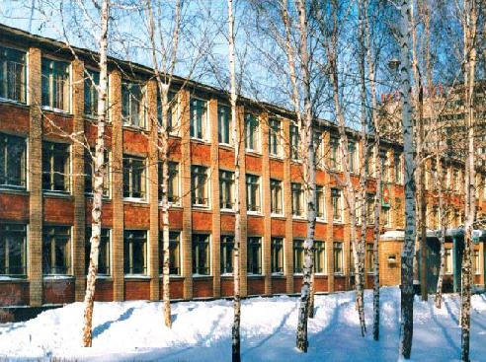
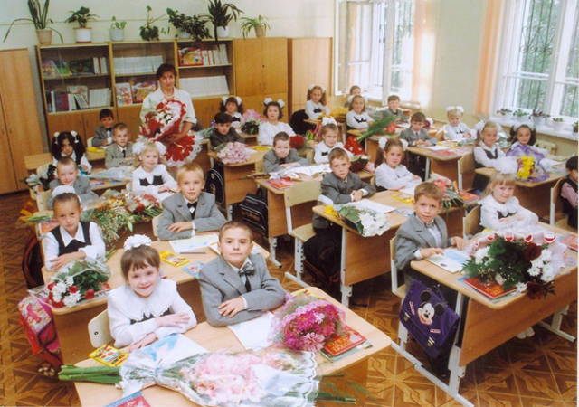
Children in Russia spend 4 years in
primary school. Most schools in Russia
have numbers, not names, and in some
schools students wear uniforms.

Slide 10
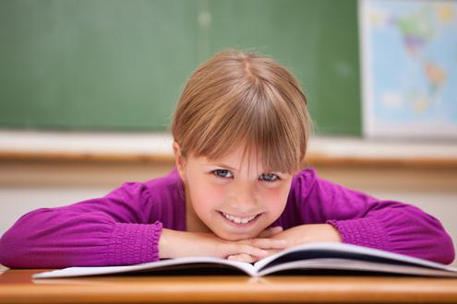
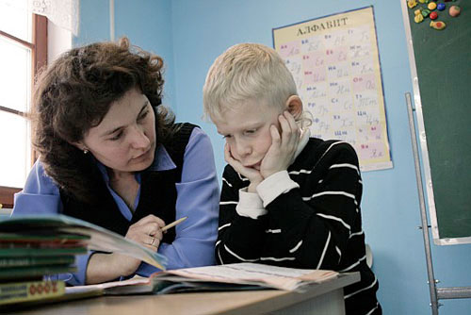
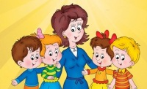
During the breaks the children play games and relax. After the lessons some students stay at school and do homework with their teachers because their parents are at work.

Slide 11
Every school has got classrooms, a gym, a computer room, a library and a canteen.
Students have 4-5 lessons a day and the subjects they have are: Russian, Maths, English, Geography, History, Computer Study, Art, Literature, Handicraft and PE.

Slide 12
A CLASSROOM the thing, at which pupils sit in
class
MATHS where you have most of your
lessons;
UNIFORM where you have your P.E. lesson
A GYM special clothes that you wear at
school
A DESK a thing we can draw with
A PENCIL a place where we keep books
A BOOKCASE a lesson where we study numbers

Slide 13
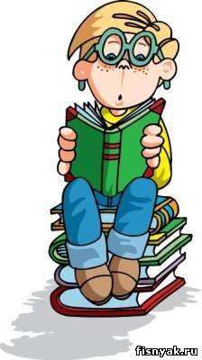
RUSSIAN ['rʌʃ(ə)n]
READING ['riːdɪŋ]
MATHS [mæθs]
ENGLISH ['ɪŋglɪʃ]
NATURE STUDY ['neɪʧə 'stʌdɪ]
COMPUTER STUDY [kəm'pjuːtə 'stʌdɪ]
ART [ɑːt]
HANDICRAFT ['hændɪkrɑːft]
PE[piːi:]

Slide 14
L | I | T | E | R | A | T | U | R | E
G | E | O | G | R | A | P | M | R | O
F | N | E | A | U | P | D | U | T | R
T | G | M | A | T | H | S | S | H | U
L | L | I | R | F | E | Y | I | R | S
B | I | O | T | O | G | Y | C | D | S
O | S | D | A | U | V | E | A | L | I
K | H | I | S | T | O | R | Y | W | A
H | I | S | M | E | R | T | I | T | N
G | E | O | G | R | A | P | H | Y | I

Slide 15
L | I | T | E | R | A | T | U | R | E
G | E | O | G | R | A | P | M | R | O
F | N | E | A | U | P | D | U | T | R
T | G | M | A | T | H | S | S | H | U
L | L | I | R | F | E | Y | I | R | S
B | I | O | T | O | G | Y | C | D | S
O | S | D | A | U | V | E | A | L | I
K | H | I | S | T | O | R | Y | W | A
H | I | S | M | E | R | T | I | T | N
G | E | O | G | R | A | P | H | Y | I

Slide 16
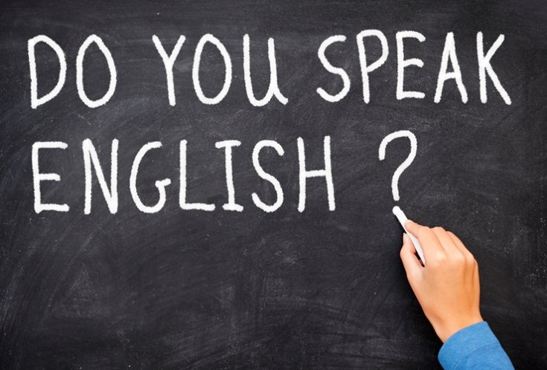
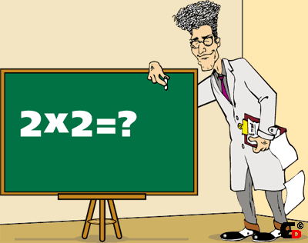
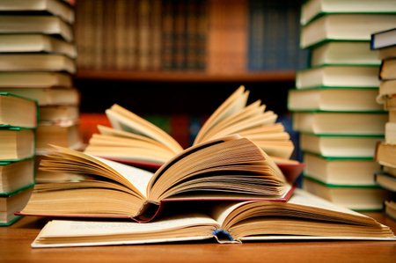
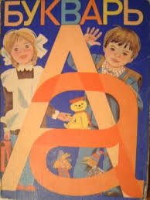
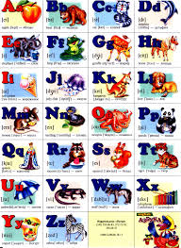
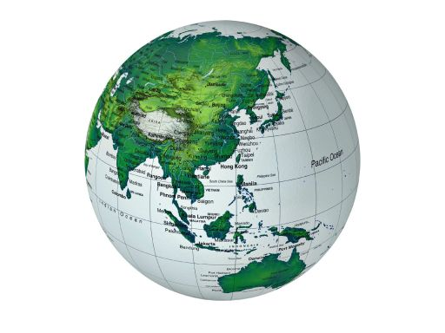
WHAT SUBJECT IS THIS?

Slide 17
Put the verbs in brackets into the PAST SIMPLE
We didn’t have our English class yesterday, as Mrs Larson ___(be) ill. So I____(come) home earlier than usual and ____(have) a lot of time before swimming. My mother ____(ask) me to go shopping with her, so we ____(go) to our favourite shop and ____(buy) a lot of tasty things for my brother’s birthday party.

Slide 18
HOMEWORK Answer the questions:
1. What’s you favourite subject at school? 2. Do you have many friends at school? 3. Do you work hard at school? 4. Do you like your school? 5. Is you school big or small?

