Slide 1
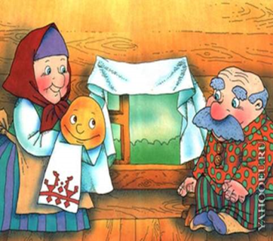
Fairy Tales
The Bun

Slide 2
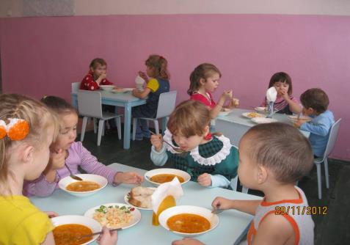

Slide 3
Complete the sentences
My cat likes to eat …
We … at two.
Tom wants to have fish …
Brother Fox is …

Slide 4
Complete the sentences
My cat likes to eat fish.
We have dinner at two.
Tom wants to have fish for dinner.
Brother Fox is silly.

Slide 5
Brother Fox sees Brother Rabbit in the well.
Brother Fox wants to have fish for dinner.
Brother Fox jumps into the bucket.
The bucket with Brother Fox in it goes down.
The bucket with Brother Rabbit comes up.
Brother Rabbit runs away.

Slide 6
Good advice

Slide 7
Home task
Ex.10 p. 78 learn by heart
Ex. 3 p. 75 (w)
Ex. 6 p. 75 r/tr.

Slide 8
Thank you for the lesson

