Slide 1
Let`s compare different things!
Презентация к открытому
уроку по английскому языку в 4 классе по теме
«Степени сравнения прилагательных»
Учитель Бустаева Эльмира Дамировна
МОУ «Житнинская СОШ»

Slide 2
Big
Long
Tall
Fast
Clean
Funny
Beautiful
Warm
fat
Small
Short
Low
Slow
Dirty
Sad
Ugly
Cold
slim

Slide 3
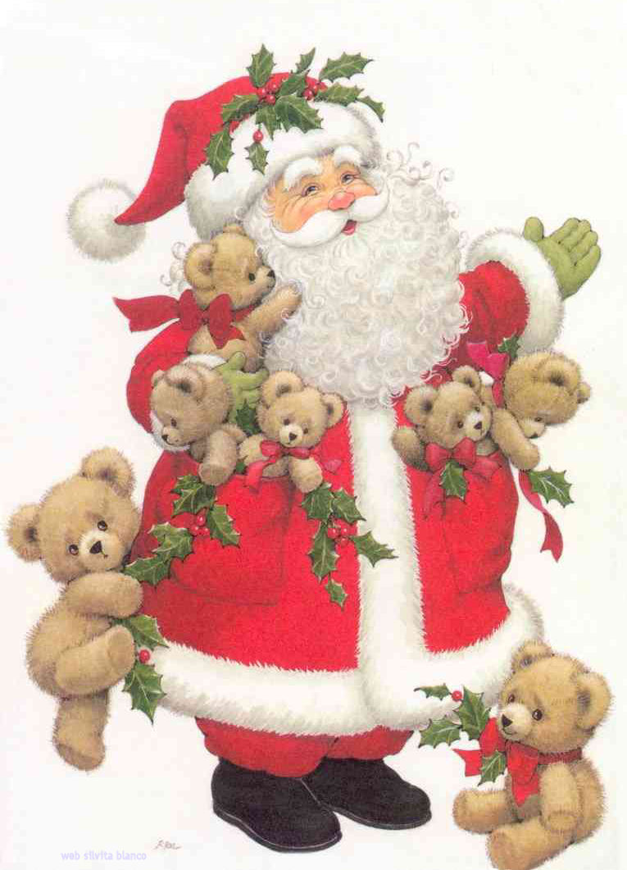
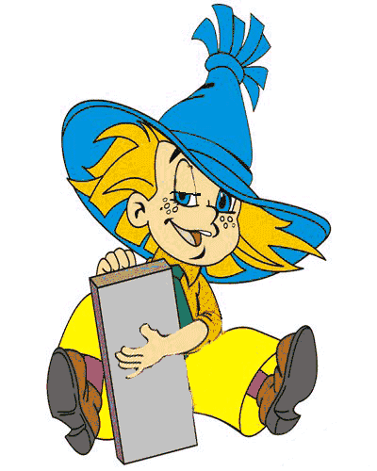
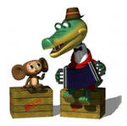
What are
they?

Slide 4
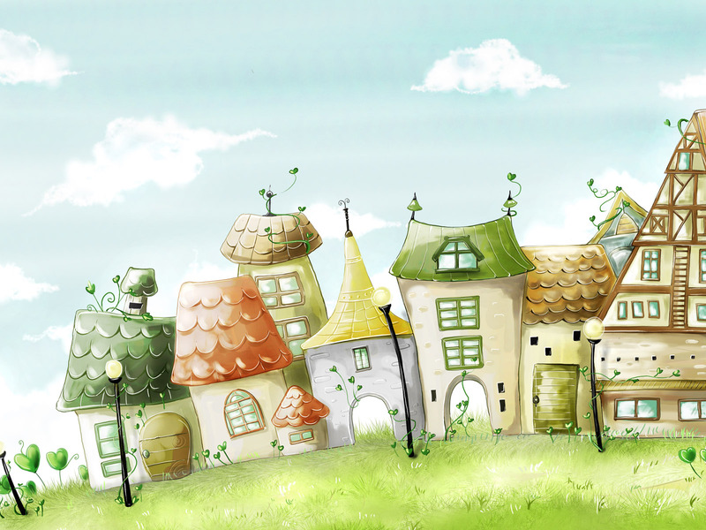
beautiful
cold
big
warm
long

Slide 5
The
most
more
-est
-er

Slide 6
положительная | сравнительная | превосходная
cold | colder | The coldest
warm | warmer | The warmest
long | longer | The longest
big | bigger | The biggest
beautiful | More beautiful | The most beautiful
funny | funnier | The funniest
high | higher | The highest

Slide 7
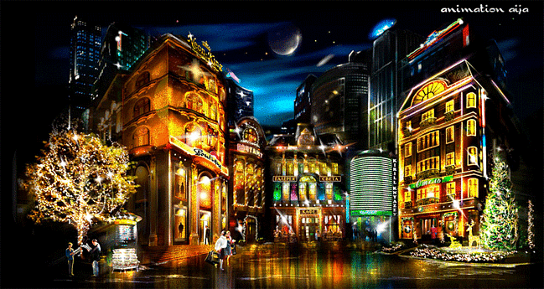
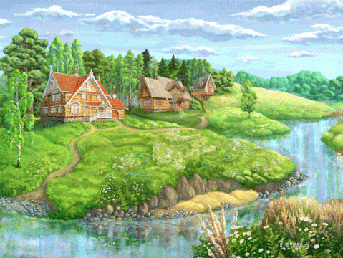
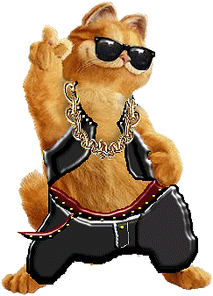
The city
The country
What is the nicest?

Slide 8
nice
high
clean
In the city the houses are
higher.
But in the country the houses are
nicer.
cleaner
The country is than the city.

Slide 9
“Yes” or “No” ?
Moscow is warmer than Africa.
Elephants are bigger than dogs.
February is the longest month of the year.
A mouse is smaller than a rabbit.
Carabas- Barabas is funnier than Buratino.
Baba-Yaga is the most beautiful.

Slide 10
The game
“A boaster”

Slide 11
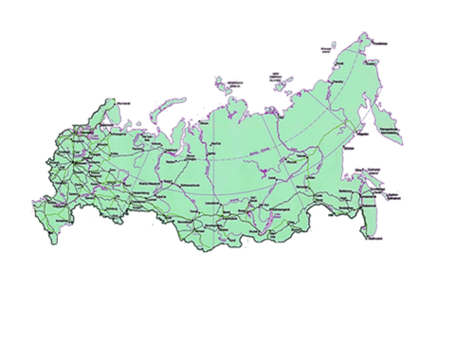
We all live in
the Russian Federation.

Slide 12
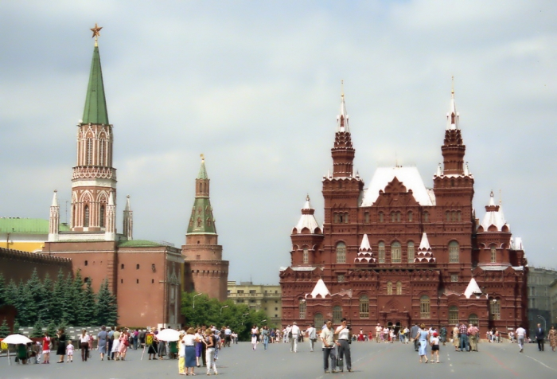
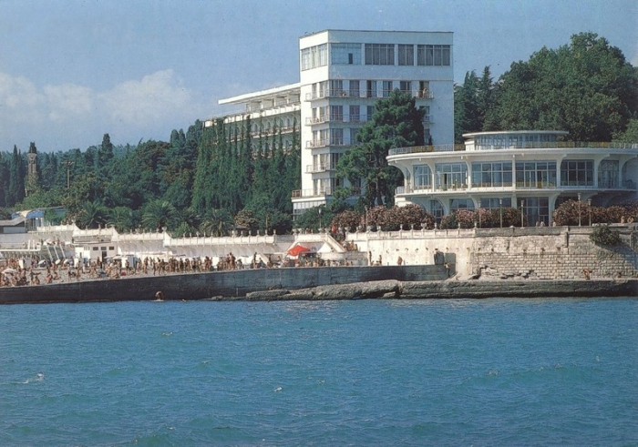
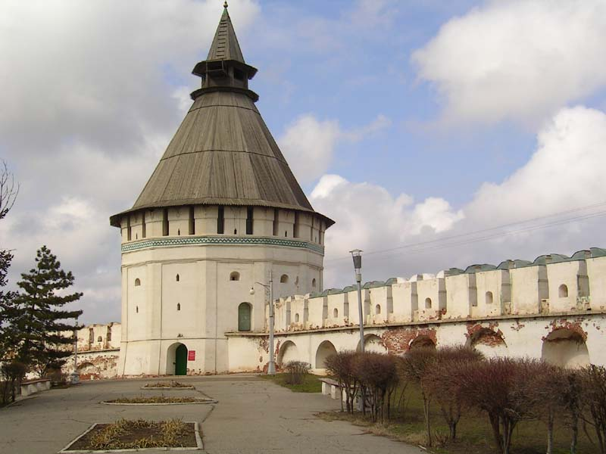
Moscow
Sochi
Astrakhan

Slide 13
Moscow
Sochi
Astrakhan
The coldest winter is in
The warmest winter is in
The hottest summer is in
The coldest summer is in
Moscow.
Sochi.
Astrakhan.
Moscow.

Slide 14
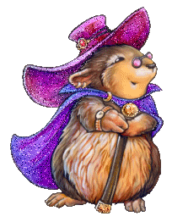
You are the nicest.
You are the cleverest.
Good luck!

