Slide 1
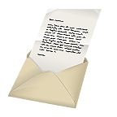
Dear friends,
My name is Mike. I am 10 years old. I am a boy.
I live in London.
My favourite pets are cats and fish. My favourite colour is red.
My favourite season is winter. I want to be your pen friend!
Mike.

Slide 2
a letter

Slide 3
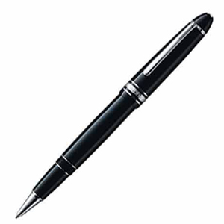
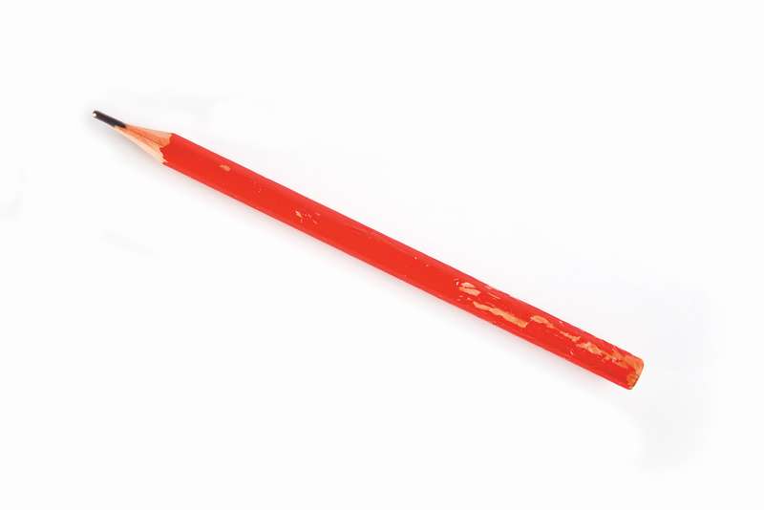
a pen

Slide 4
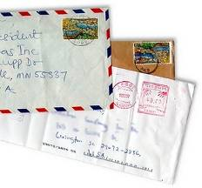
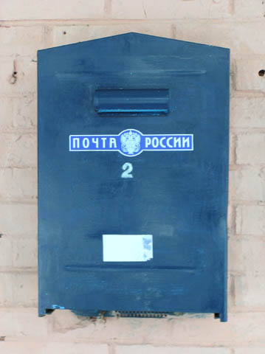
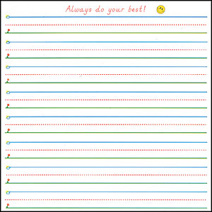
a letter-box

Slide 5
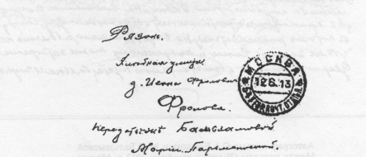
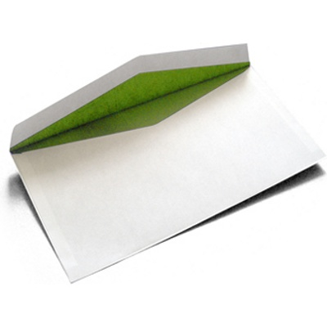
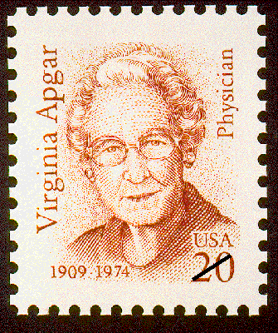
a stamp

Slide 6
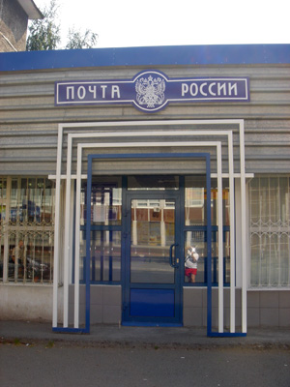
a postman

Slide 7
a postcard

Slide 8
paper

Slide 9
From: Dasha Petrova To: Jim Carry
5, Krasnaya Street 7, Oxford Street
Penza 458905 London W 13 NP
Russia Great Britain
an address

Slide 10
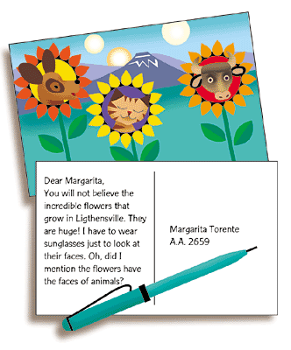
post office

Slide 11
Dear ______
Mike,
a boy
red
Nastya
My name is_________.
a girl
green
spring
I am________.
a girl
I am____years old.
9
cats
blue
summer
I live in__________.
Kamensk
dogs
yellow
autumn
My favourite pets are____
cats.
fish
brown
winter
My favourite colour is____
red.
My favourite season is_____
spring
parrots
white
Nastya.
________

Slide 12
What is your name?
How old are you?
Where do you live?
What are your favourite pets?
What is your favourite colour?
What is your favourite season?

Slide 13
From: ________ To:__________
________ __________
Nastya
Mike
Kamensk
London

