Slide 1
Поле чудес

Slide 2
It is funny, it is not big. It can jump and climb
m | o | n | k | e | y
No letter
a
b
c
d
e
f
g
h
i
j
k
l
m
n
o
p
q
r
s
t
u
v
w
x
y
z

Slide 3
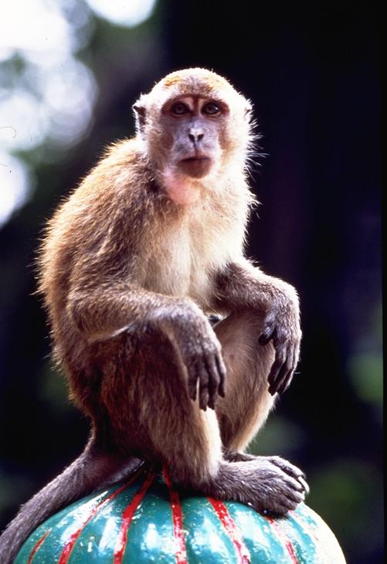

Slide 4
It is my profession
t | e | a | c | h | e | r
No letter
a
b
c
d
e
f
g
h
i
j
k
l
m
n
o
p
q
r
s
t
u
v
w
x
y
z

Slide 6
It is a colour
b | l | a | c | k
No letter
a
b
c
d
e
f
g
h
i
j
k
l
m
n
o
p
q
r
s
t
u
v
w
x
y
z

Slide 8
It is big. It is grey. It has a long nose.
e | l | e | p | h | a | n | t
No letter
a
b
c
d
e
f
g
h
i
j
k
l
m
n
o
p
q
r
s
t
u
v
w
x
y
z

Slide 10
Thank you for the game!

