Slide 1
spring summer
autumn winter

Slide 2
play good year
snowy month
long season swim
day sunny ride
week
go short make

Slide 3
day short play
week long go
month sunny make
year good swim
season snowy ride

Slide 4
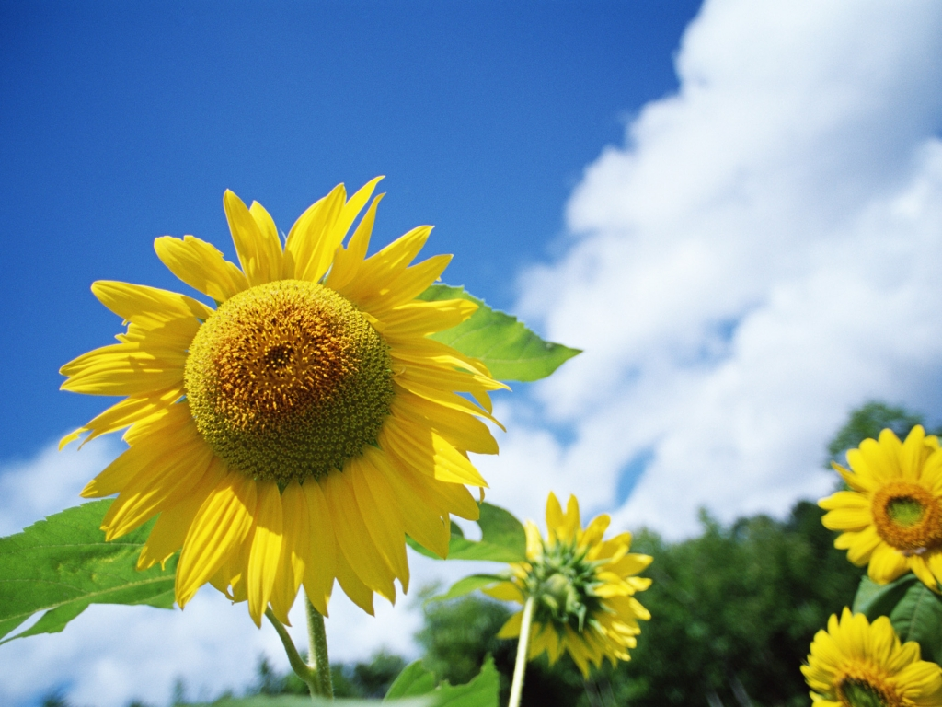
summer

Slide 5
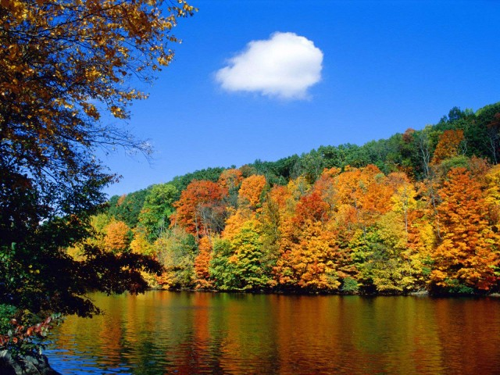
autumn

Slide 6
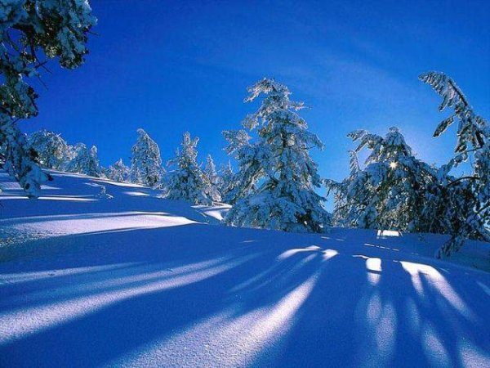
winter

Slide 7
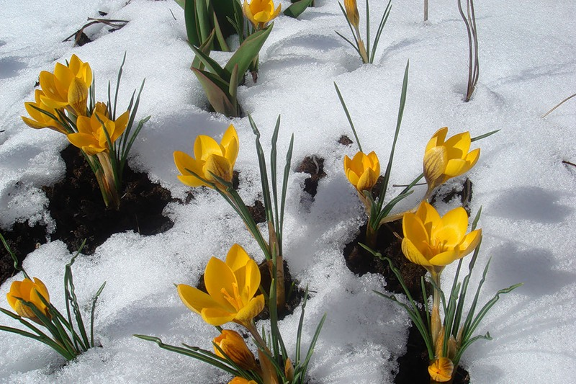
spring

Slide 8
spring summer
autumn winter

