Slide 1
HOLIDAYS
Creative team : Ivanova Julia,
Gamov Vitya,
Potemkina Anya,
Vorotilova Dasha.
Teachers : Kostyukova O.V.
Vinichenko L.N.

Slide 2
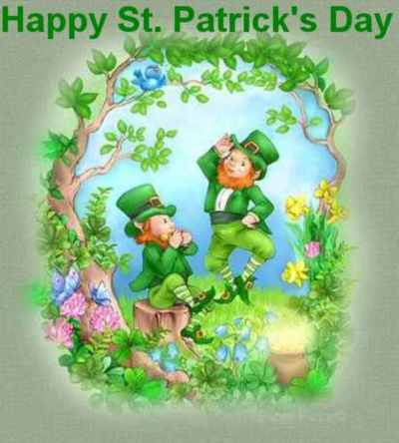
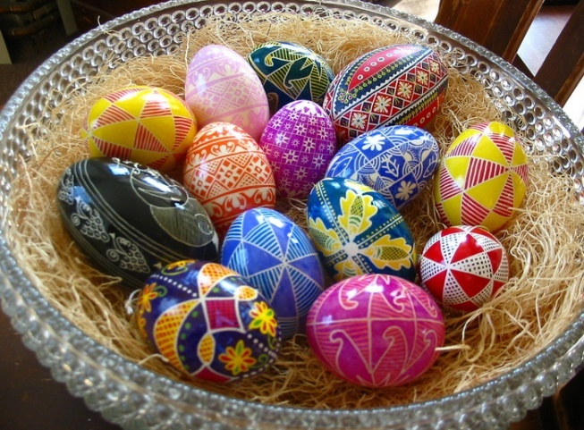
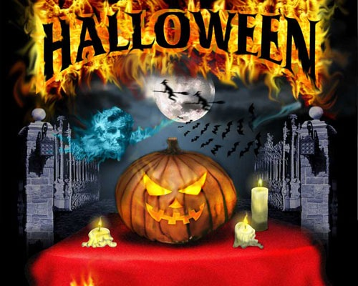
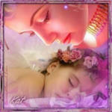
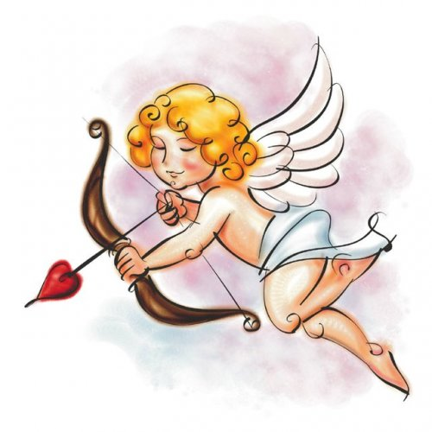
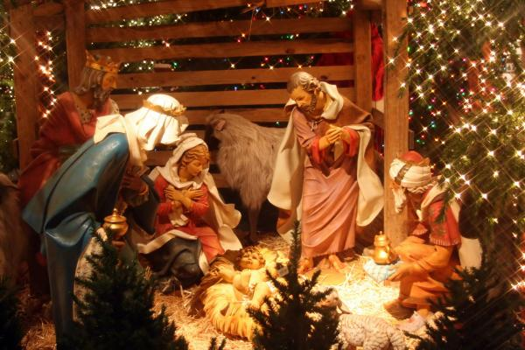
The aim of our project is to get the best knowledge of holidays in Great Britain.

Slide 3
Do you know about holidays in Great Britain?

Slide 4
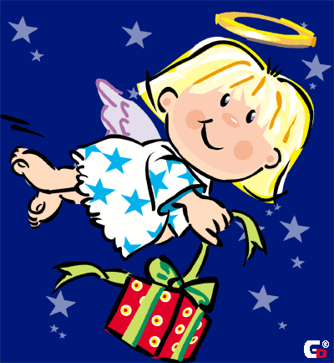
Christmas
On the 25th of December there is the greatest holiday – Christmas. People send X-mas cards to their friends and relatives.
They buy a Christmas tree and decorate it with toys, coloured balls and lights.
Children wake up early to find stockings full of small presents on their beds.

Slide 5
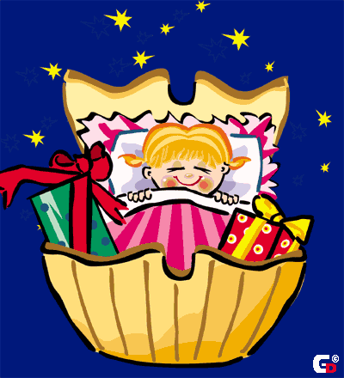
New Year
New Year’s Eve all British people celebrate on the 31st of December. Most people go to see their friends and relatives.
At midnight they sing New Year songs and wish a happy New Year to each other.

Slide 6
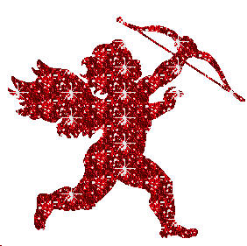
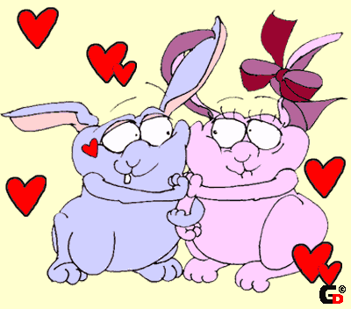
St. Valentine’s day
On the 14th of February there is St. Valentine’s Day. People send Valentine’s cards to someone they love. Usually they don’t sign them – you must guess who sent cards to you.

Slide 7
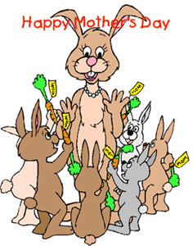
Mother’s day
In March there is a holiday for English women – Mother’s Day.
People in the family try to help them.
On that day they visit their mothers and give them presents and “A Mother’s Day Card”.

Slide 8
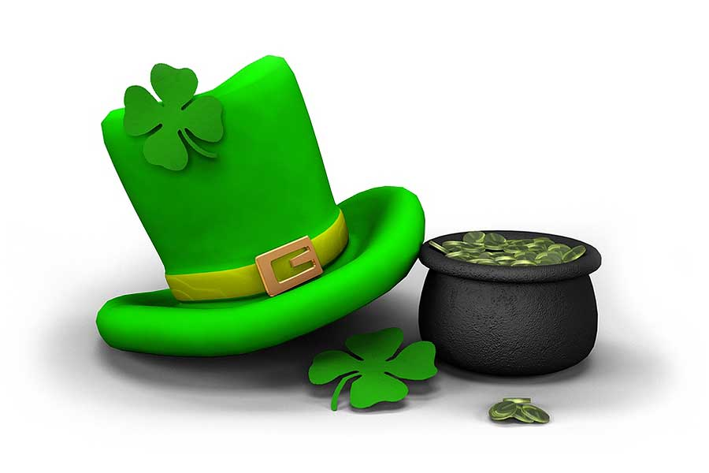
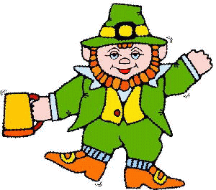
ST. PATRICK’S DAY
The 17th of March is a national holiday in Ireland – St. Patrick’s day. On that day people wear a shamrock. A shamrock is a plant with three or four leaves. It is the national symbol of Ireland.
St. Patrick was a man who had wonderful power. He cleared Ireland of snakes.

Slide 9
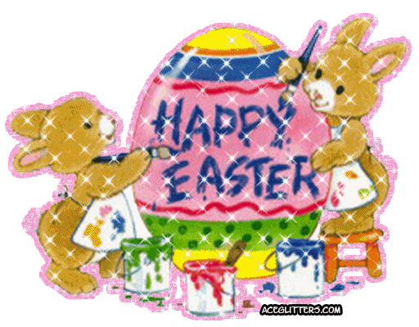
Easter
In April or at the end of March English people celebrate Easter Day.
On Easter Sunday children get chocolate eggs and rabbits.

Slide 10
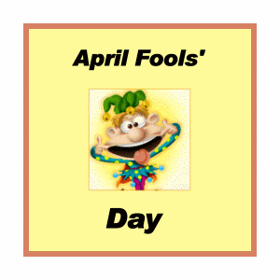
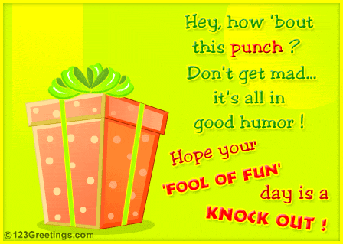
April Fool’s Day
April Fool’s Day is on the 1st of April. English children like this day very much. They play jokes and tricks on other people, even on teachers.

Slide 11
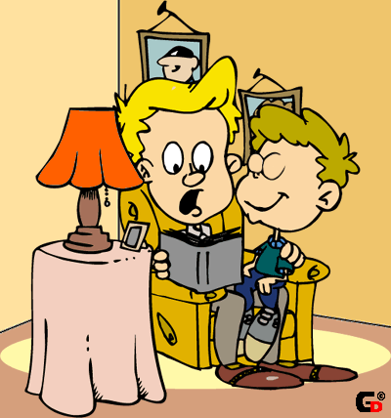
Father’s day
In June English people celebrate Father’s Day.
On that day children send cards and give presents to their fathers.

Slide 12
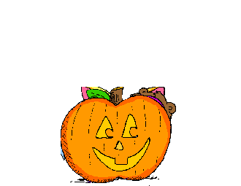
Halloween
On the 31st of October there is Halowe’en. The symbol of this holiday is "Jack o'lantern". People make it from a pumpkin.
Children like Haloween parties, they put on witch’s and ghost’s dresses. They go “trick or treat”.

Slide 13
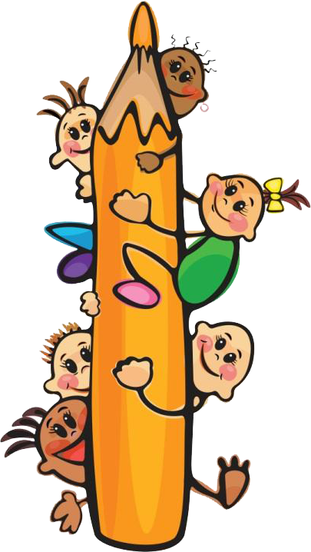
We have proved our hypothesis: “Children don’t know much about holidays in Great Britain.

Slide 14
Test yourself
Match holiday and its date.
Christmas
New Year
St. Valentine’s Day
Mother’s Day
St. Patrick’s Day
Easter
April Fool’s Day
Father’s Day
Halloween
On the 1-st of April
On the 31-st of October
On the 25 –th of December
In April or in March
On the 31-st of December
On the 17-th of March
In June
On the 14 –th of February
In March

Slide 15
THANK YOU

