Slide 1
Спектакль для родителей и детей «Fly’s Birthday Party» участники - ученики 3 класса
Подготовила и провела
Преподаватель
Шульгина Елена Викторовна

Slide 2
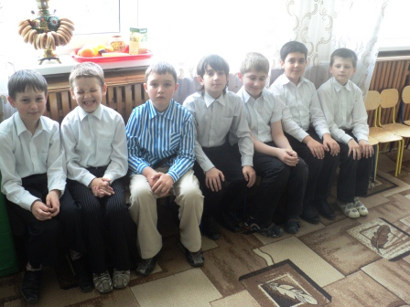
We are ready and happy…

Slide 3
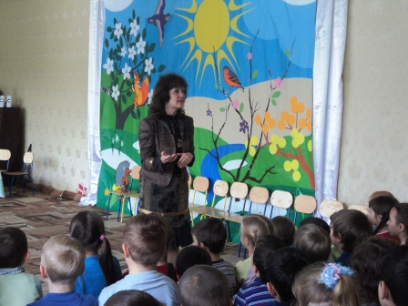
You are to answer some questions

Slide 4
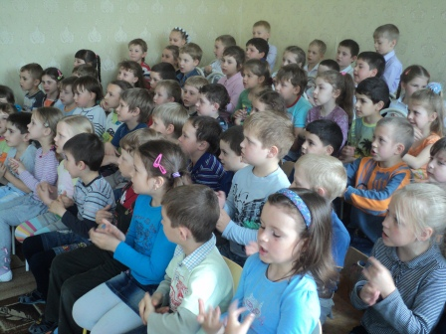
We always like to play…

Slide 5
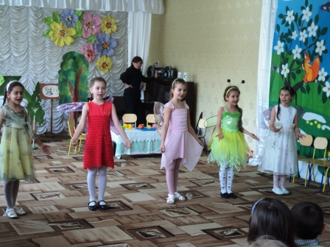
We are pretty flies

Slide 6
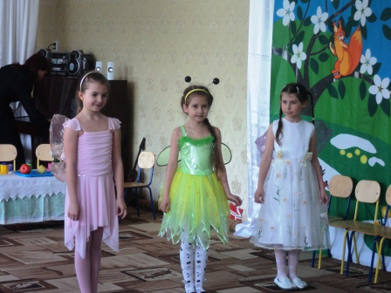
We will have our birthday tomorrow

Slide 7
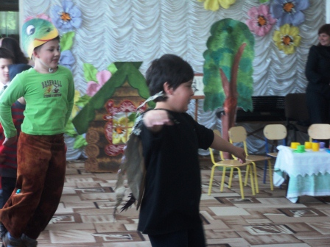
We can sing and dance

Slide 8
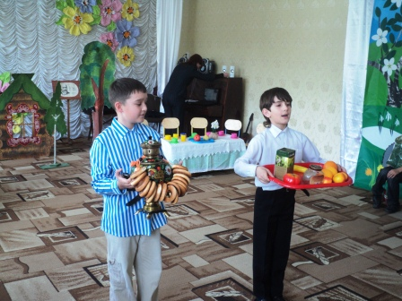
We are sales persons

Slide 9
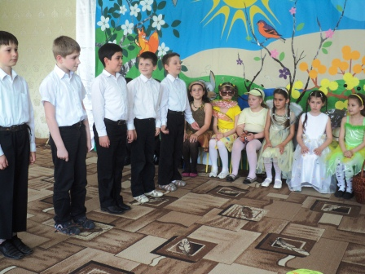
We are funny narrators

Slide 10
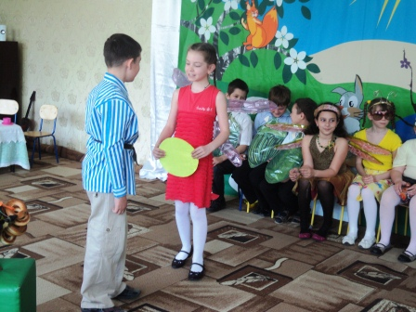
I would like a samovar

Slide 11
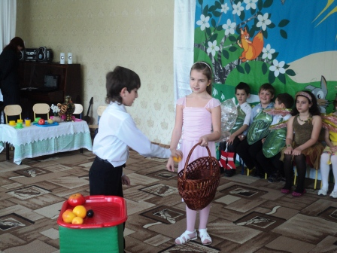
At the market

Slide 12
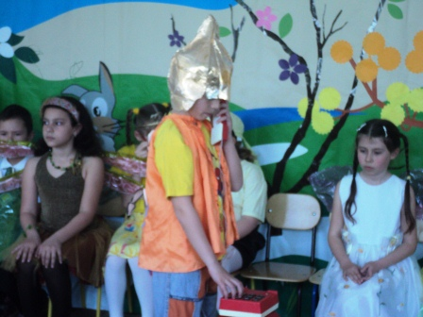
Ant likes to speak on the telephone

Slide 13
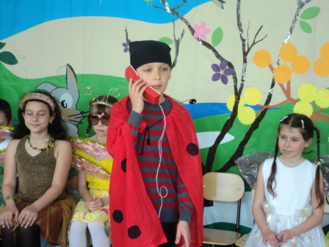
Lady Bug is very strict and serious

Slide 14
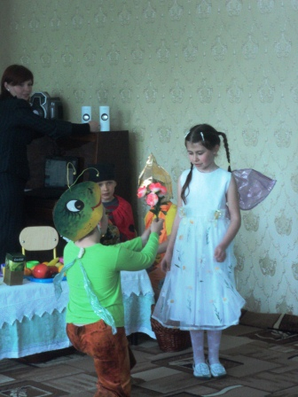
I love you… I congratulate you…Oh, my beauty!

Slide 15
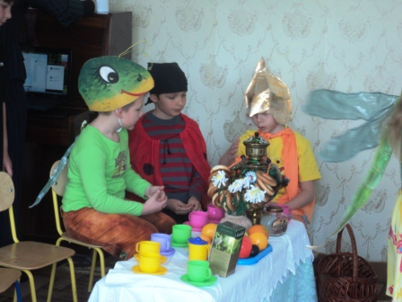
The first guests

Slide 16
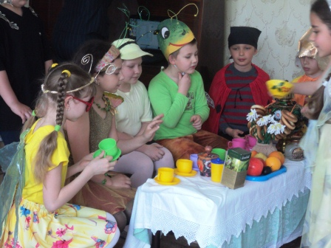
The food is very tasty!

Slide 17
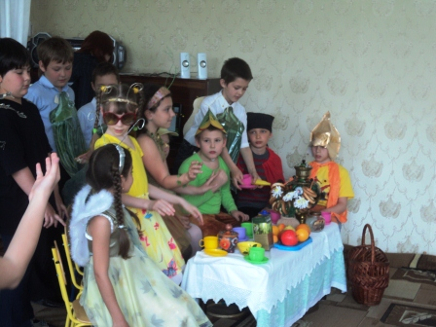
The visitors eat and talk

Slide 18
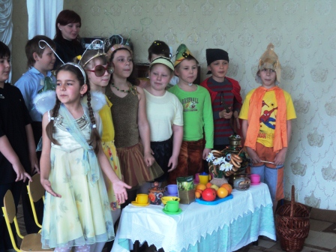
Dear butterfly, help yourself!

Slide 19
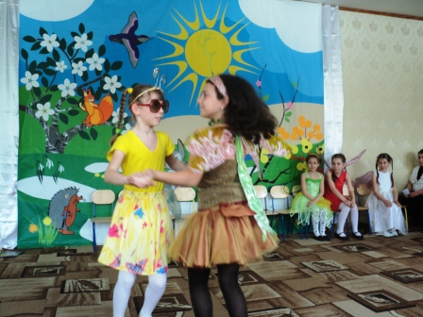
It’s a real surprise for all of us

Slide 20
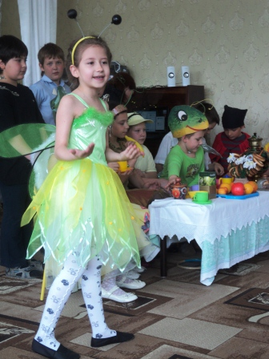
Dear friends! Let us sing! Let us dance!

Slide 21
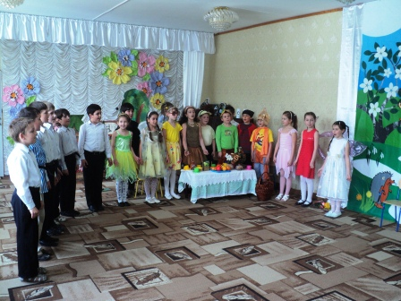
Мухи, мухи-цокотухи, именинницы!

Slide 22
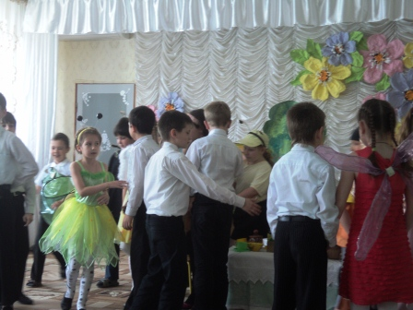
All of them like to dance very much

Slide 23
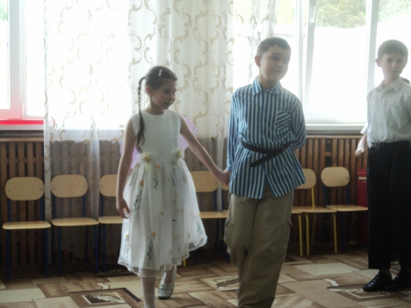
The fly and the shop assistant dance together

Slide 24
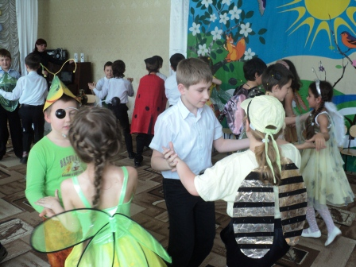
You can see everybody dancing merrily

Slide 25
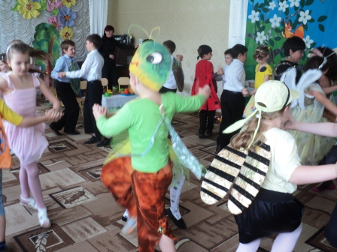
It’s a real pleasure to see the children dancing

Slide 26
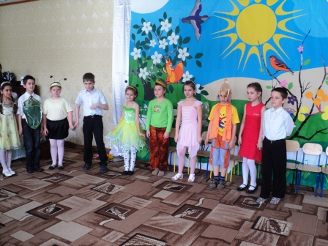
The merry song about friendship

Slide 27
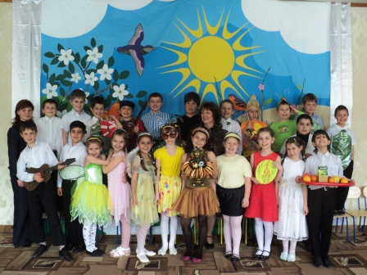
These are our artists, the pupils of the 4th form.

Slide 28
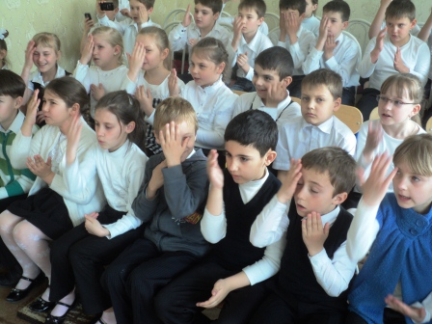
The spectators are active partakers of the fairy-tale

