Slide 1
Seasons and the weather

Slide 2
There are four seasons in the year.

Slide 3
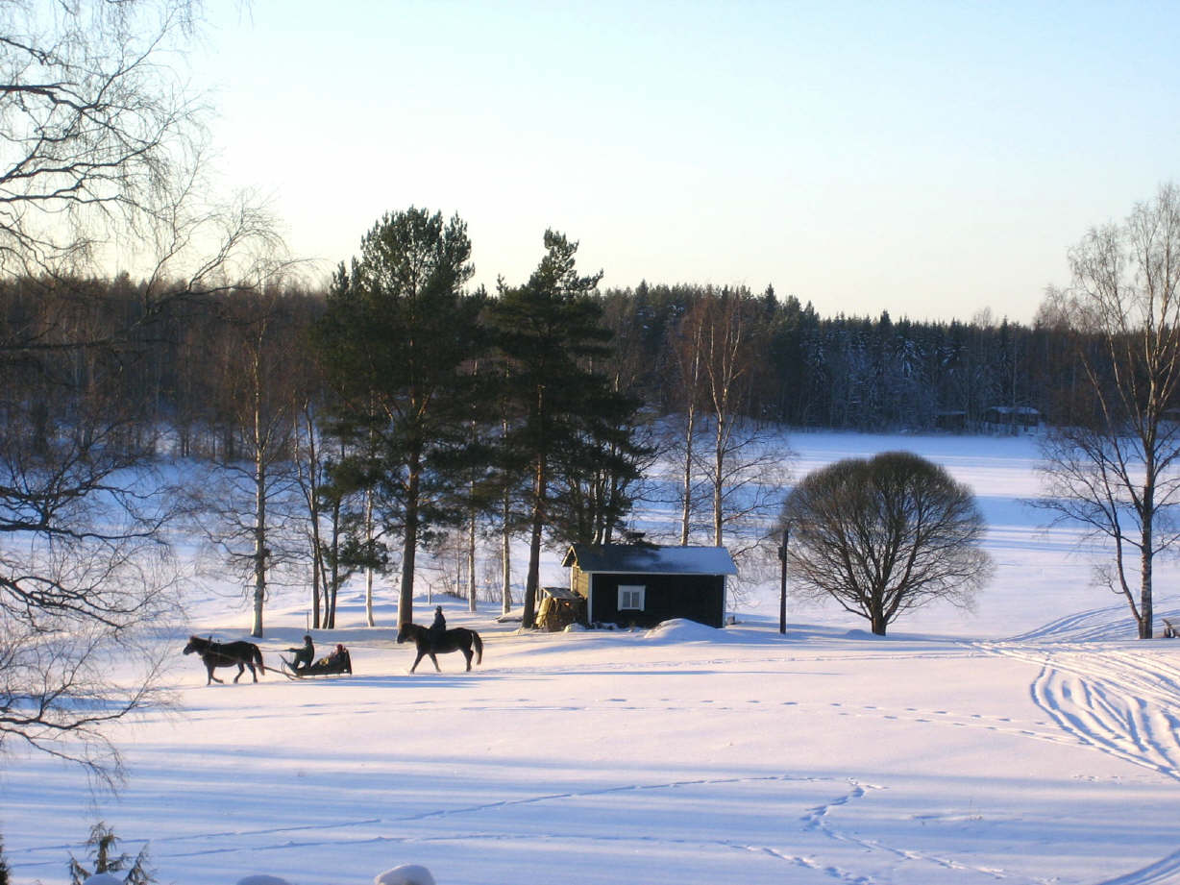
They are: winter
winter

Slide 4
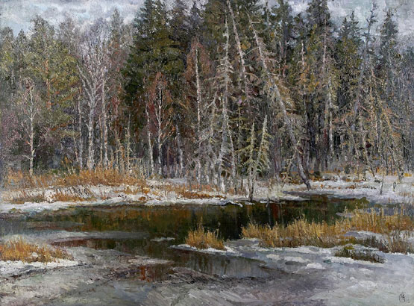
spring
Spring

Slide 5
summer
summer

Slide 6
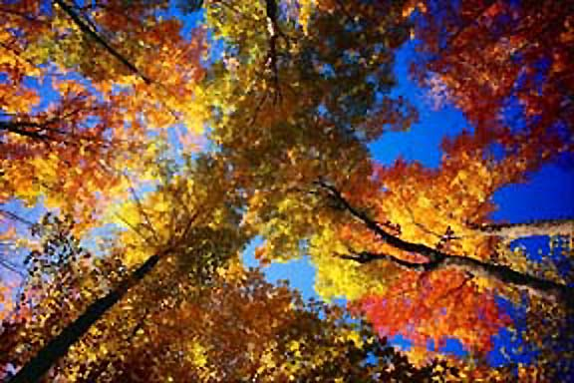
autumn
autumn

Slide 8
Seasons

Slide 9
Запомните новые слова.
Солнечно Sunny
Ветрено Windy
Облачно cloudy
Снежно snowy
Жарко hot
Холодно cold

Slide 10
Windy

Slide 11
HOT

Slide 12
rainy

Slide 13
cloudy

Slide 14
snowy

Slide 15
cold

Slide 16
sunny

Slide 17
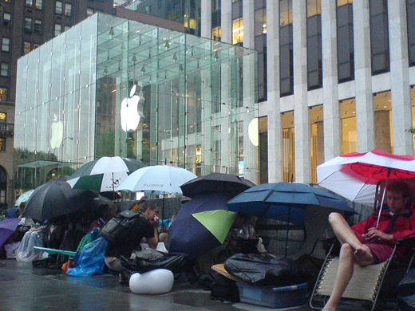
Какая погода в разных странах?
It is ……………. In America

Slide 18
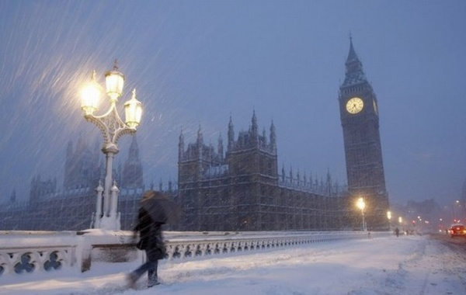
It is……. In England

Slide 19
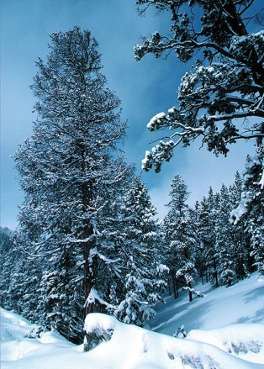
It is…………..in Russia

Slide 20
It is………. in Africa.

Slide 21
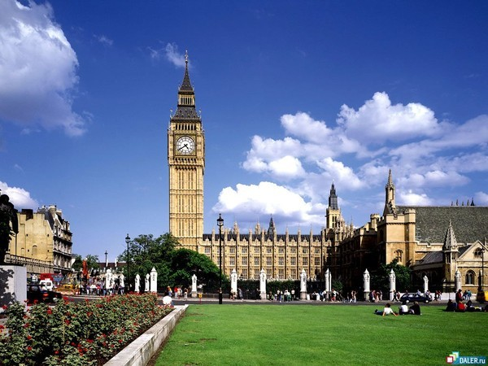
It is …….. in England.

