Slide 1
TIME

Slide 2
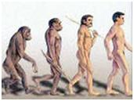
is scope for the development of abilities ...

Slide 3
Manage their time - to develop

Slide 4
Time Management - implementation of the organization of time in the life of one person, namely me.

Slide 5
Time Management
=
Organization of time - a scientific approach to managing their time, helping to do more of what planned.

Slide 6
Why do you need time management?

Slide 7
17%

Slide 8
WHY TIME MANAGEMENT?

Slide 9
STATEMENT OF PURPOSE

Slide 10
Objectives should be writtenе

Slide 11
RECREATION
WORK
The coordinates of your achievements
FAMILY
MONEY
HOUSE

Slide 12
Roll out the lip

Slide 13
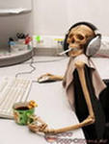
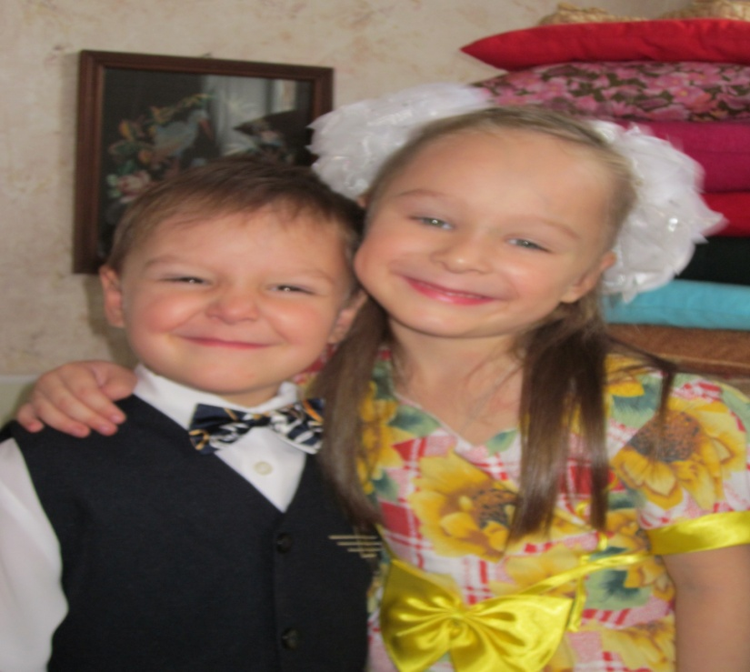
WORK
Determination of the main goals
HOUSE
LEISURE
KIDS
EDUCATION

Slide 14
LIMITED TIME

Slide 15
RIGHT TO A MISTAKE

Slide 16
THANK YOU.

