Slide 1
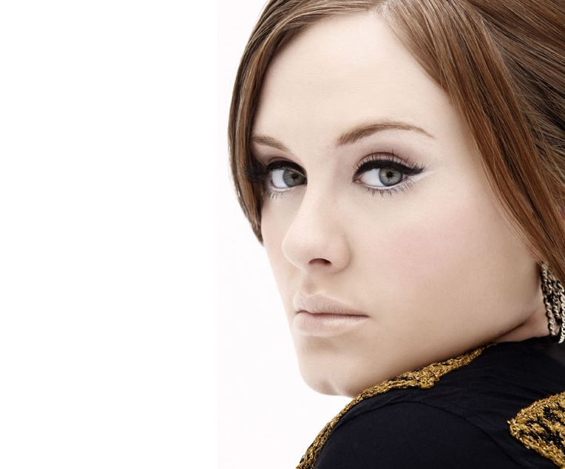
A
D
E
L
e

Slide 2
Name:
Adele Laurie
Blue Adkins
Birth:
5th May 1988
Place of residence:
Great Britain,
London

Slide 4
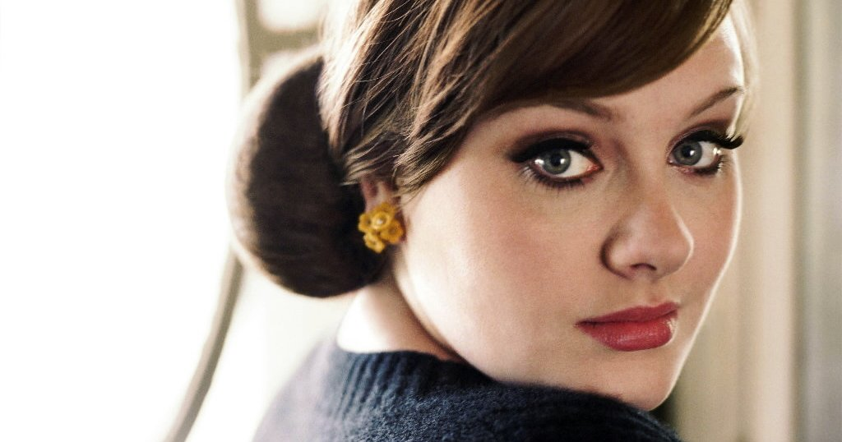

Slide 5
Don`t you remember…

Slide 7
Rolling In the Deep

Slide 9
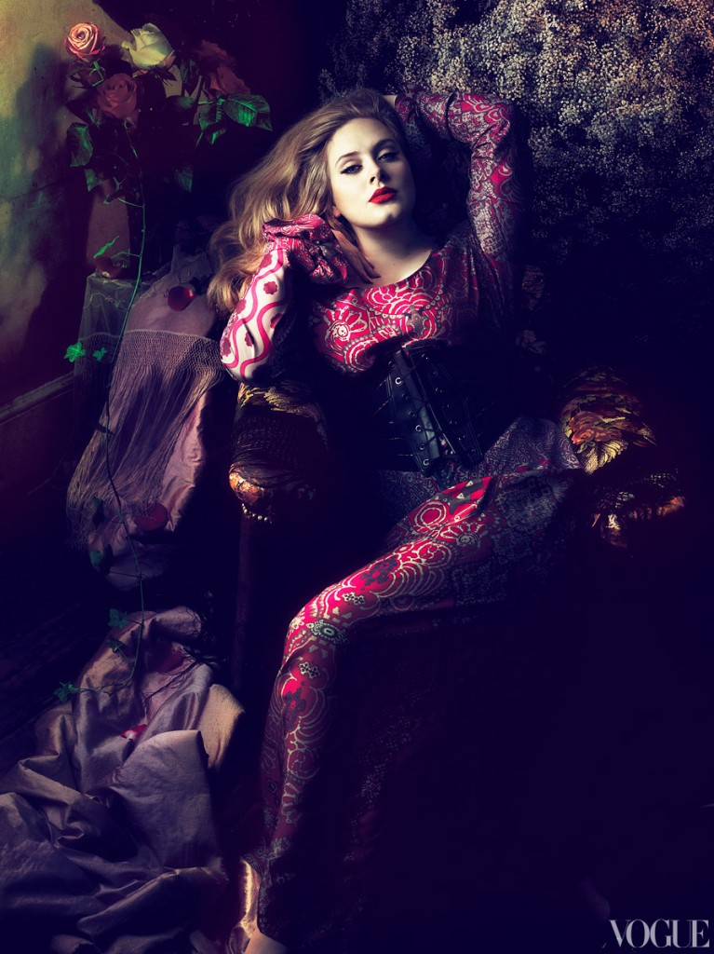

Slide 10
Someone
Like
You

Slide 12
Set Fire
to the Rain

Slide 13
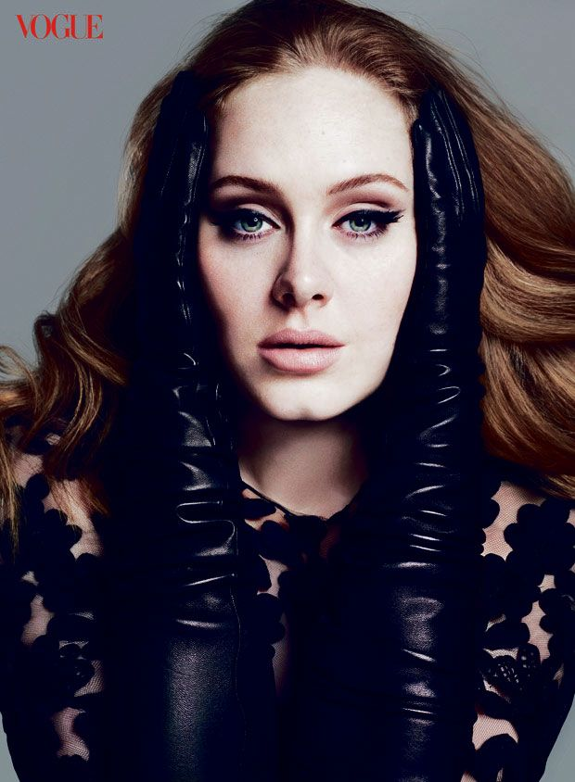

Slide 15
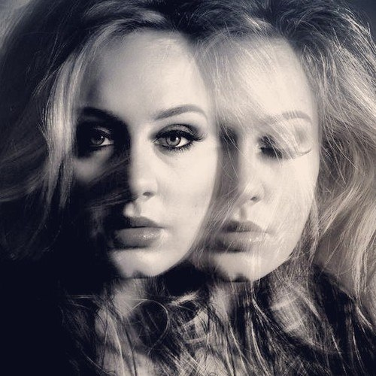
A
D
E
L
E

Slide 16
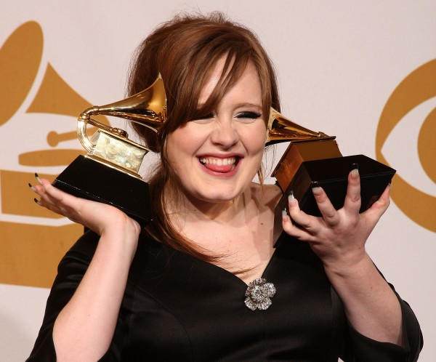
G
R
A
M
M
y
2011

Slide 17
Grammy - 2012

Slide 19
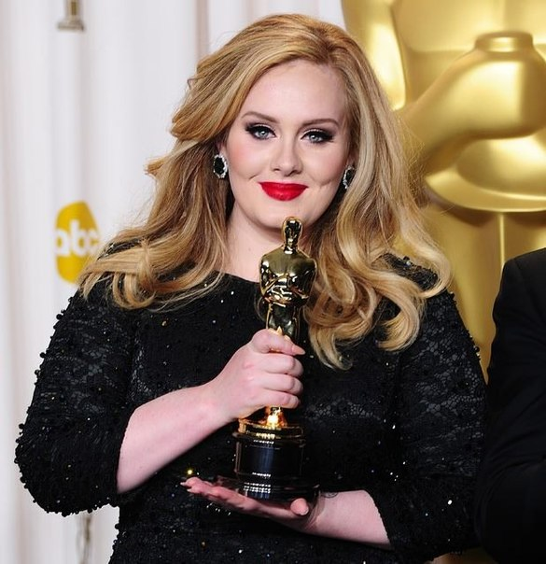
ADELE

