Slide 1
Sport in Yakutia
Sport in Yakutia

Slide 2
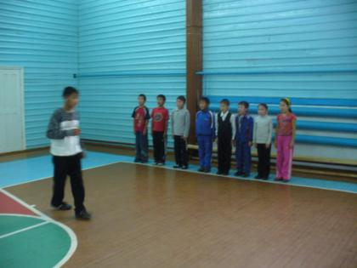
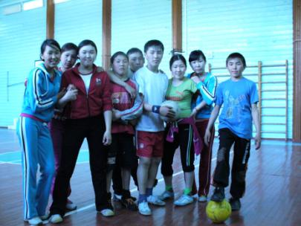
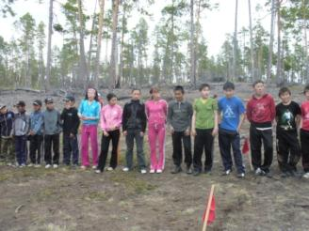
«Sport for all» has recently become a motto of everyday life. Physical education, which includes sport Is compulsory subject in all schools, colleges and universities. Basketball, football, volleyball and chess competitions are held among schoolchildren.

Slide 3
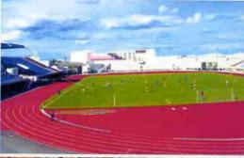
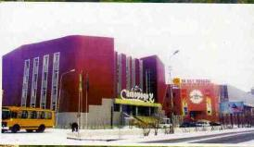
the Tuymaada Stadium, the Samorodok swimming pool
Institute for Physiche Education and Training at the Sacha State University were all opened during the last decade. All the necessary conditions for sport and recreational development have been created in the republic, with such sports facilities as the Tuymaada Stadium, the Elley Bootur Ice Palace with an ice skating rink, the 50 years of Victory sports palace, the Samorodok and Dolgun swimming pools, the Yunost students sports centre in Yakutsk.
the Institute for Physical Education and Sports in Churapcha
Sports college of the Olympic reserve in Yakutsk,

Slide 4
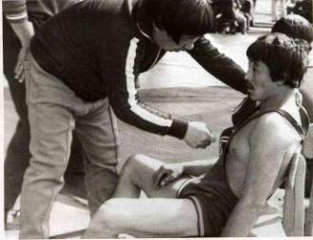
In the 1964 the first sports boarding school was opened in the rural area of Churapcha. The Churapcha sportschool аfter Dmitriy Korkin is wellknown for our wrestler.
Dmitriy Korkin
The first master of sport wrestler Vladimir Danilov

Slide 5
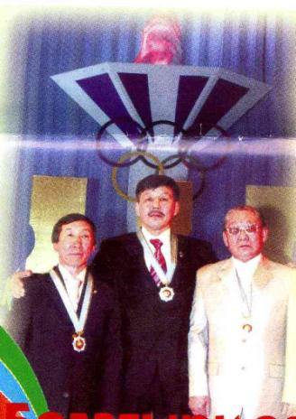
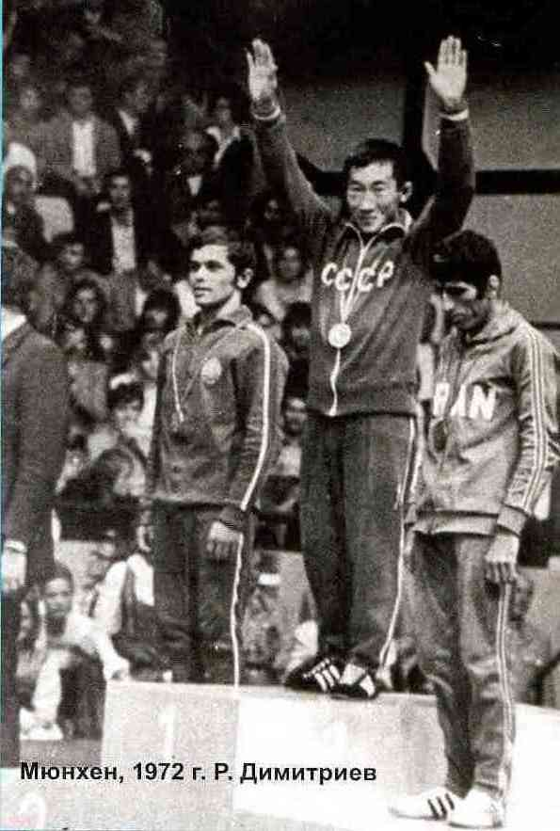
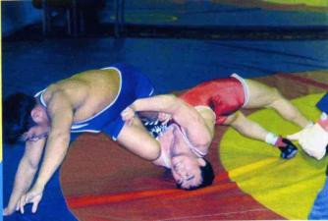
There are three Olympic champion in the 21st Olympics in Montreal. They are Pavel Pinigin, Roman Dmitriev, Alexander Ivanov

Slide 6
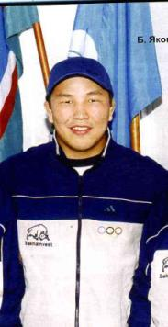
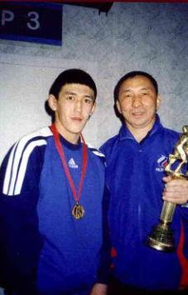
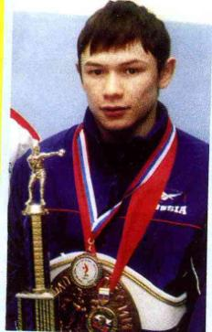
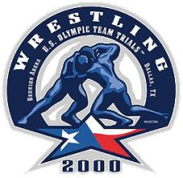
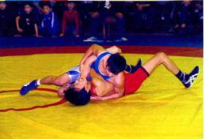
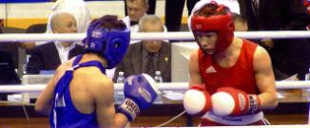
The Republic is proud of its worldchampions-free style wrestlers German Kontoev, Leonid Spiridonov, boxer and three-time European Champion Georgiy Balakshin,

Slide 7
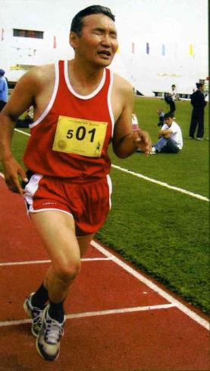
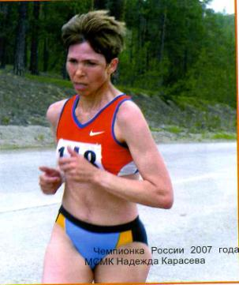
the athleets Nadezda Karasyova, Tatyana Zhirkova

Slide 8
boxer Oksana Vasileva
paraolympic champion swimmer Nastya Diodorova

Slide 9
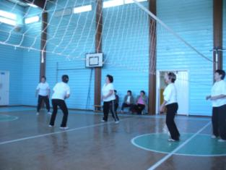
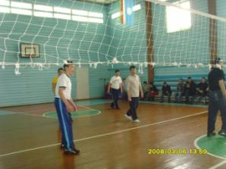
Basketball, football, volleyball and chess competitions are held among schoolchildren and grown-ups.

Slide 10
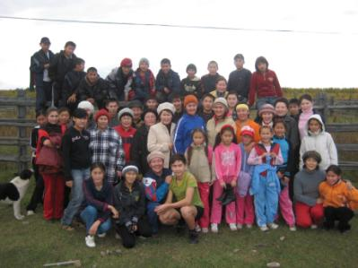
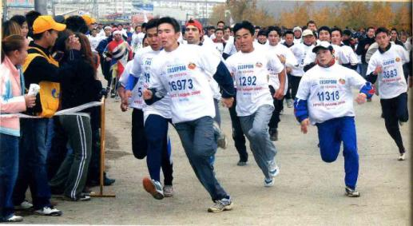
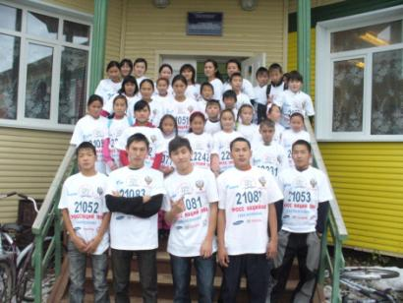
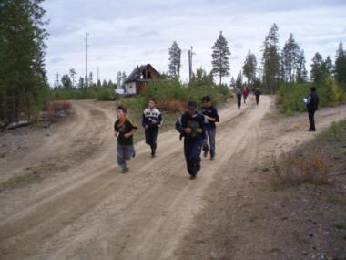
Every spring, autumn, thousands of citizens-take part in a marathon, running. This running has “Kross natsii’ Our schoolchildren, teachers take part every autumn in this compteitions.

Slide 11
National sports are part of traditional Sakha culture. The sports include khapsagai(form of wrestling.)
khapsagai
. It is testing strength, will-power, speed and flexibility

Slide 12
There are three kinds of nationale jumping sports(kylyy, ystanga, kuobach)

Slide 13
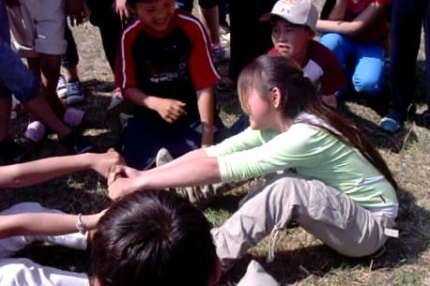
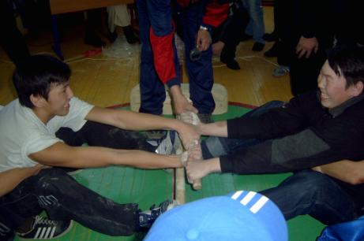
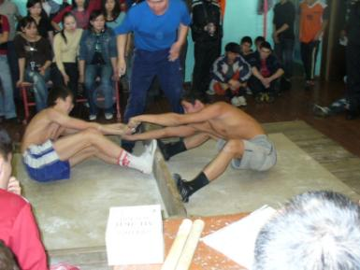
The sakha people like mas-wrestling(stick pulling). We like mas-wrestling too .

Slide 14
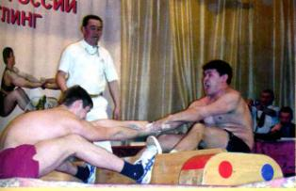
Mas-wrestling. The best mas-wrestler in Jakutia is Nikolay Kolodko
Mas-wrestler Nikolay D,yakonov

Slide 15
The other popular native kinds of sport are tipping the stick,
tug of war
archery(shooting with a bow and arrows)

Slide 16
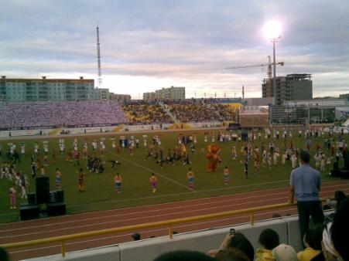
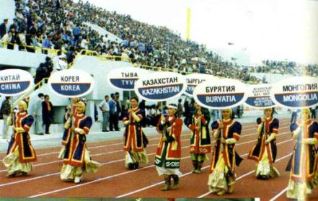
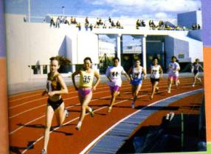
The Republic hosted the children of Asia International Games in the 1996, 2000,2004,2008/ The aim of the games is to promote peach and friendship among the children of the Asian-Pacific countries.

Slide 17
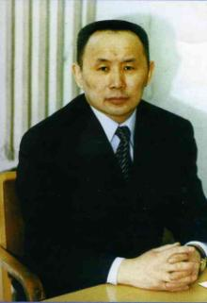
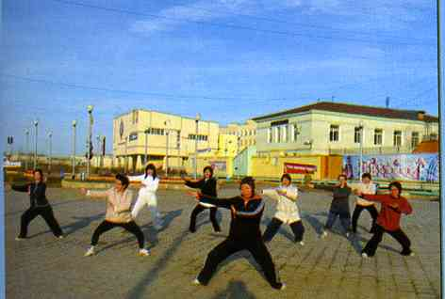
Necessary conditions for attracting people to active and regular physical training and sport are created by the state Comittee of Sport.
The morning exercises in the open air in the squares of Yakutsk
Charman of state Physical Training and Sport Comitee of Sakha Republick(Yakutia) M Gulyaev.

