Slide 1
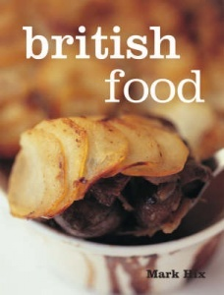
Traditional British Meals
by Shevtsova Irina Nikolaevna
Secondary school # 12
Baikalsk, Irkutsk region

Slide 2
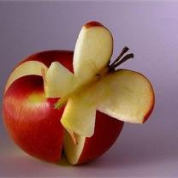
An apple a day keeps a doctor away
Вкуснотища! Very Good! Пищу называем Food
Для Шарика, для друга Припас я сахар- sugar
Всегда ты сладкий ждешь сюрприз Конфетки по-английски –sweets
Это вовсе не каприз: Сыр мы называем cheese
Мясо жарится, шкварчит, Мясо по- английски meat
Рыбу ловишь- не шумишь, Рыба по- английски fish
Молоко я пить привык Молоко иначе milk
Вини-Пуха нет ли с вами А- то спрячу мед свой- honey
Масло нужно всем ребятам Масло по-английски butter.

Slide 3
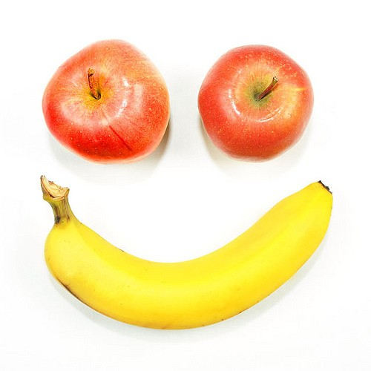
SMALL TALK
Practice the dialogue “I haven`t decided yet” in a restaurant.
What are you going to have for lunch?
I haven`t decided yet.
What are you going to have?
I haven`t decided yet.
What are you going to drink?
I haven`t decided yet.
What are you going to have?
I haven`t decided yet.
What are you going to have for dessert?
I haven`t decided yet.
What are you going to have?
I haven`t decided yet.
I haven`t decided yet.

Slide 4
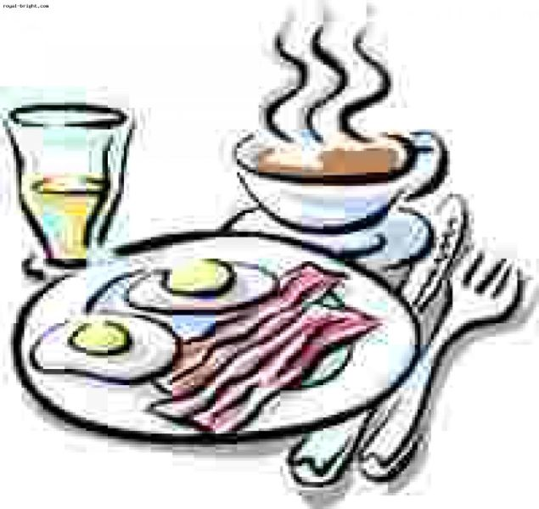
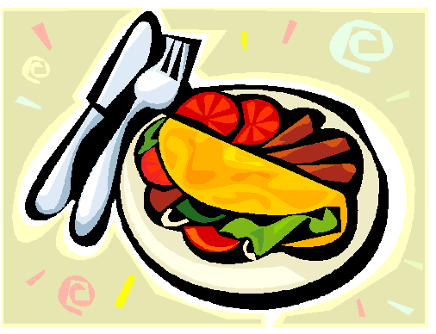
Remember the key Vocabulary
meal
supper
starter
snack
course
pastries
pub
lunch bag

Slide 5
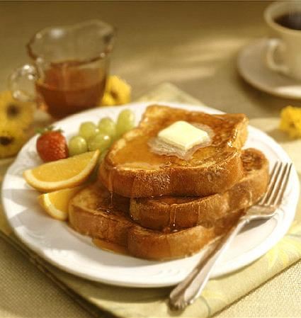
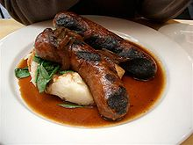
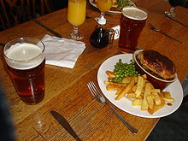
There are 3 main meals of the day
The first is breakfast
The third is DINNER
The second is lunch

Slide 6
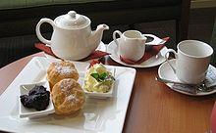
But in the UK there is a tradition to have 5 o`clock tea

Slide 7
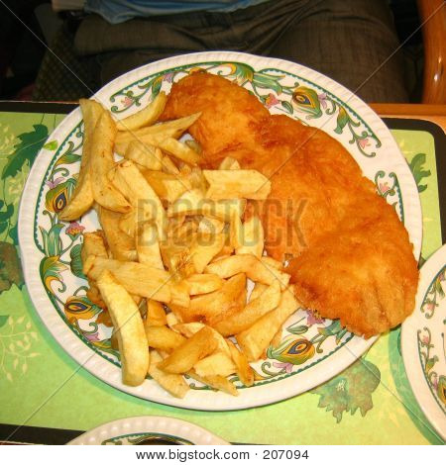
Some people have supper.
.
It is time between dinner and before they go to bed

Slide 8
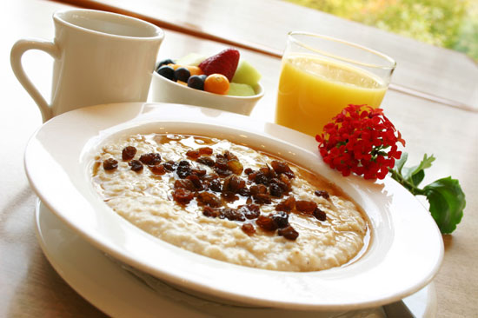
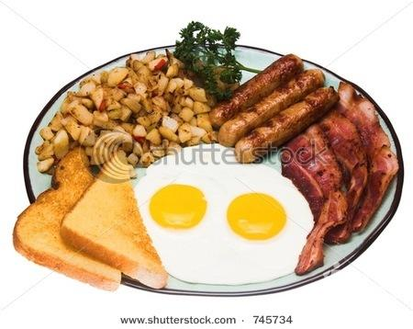
FOR BREAKAST THEY USUALLY HAVE PORRIDGE
OR SCRAMBLED EGGS

Slide 9
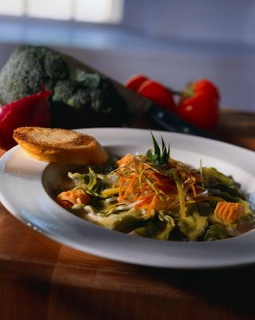
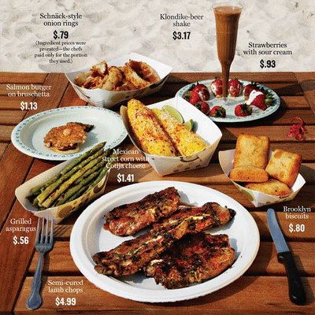
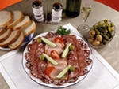
Lunch can be a one-course a two-course a three-course meal

Slide 10
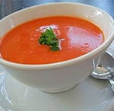
Some people may have a starter for lunch. .
A starter can be soup OR some light dish to get the appetite going

Slide 11
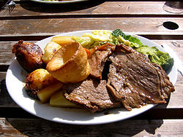
The main dish is usually meat and vegetables

Slide 12
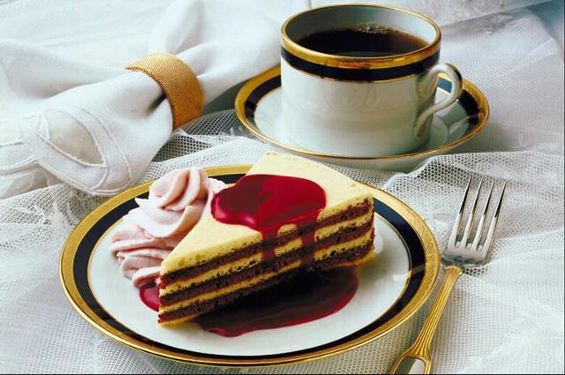
You can have for the third course: - Fruit - pastries - cake (they call it pudding)

Slide 13
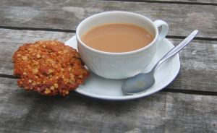
Some people SNACK between meals
To snack = to eat some light food may be coffee and a biscuit also some light not filling food.
Just to carry people through one meal to the next.

Slide 14
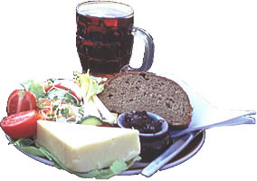
Restaurants are expensive in Great Britain
People prefer eating out in Pubs

Slide 15
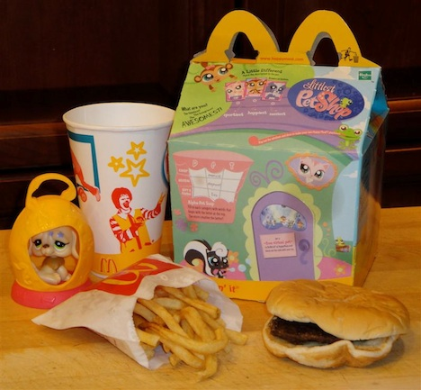
Children always take lunch bags to school.

Slide 16
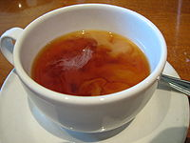
CHECKING-UP
What new words have you learnt?
What are traditional British meals?
When is supper?
How many courses can be in lunch?
What do the British have for lunch?
What is starter?
What is snack?
What do the British usually have for breakfast?

Slide 17
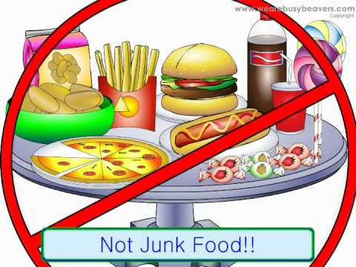
SPEAKING UP
Group work
1. We would like to represent you American/British/Russian food.
2. People usually have … meals a day.
3. They prefer to eat out / at home.
4. The … like eating … food.
5. Such food makes people … .
6. The national food is ….
7. We (don`t) like it because …

Slide 18
Enjoy the poetry
Lunch time! At a restaurant! I can order lunch just my size: milk, a sandwich, fruit, and a really fun surprise.
Eat right at lunch time. Listen to what I say. I need more energy to get me through my day.
Now I’ve been playing all afternoon with my friends in the park. I know that I have to go home now, I can tell because it’s getting dark.
Dinner time! I’m hungry! I wonder what my mommy made: chicken, rice, broccoli, and a glass of lemonade.
Eat right at dinner. Listen to what I say, Building strong bodies, strength for another day.
When I wake up in the morning, the first thing I want to do, Is get myself dressed and go down to the kitchen to get myself some food.
Breakfast time! I’m hungry! Here’s what I like the most: Juice, cereal, melon, and a piece of buttered toast.
Don’t miss your breakfast! Listen to what I say. Now I have energy, Enough to start my day.
When my mommy says, “It’s lunch time, and today is a special treat. We’re driving downtown to meet your friends at a restaurant where we’ll eat.”

Slide 19
Think Way
Обозначьте ТЕМУ (1 слово)
2. Опишите ТЕМУ (в 2 прилагательных)
3. Опишите ТЕМУ (в 3 глаголах)
4. Дайте фразу или предложение (из 4 слов).
Выразите ваше отношение к теме или ваши чувства.
5. Дайте СИНОНИМ к теме (1слово)

