Slide 1
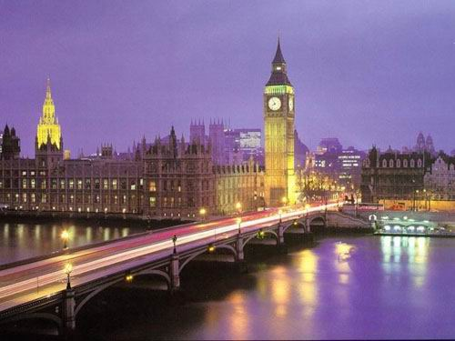
london

Slide 2
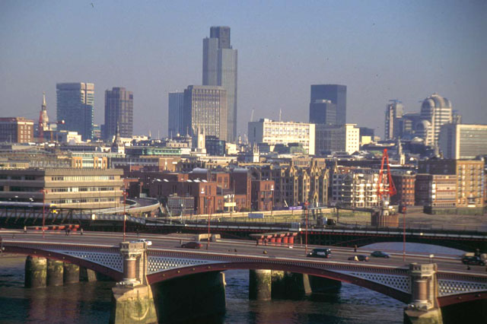
London is the capital of Great Britain, its political, economic and cultural centre. It's one of the largest cities in the world. Its population is more than 9 million people. London is situated on the river Thames. There are 17 bridges that cross the river. The city is very old and beautiful. It was founded more than two thousand years ago. Traditionally London is divided into several parts: the City, the West End, the East End and Westminster.

Slide 3
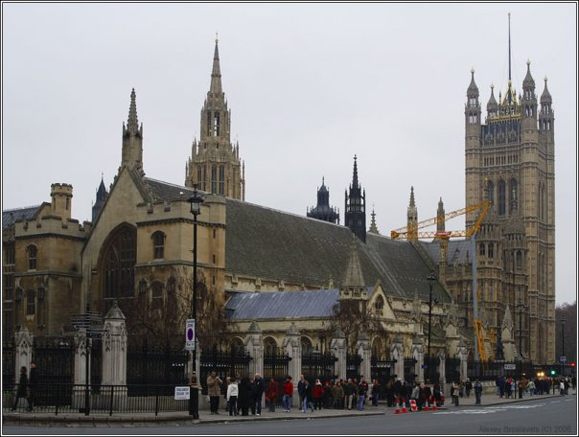
The City is the oldest part of London, its financial and business centre. The heart of the City is the Stock Exchange. Westminster is the most important part of the capital. It's the administrative centre. It includes Buckingham Palace, where the Queen lives. The Houses of Parliament, the seat of the British Government, are there. It's a very beautiful building with two towers and a very big clock called Big Ben. Big Ben is really the bell which strikes every quarter of an hour. Opposite the Houses of Parliament is Westminster Abbey. It's a very beautiful church built over 900 years ago. The tombs of many great statesmen, scientists and writers are there.

Slide 4
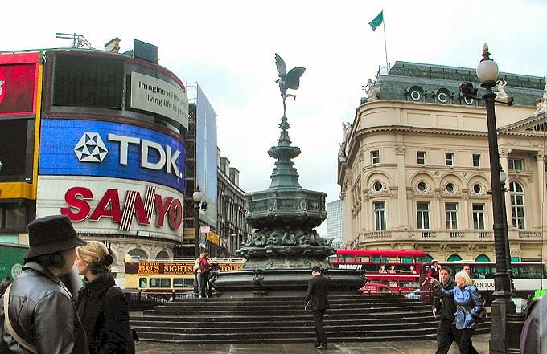
To the west of Westminster is West End. Here we find most of the big shops, hotels, museums, art galleries, theatres and concert halls. Picadilly Circus is the heart of London's West End. In the West End there are wide streets with beautiful houses and many parks, gardens and squares.

Slide 5
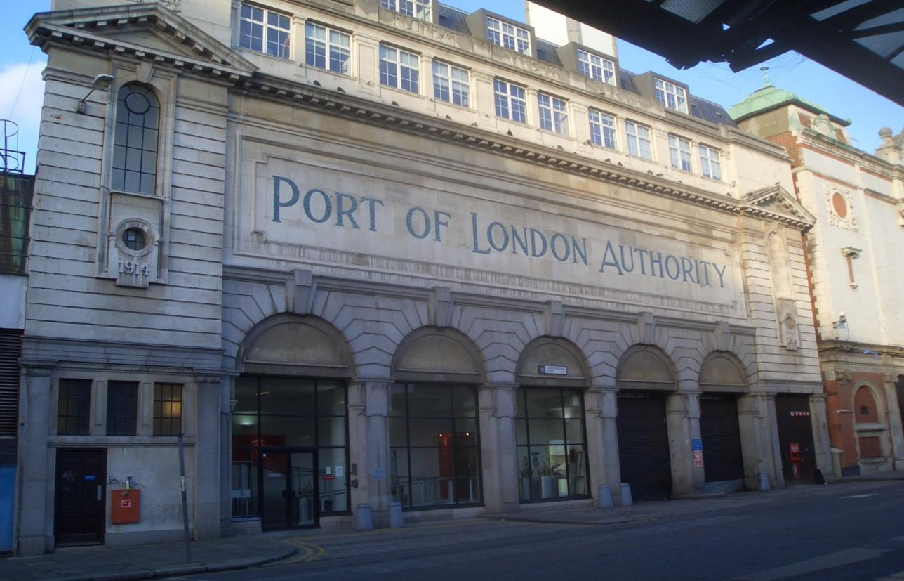
To the east of Westminster is the East End, an industrial district of the capital. There are many factories and the Port of London there.

Slide 6
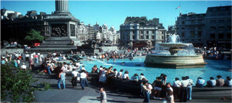
London has many places of interest. One of them is Buckingham Palace. It's the residence of the Queen. The English are proud of Trafalgar Square, which was named so in memory of the victory at the battle. There in 1805 the English fleet defeated the fleet of France and Spain.

Slide 7
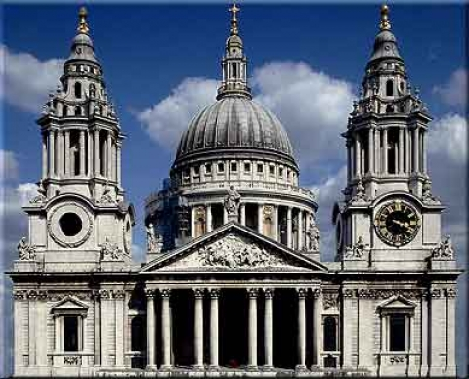
St.Paul's Cathedral- is the seat of the Bishop of London and a major London landmark .It was completed on October 20, 1708 by Sir Christopher Wren . The dome contains three circular galleries - the internal Whispering Gallery, the external Stone Gallery and the external Golden Gallery. The Whispering Gallery derives its name from its unusual acoustics, which cause whispers to echo around the dome.

Slide 8
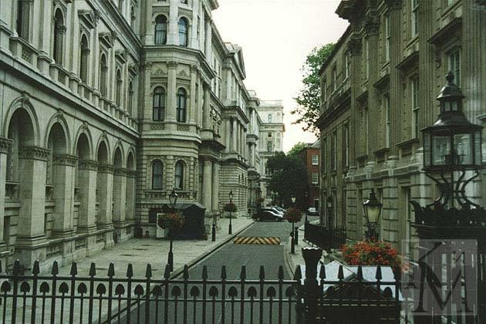
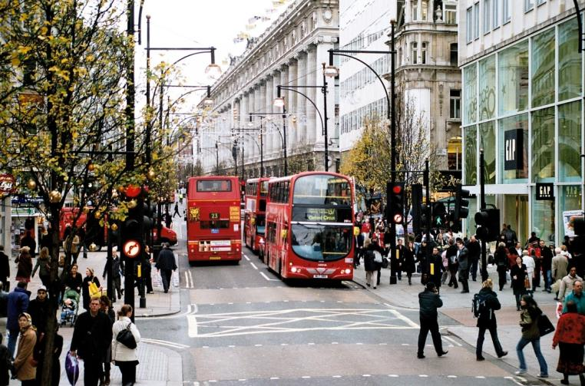
London's long-past history is told by its streets. There are many streets in London which are known all over the" world. Among them Oxford Street, Downing Street and a lot of others can be mentioned.
And tourists are usually attracted not only by the places of interest but by the streets too. If you are lucky enough to find yourself in London some day you will have a lot to see and enjoy there.

Slide 9
Questions:
1.Is London a young city? 2. Where is London situated? 3. How many bridges cross the river Thames?
4. What is the oldest part of London? 5. What is situated in the West End? 6. Where are the most of Government buildings situated? 7. Where is the largest clock in the country located? 8. How often does Big Ben strike? 9. What is the official London residence of the Queen? 10. What square is situated in the centre of the West End ? 11. When was ST Paul’s Cathedral founded?
12. How many galleries are there in it?

Slide 10
Web sites:
www.alshar.ru
www.megabook.ru
www.wikimedia.org
www.am111.ru
www.juntadeandalucia.es
www.static.diary.ru
www.holidaym.ru

