Slide 1
England, Scotland, Wales …
The United Kingdom of Great Britain
and Northern Ireland
Соединенное Королевство Великобритании и Северной Ирландии
Union Jack

Slide 2
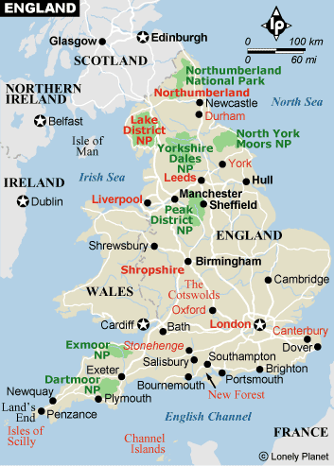
Great Britain
The UK
G. B.
The United Kingdom

Slide 3
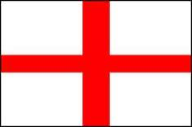
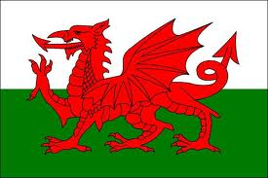
The United Kingdom of Great Britain
and Northern Ireland
England Wales
Scotland Northern Ireland
a rose
a daffodil
a shamrock
a thistle

Slide 4
UK population diagram

Slide 5
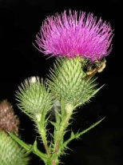
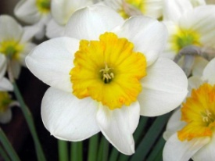
Fact File on Great Britain
 | Country
1 | Capital
2 | Population
3 | Places of interest/ Interesting facts

Slide 6
Fact File on Great Britain
 | Country | England | Scotland | Wales
1 | Capital | London | Edinburgh | Cardiff
2 | Population | 49 million | 5 million | 3 million
3 | Places of interest/ Interesting facts

Slide 7
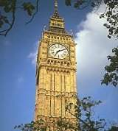
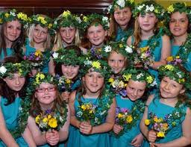
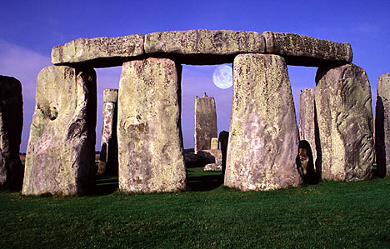
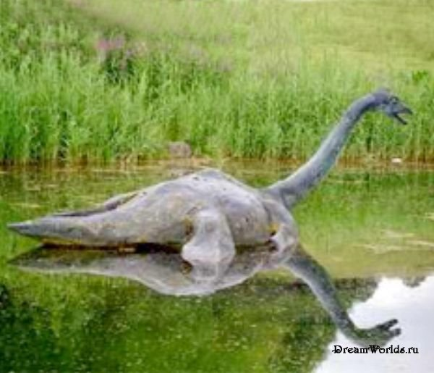
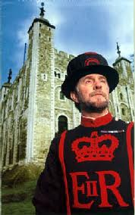
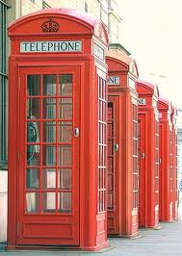
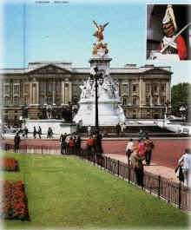
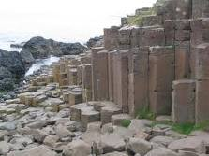
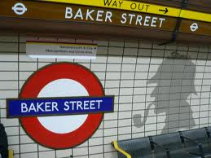
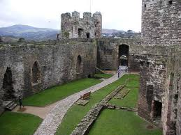
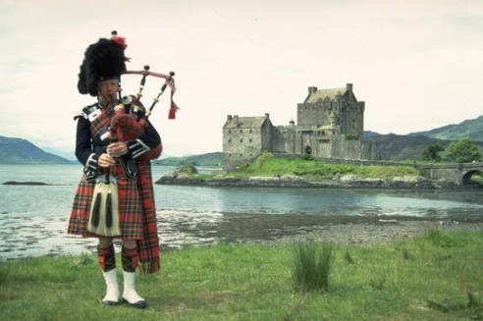
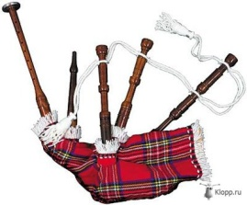
6
10
4
1
5
2
3
7
8
9
11
A
B
C
D
E
F
G
H
I

Slide 8
6
10
E
4
F
1
5
2
B
A
3
H
7
D
8
11
G
9
C
Extra -
I

Slide 9
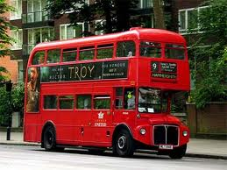
Red is a very popular colour in England

Slide 10
In London to see
In Wales to visit
In England I’d like to walk along
In Scotland to take photos of
In Northern Ireland to watch

Slide 11
Homework: 1) complete the Fact File on Northern Ireland; 2) p. 30-31, Lesson 3 (WB).
Fact File on Great Britain
 | Country | England | Scotland | Wales | Northern Ireland
1 | Capital | London | Edinburgh | Cardiff | ?
2 | Population | 49 million | 5 million | 3 million | ?
3 | Places of interest/ Interesting facts |  |  |  | ?

Slide 12
Name the parts of Great Britain.
What are their capitals and symbols?
Would you like to visit Great Britain?

Slide 13
Thank you!
Good bye!

